Slide 1
Green Engineering
2nd marking period
Capstone project:
design a “city of the future”

Slide 2
What’s Infrastructure?
If it doesn’t work… you’ll know it

Slide 3
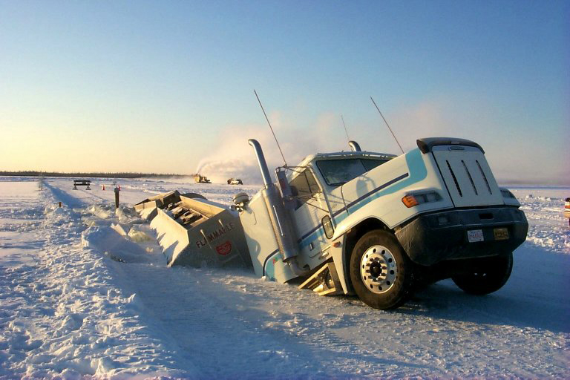

Slide 4
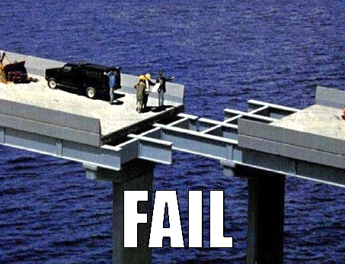

Slide 5
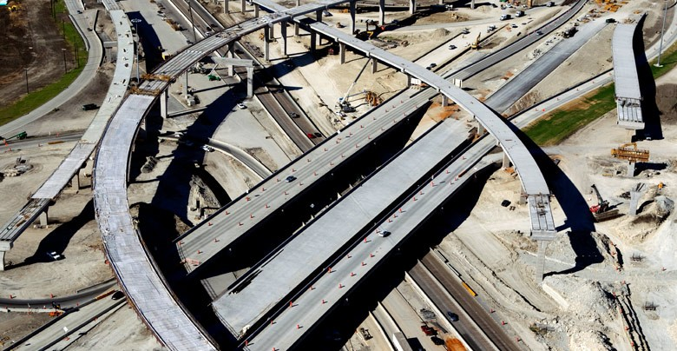

Slide 6
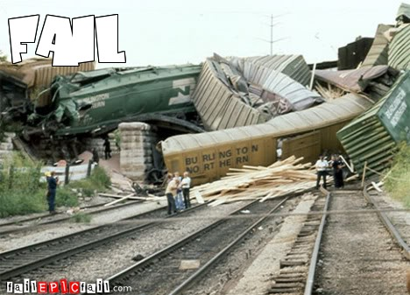

Slide 7
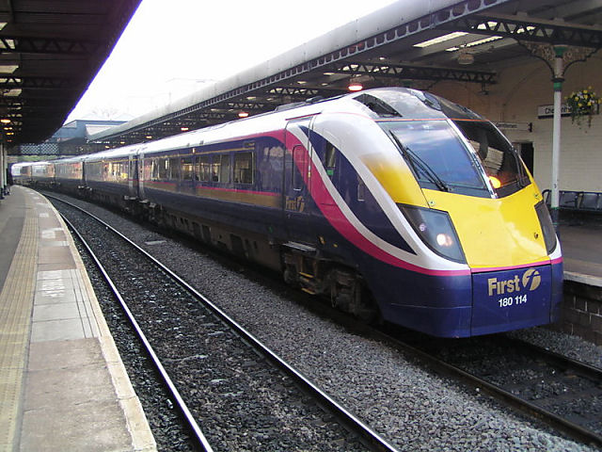
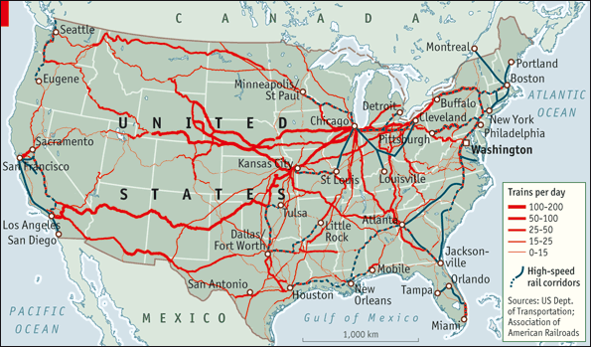

Slide 8
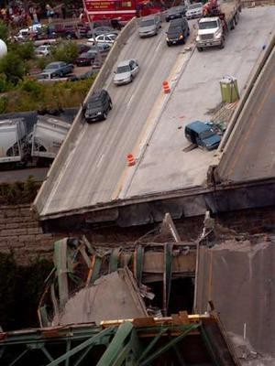
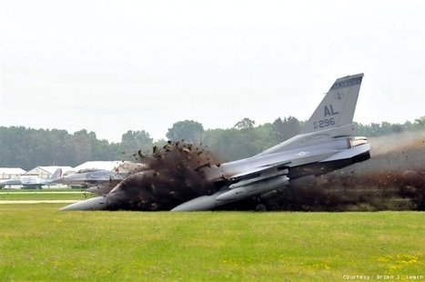

Slide 9
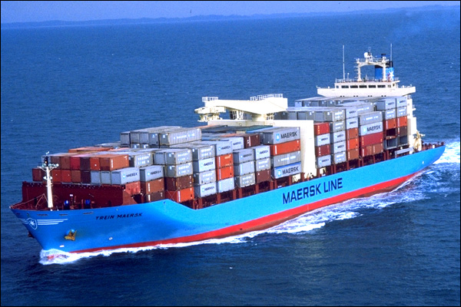
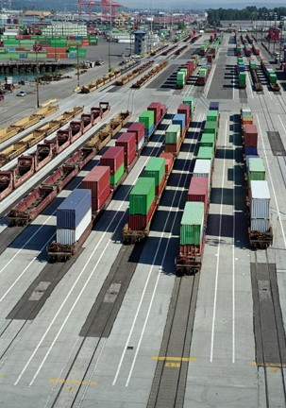
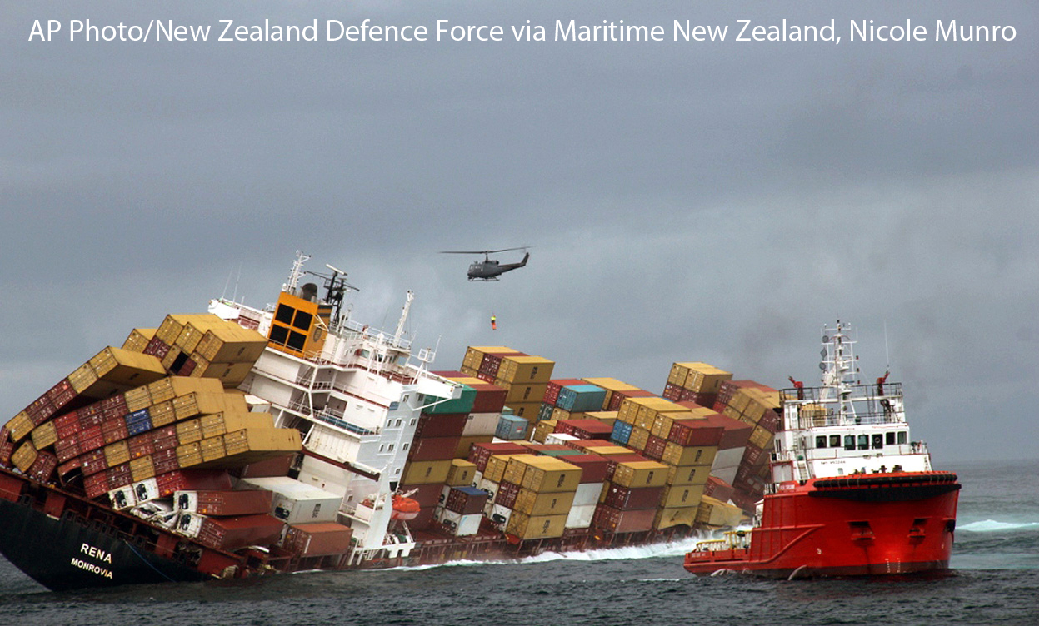
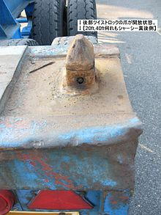
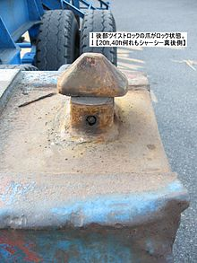
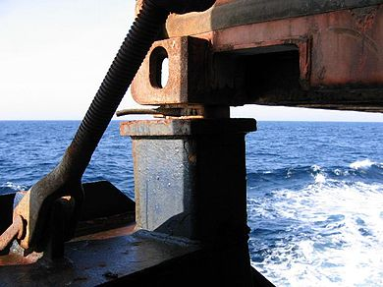
Twistlock revolutionized world economy land & sea

Slide 10
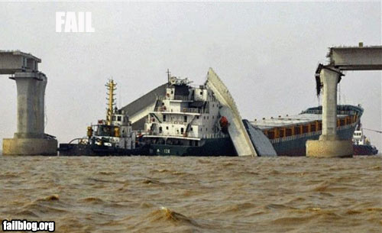

Slide 11
What’s the point of understanding infrastructure?
Either you’ll be paying for this stuff (as a consumer/renter/homeowner/business owner/taxpayer)
Or, you’ll be earning a living in some related occupation (as a teacher, truck driver, ditch digger, contractor, engineer, electrician, plumber, mechanic, plant operator, administrator, policy analyst, politician, etc…)

Slide 12
So what’s infrastructure?
It’s what ties everything together. Systems:
Roads, gas stations, airports, railroads, seaports & other transportation support
Pipelines for oil and natural gas, refineries, wells and mines
Electric grid, power plants, substations,
Water supply
Waste water treatment
GIS
GPS

Slide 13
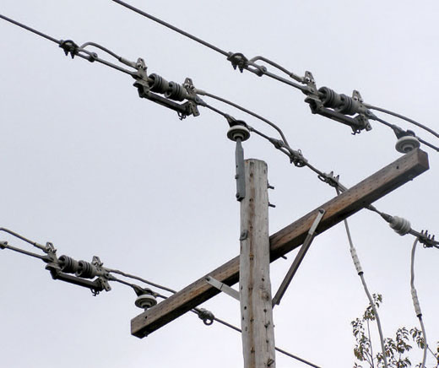
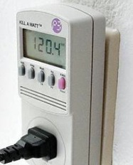
How does the phone call or the electricity get to your house?

Slide 14
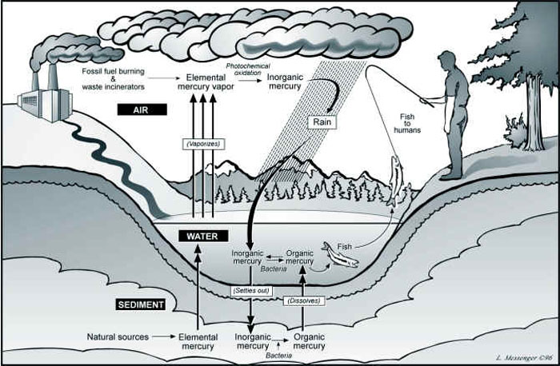
How does the potent neurotoxin mercury get into your tuna fish sandwich?

Slide 15
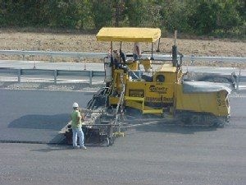
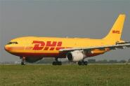
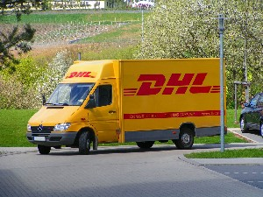
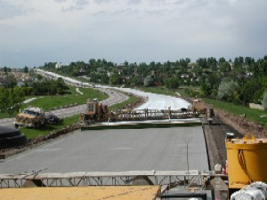
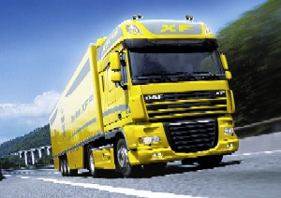
http://blog.fleetowner.com/trucks_at_work/category/freight/page/9/

Slide 16
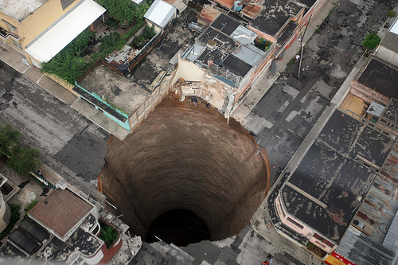

Slide 19
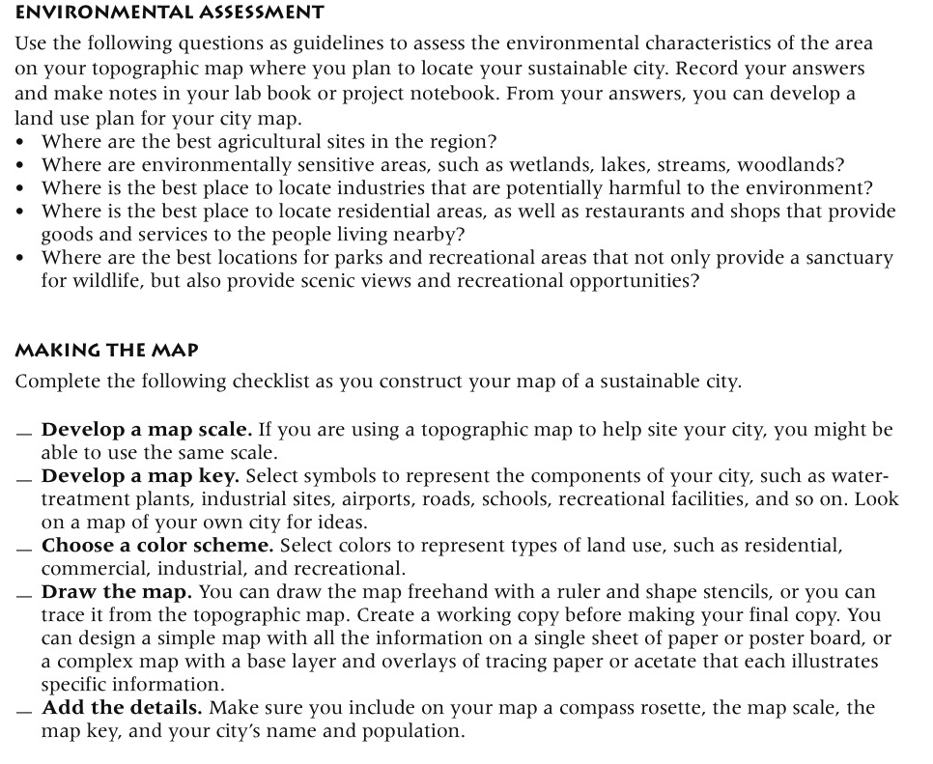

Slide 20
