Slide 1





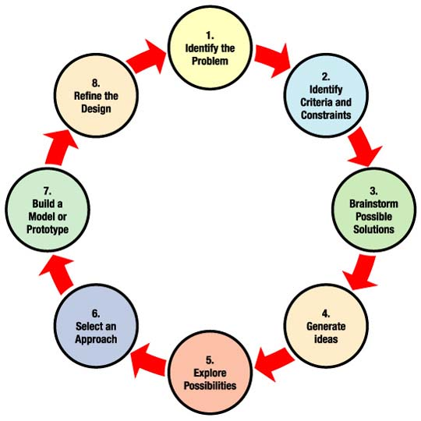
Incorporating Engineering into Earth Science
Jonathan Cue – Everett High School
Project GOALS
Action plan and implementation schedule
Student deliverables
Incorporate Engineering into Earth Science.
Student Deliverables: Students will photograph their progress and develop a PowerPoint presentation of the EDP as it relates to their project. The students will present during the second/third week of the fourth quarter. Their PowerPoint will then be updated, presented and graded at the end of the project. It represents 30% of the students’ grade.
Students will create a prototype of a climate change mitigation device. The prototype represents 70% of the students’ grade.
Goal / Objective: Incorporate Engineering into Earth Science
District / School Environment: Everett High School, Grades 11 and 12.
Project Components: Earth Science, Environmental Science, Climate Change, Engineering Solutions
Introduction/Project Definition: This is a quarter long Capsule Project asking students to develop engineering solutions to climate change.
Team Membership: Jonathan Cue, Rachid Farhat, Len Martino, Brad Mingels (NEU)
Action Plan: 1 week during Earth Science
Quick Measure: Lab icebreaker for one class period. Students measure and estimate weights of objects without instruments.
Measurement pre-test, then give instruments to measure (rulers, calipers, etc.)
Measurement lecture on the importance of resolution in science.
Measurement Quiz.
Action Plan: 1 week during Environmental Science section
Weather pretest.
Weather instruments lecture.
Build weather instruments lab:
http://www.bwca.cc/weather/weatherblueprints.htm
Weather Quiz.
Action Plan: 2 weeks during Climate Change section
Climate change pretest.
Climate change research: What does climate change mean for Everett?
Climate change presentations by students.
Climate change lecture.
Climate change quiz.
Action Plan: Capsule Project assigned for last quarter:
Design and build a working prototype of a device to mitigate climate change.
Introduce Solid Works.
Project COMPONENTS
Earth Science: Students measure and estimate weights of objects without instruments.
Environmental Science: Students build weather instruments.
Climate Change Science: Students research causes of Climate Change
Engineering: Design and build a working prototype of a device to mitigate climate change.
Small Group Dynamics: Richard Hackman: Five conditions that increase the chance that groups will be successful.
  Clear boundaries which clarify who is in group.
  A clear, challenging, and consequential goal.
  Tasks which have variety, a group size that is not too large, talented group members who have at least moderate social skill, and strong norms that specify appropriate behavior.
  Group based rewards linked to group performance, adequate resources, ongoing development of member skills.
Engineering design process

Slide 2
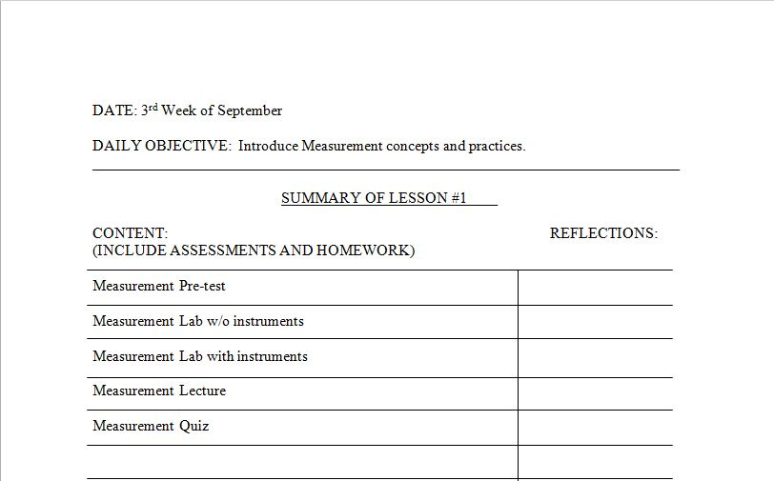
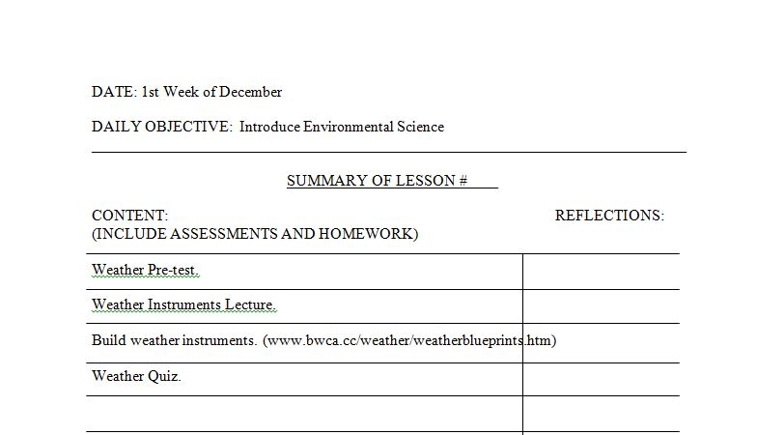
Lesson Plans

Slide 3
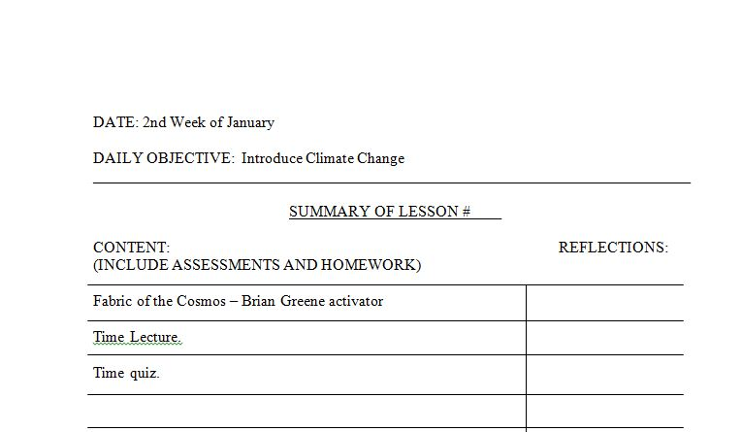
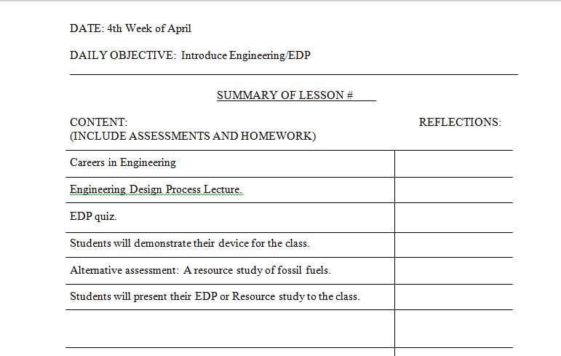
Lesson Plans

Slide 4
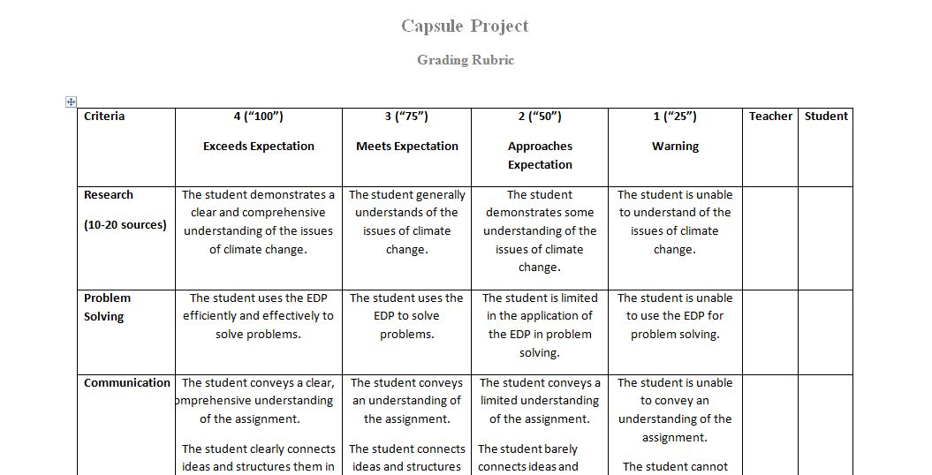
Rubric

Slide 5
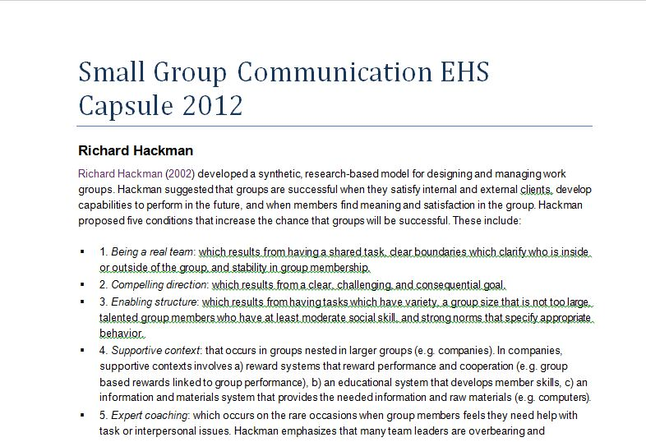
Small Group Communication

