Slide 1
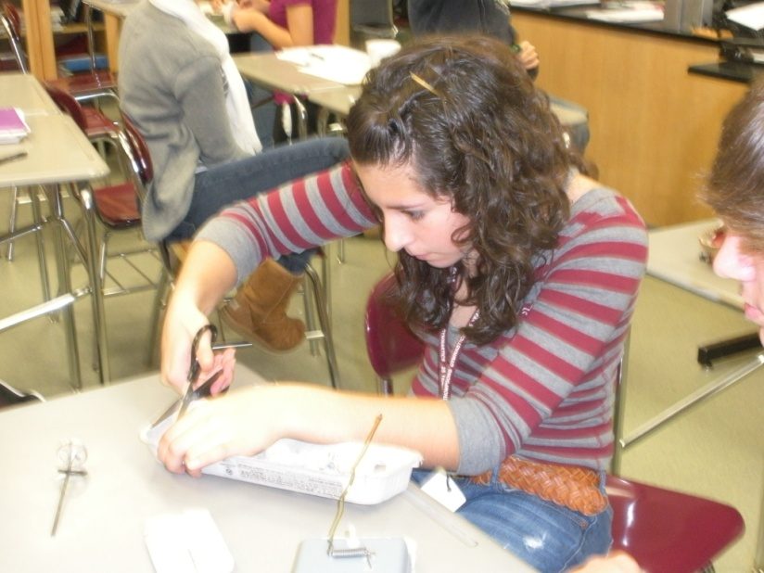
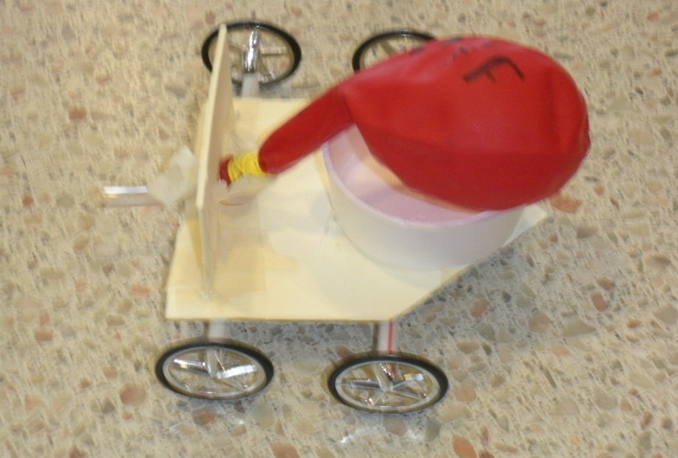
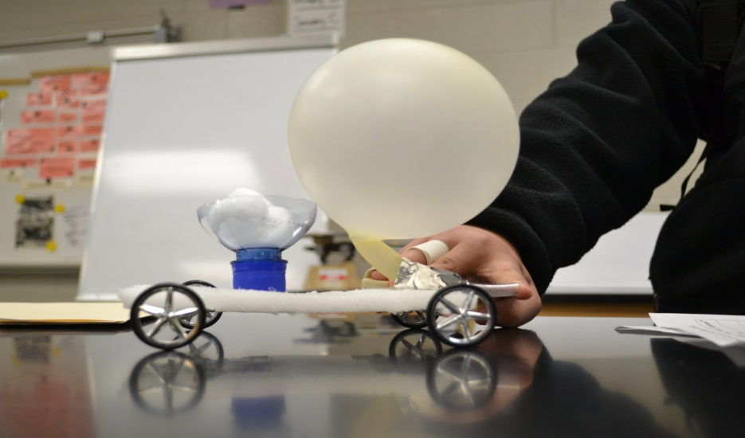
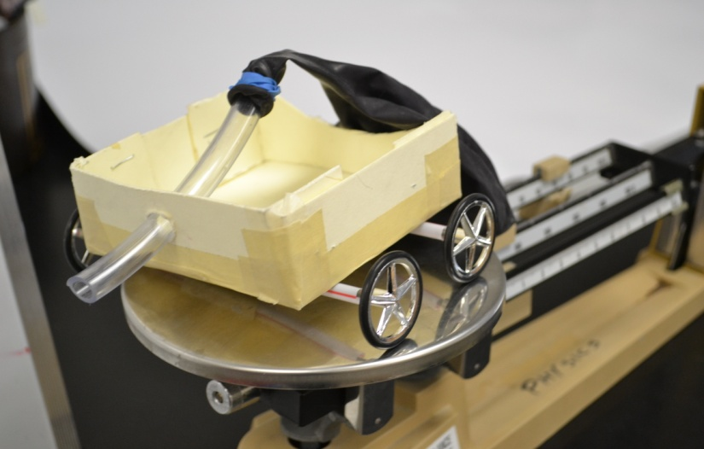
Application of EDP and Laws of motion to a self-propelled car

Slide 2
Background information: what students needed to know
How to calculate velocity
Newton’s 3 Laws of Motion
Kinetic and static friction
Momentum
Making sketches
EDP steps

Slide 3
As engineers for a toy manufacturing company, students were expected to:
1. Work as a team
2. Commit a design to paper (most challenging for some students)
3. Meet a deadline
4. Test their car for speed
5. Problem solve and redesign after initial test

Slide 4
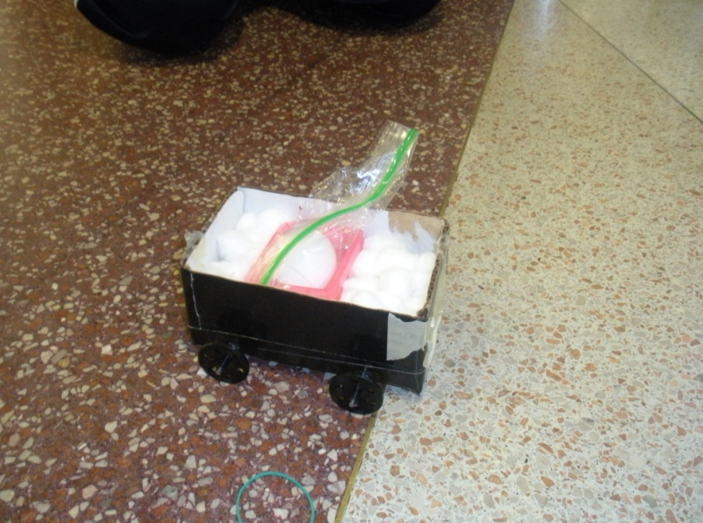
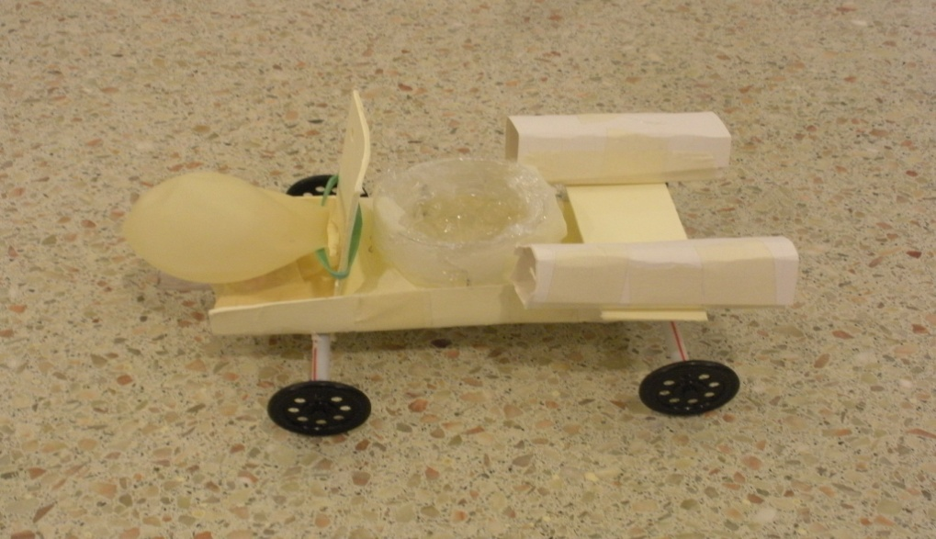
Part 2: Crash test
Testing momentum and Newton’s Third Law
Students secure an egg in the car and crash it into a wall.

Slide 5
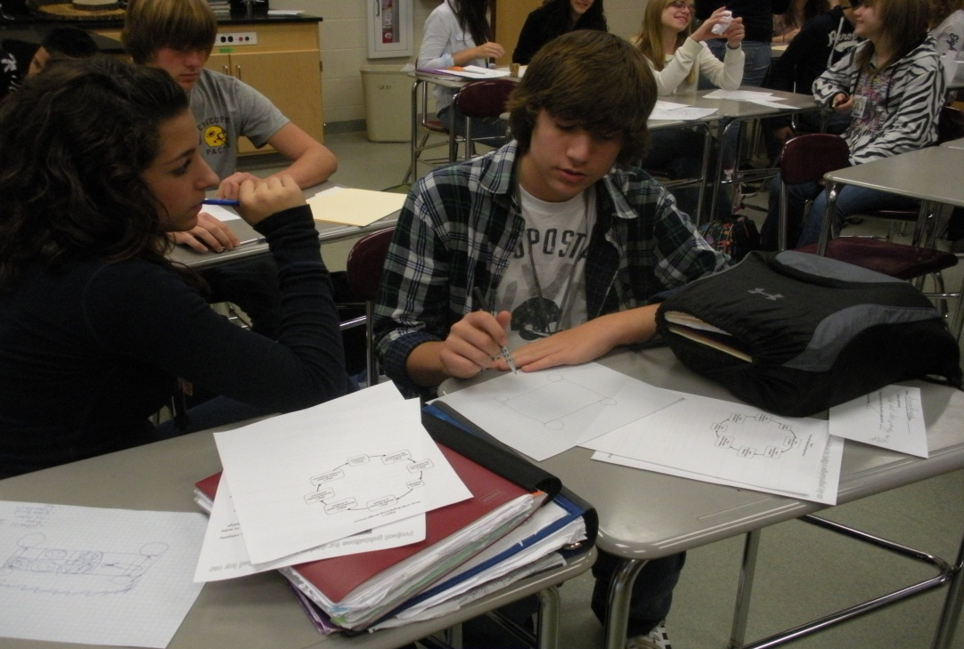
Calculations
Velocity
With and without the egg
Momentum

Slide 6
Final Product
Create an instructional manual explaining
how to build a self-propelled car
how the car involves of physics
How to use the EDP

Slide 7
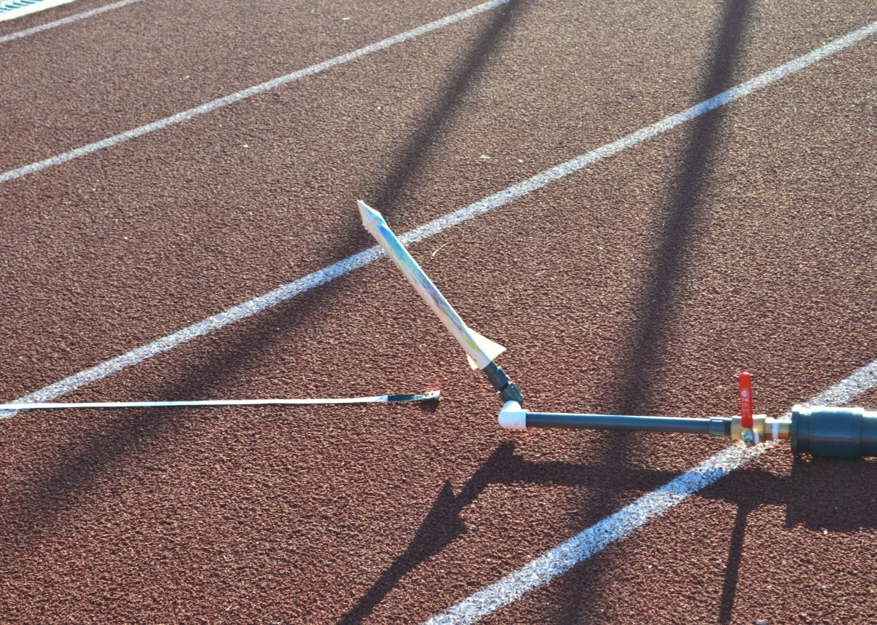
Rocket launcher

Slide 8
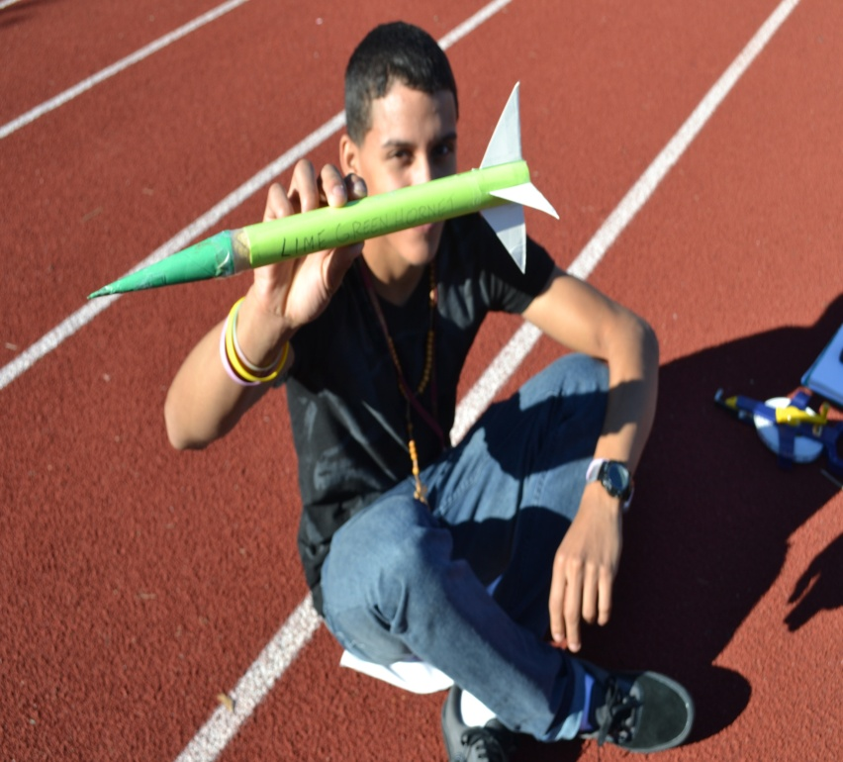
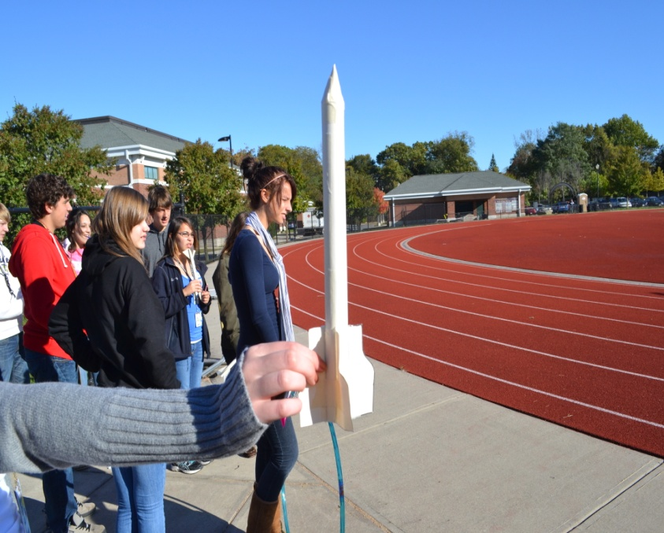
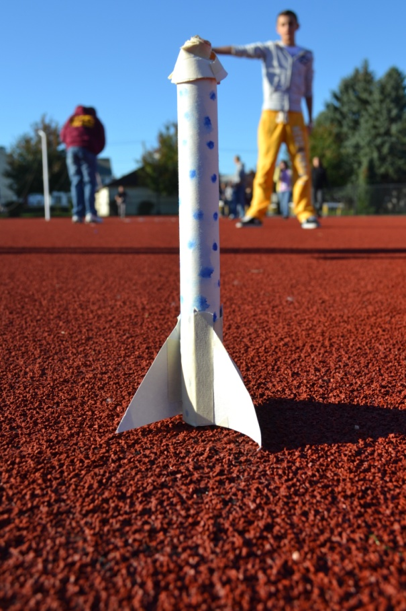

Slide 12
