Slide 1

Activity 1 : Design Challenge:
The Three Legged Chair
The Engineering Design Process

Slide 2

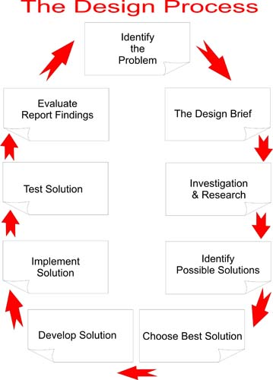
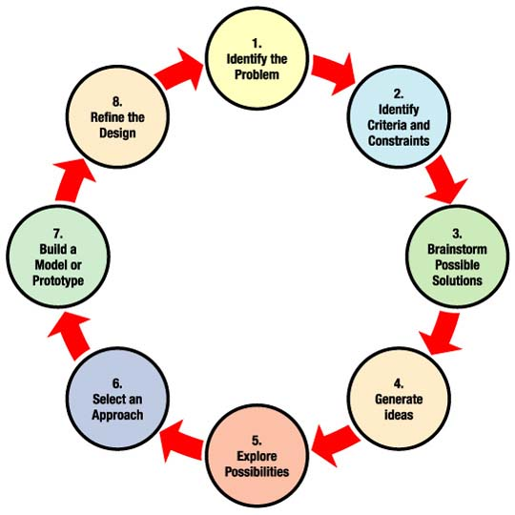
The Engineering Design Process

Slide 3

Summary of Basic Steps
Define the Problem
Research the Problem
Develop Possible Solutions
Choose the Best Solution
Create a Prototype
Test and Evaluate
Communicate
Redesign (if necessary)

Slide 4

Engineering vs. Science
“ While the goal of science is to create new knowledge of the material world, the goal of engineering is to develop new solutions to technological problems.”
“Each, however, uses an iterative cycle of development, testing and refinement, whether it be ideas or of designs.”
- National Science Standards

Slide 5

Define the Problem
- Build a three legged chair using 75% recycled materials at an extremely low cost and the capability of supporting at least 30lbs.
Constraints
Limited time
Limited cost
Limited supplies

Slide 6

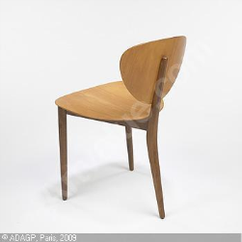
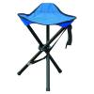
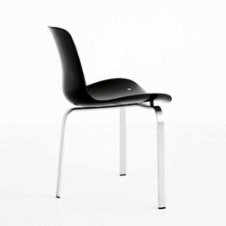
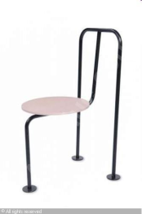
Research the Problem
** Research possibilities if not limited by time:
Successful Chair Designs
Engineering Background Information
(structural analysis)
- Market Survey (What do customers want in a three legged chair?)

Slide 7


Develop Possible Solutions
New Ideas – How do I make a three legged chair more ‘green’?
What materials are commonly recycled?
Brainstorm / Consider all possible ideas.
Sketch out preliminary designs.

Slide 8

Create a Prototype
Supplies Available:
Card Board (12”x 19”)
Stirring Sticks
Wood ( ½” x ½” x 15”)
Tape (masking & duct)
Corrigated potting containers
Clear plastic tubes (46”)
½” PVC piping (36” or 48”)
Cellofoam Sheets (14 ½” x 48” x ¾”)
Padding
Brown Roll Paper

Slide 9

Communicate
Test and Evaluate
Testing will be done by loading 30lbs of free weights onto completed chair in 10lb increments.
Groups will present / sell their design to the class by presenting their chair before testing and will communicate design flaws and improvement after testing.
Redesign
Communicated after testing to the class.

Slide 10

Your Budget is $5.25
Card Board (12”x 19”) $.50 / each
Stirring Sticks free (within reason)
Wood ( ½” x ½” x 15”) $.25 / each
Tape (masking & duct) free
Corrigated potting containers $.15 / each
Clear plastic tubes (46”) $ .75 each
½” PVC piping (36” or 48”) $ 1.00 or $1.25 each
Cellofoam Sheets (14 ½” x 48” x ¾”) $1.00 each
Padding $ .50 a bunch
Brown Roll Paper $ .35 / yard
SUPPLIES MAY RUNOUT – Plan your design accordingly!

Slide 11

Outcomes / Goals
Sketch a scaled blueprint on brown paper.
Construct 3 legged chair using given supplies and budget.
Pitch your design to the class before testing.
Test chair using weights.
Provide improvements based on testing to the class.

Slide 12
Time
1 hour
Idea → Prototype
http://classtools.net/education-games-php/timer

Slide 13

Presentations and Testing
Guidelines
Hang up original blueprint on wall.
Explain the rationale for your design and your use of funding.
Test your design using weight in increments of 10 lbs.
Explain any improvement your group would make after seeing results of your test.
Group presentations limited to 10 minutes each.

