Slide 1
A Framework for K-12 Science Education: Practices, Crosscutting Concepts, and Core Ideas
National Research Council
Of the National Academies
This slide show was created as a quick digest for the CAPSULE program

Slide 2
Three Dimensions To be woven together in standards, curriculum, instruction and assessments
Scientific and Engineering Practices specific skills and knowledge
Cross Cutting Concepts application and links across domains
Disciplinary Core Ideas broad importance, key for understanding complex ideas, relevant to students, and learnable over multiple grades
The role of science education is not to teach “all the facts” but rather to prepare students with sufficient core knowledge so that they can later acquire additional information on their own.
This slide show was created as a quick digest for the CAPSULE program

Slide 3
Science and Engineering Require Both Knowledge and Practice
This slide show was created as a quick digest for the CAPSULE program

Slide 4
Practices for Classrooms K-12
Asking questions (for science) and defining problems (for engineering)
Developing and using models
Planning and carrying out investigations
Analyzing and interpreting data
Using mathematics, information and computer technology, and computational thinking
Constructing explanations (for science) and designing solutions (for engineering)
Engaging in argument from evidence
Obtaining, evaluating, and communicating information
This slide show was created as a quick digest for the CAPSULE program

Slide 5
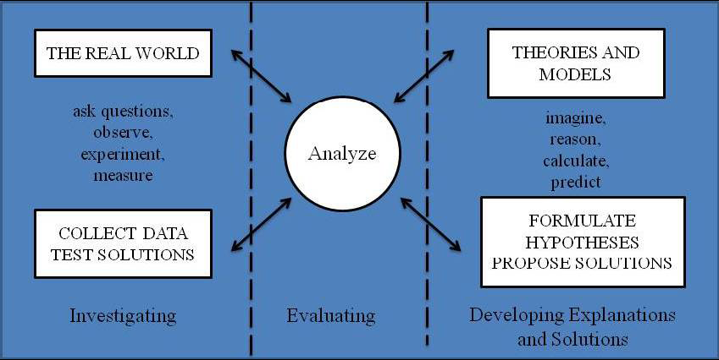
How the Practices Are Integrated into Both Inquiry and Design
FIGURE 3.1 The three spheres of activity for scientists and engineers.
This slide show was created as a quick digest for the CAPSULE program

Slide 6
Crosscutting Concepts
Patterns.
Cause and effect: Mechanism and explanation
Scale, proportion, and quantity
Systems and system models
Energy and matter: Flows, cycles, and conservation
Structure and function
Stability and change
This slide show was created as a quick digest for the CAPSULE program

Slide 7
Core Ideas in Physics
MATTER AND ITS INTERACTIONS How can one explain the structure, properties, and interactions of matter?
MOTION AND STABILITY: FORCES AND INTERACTIONS How can one explain and predict interactions between objects and within systems?
ENERGY How is energy transferred and conserved?
WAVES AND THEIR APPLICATIONS IN TECHNOLOGIES FOR INFORMATION TRANSFER How are waves used to transfer energy and information?
This slide show was created as a quick digest for the CAPSULE program

Slide 8
Core Ideas in Life Science
FROM MOLECULES TO ORGANISMS: STRUCTURES AND PROCESSES How do organisms live, grow, respond to their environment, and reproduce?
ECOSYSTEMS: INTERACTIONS, ENERGY, AND DYNAMICS How and why do organisms interact with their environment, and what are the effects of these interactions?
INHERITANCE OF TRAITS How are the characteristics of one generation related to the previous generation?
BIOLOGICAL EVOLUTION: UNITY AND DIVERSITY How can there be so many similarities among organisms yet so many different kinds of plants, animals, and microorganisms? How does biodiversity affect humans?
This slide show was created as a quick digest for the CAPSULE program

Slide 9
Core Ideas in Earth Science
EARTH’S PLACE IN THE UNIVERSE What is the universe, and what is Earth’s place in it?
EARTH’S SYSTEMS How and why is the earth constantly changing?
EARTH AND HUMAN ACTIVITY How do Earth’s surface processes and human activities affect each other?
This slide show was created as a quick digest for the CAPSULE program

Slide 10
Core Ideas in Engineering, Technology and Applications of Science
ENGINEERING DESIGN How do engineers solve problems?
LINKS AMONG ENGINEERING, TECHNOLOGY, SCIENCE, AND SOCIETY How are engineering, technology, science, and society interconnected?
This slide show was created as a quick digest for the CAPSULE program

Slide 11
ENGINEERING DESIGN How do engineers solve problems?
Defining and Delimiting an Engineering Problem What is a design for? What are the criteria and constraints of a successful solution?
Developing Possible Solutions What is the process for developing potential design solutions?
Optimizing the Design Solution How can the various proposed design solutions be compared and improved?
This slide show was created as a quick digest for the CAPSULE program

Slide 12
LINKS AMONG ENGINEERING, TECHNOLOGY, SCIENCE, AND SOCIETY How are engineering, technology, science, and society interconnected?
Interdependence of Science, Engineering, and Technology What are the relationships among science, engineering, and technology?
Influence of Engineering, Technology and Science on Society and the Natural World How do science, engineering, and the technologies that result from them affect the ways in which people live? How do they affect the natural world?
This slide show was created as a quick digest for the CAPSULE program

