Slide 1




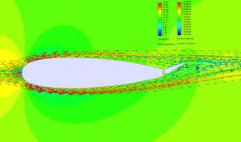
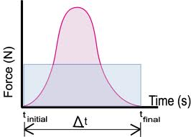
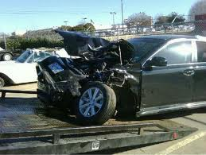
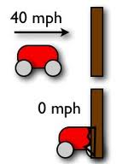

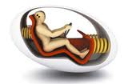
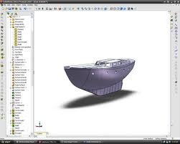
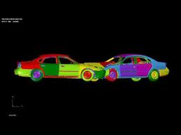
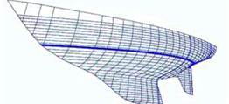
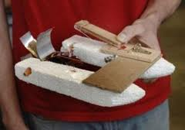
RE-ENGINEERING PHYSICS LABS
ANN KAISER LA SALLE ACADEMY PROVIDENCE RI
GOALs and Objectives
To use the EDP in physics lab activities. Specifically, a momentum lab and a fluid dynamics lab will be based on the EDP. In addition to applying physics principles to final product design, students will also design lab procedures.
ACTION PLAN
Crumple Zone Lab
Define the Problem:
Develop impulse - momentum theorem. Investigate applications of impulse in design (safety, sports, etc.). Discuss causes of injury in accidents. Bring in industry experts if possible.
Research/Brainstorm:
View IIHS video Understanding Car Crashes: When Physics Meets Biology. Identify variables that impact crumple zone design. Design crumple zones to test. 3 designs for each of 2 variables.
Prototype/Test:
Crumple zones will be attached to dynamics carts. Carts will be released on a dynamics track positioned at a specific angle to standardize acceleration. Experimental design is student generated. Students will determine what probes and sensors to use in order to obtain information about force, time, velocity and acceleration.
Analyze/Evaluate:
Analyze graphs of force vs. time; relate impulse to changes in velocity, and explain results in terms of materials and geometry.
Refine:
Each group will combine the best results for each variable into a design and test it. Goal is to obtain a “Five Star Safety Rating” (the best).
Communicate:
Lab report with sketches, experimental set-up and procedure, results and analysis.
Poster relating project to the EDP.
Mousetrap boats
Define the Problem:
Introduce fluid dynamics, factors influencing drag and lift. Review concepts of potential and kinetic energy. Discuss applications of the concepts above to applications in flight, sports, automobile and boat design. Bring in industry experts. Goal is design the fastest boat.
Research/Brainstorm:
Students will research and brainstorm to design hull prototypes and the ideal use of the mousetrap for power. Students will also design a method for testing their hull prototypes before attaching a mousetrap.
Prototype/Test:
Student groups will design several hull prototypes and modify the final one based on their testing. All modifications must be supported by test results. Students will also design a power train for the final boat. Students will attempt to model flow using SolidWorks and/or FoilSim. Boat testing will be videotaped for video analysis.
Analyze/Evaluate:
Students will attach a mousetrap to their boats. Fully assembled boats will be tested for speed and their ability to maintain a steady course.
Refine:
Boats will be modified based on testing. Modifications must be justified and documented before final testing.
Communicate:
Groups will submit a final report documenting the EDP, hull testing procedure, final boat design and all results of testing. Sketches of preliminary and final hull designs and experimental set-ups will be included.
Groups will be prepare a PowerPoint to present their designs.
STUDENT OUTCOMES
Content
Application of the Engineering Design Process
Application of fundamental physics concepts to product design
Concept of momentum in two body system analysis
Effect of variables in the impulse-momentum equation
Clarification of the principles and factors affecting fluid flow
Potential–kinetic energy transfers
Use of material choice and geometry in design
Skills
Identification of variables
Experimental Design
Group decision making
Communicating Results
Exposure to FEA,CAD,CFA
CONTEnT
Specific projects are as follows
1.CRUMPLE ZONE DESIGN
Student understanding of impulse-momentum will be enhanced by applying the Engineering Design Process to automotive safety issues.
This project will involve researching crumple zone design in order to determine criteria for optimum safety. Students will then choose three crumple zone designs to fabricate from materials supplied by the instructor.
Students will design 3 crumple zones to test using dynamics carts and Vernier probeware (force sensors, wireless dynamics sensors, accelerometers and motion detectors) to plot force versus time graphs.
An opportunity for modification and optimization based on test results will be provided.
2. MOUSETRAP BOATS
This project will involve researching hull design in order to minimize resistance and maximize stability for enhanced speed through the water.
Unpowered prototype hulls will be tested using a method designed by the group
A mousetrap will be attached d to the best hull, using a power train designed by the group.
Powered vessels will be tested in troughs designed from rain gutters. Boats will be videotaped and motion detectors will be used to measure velocity and acceleration.
Students will have an opportunity to make minor modifications based on test results and re-test.
Experts from the extensive boat manufacturing industry in our area will be enlisted to meet with students.
EXTENSIONS
Use of CAD for design.
Use of Finite Element Analysis
Foil and wing design
Additional aspects of automotive safety.

