Slide 1
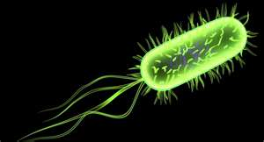
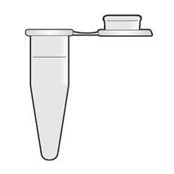
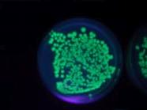
Ann Brophy
CAPSULE
Implementation Presentation
AP Biology
BIOTECHNOLOGY and MOLECULAR GENETICS

Slide 3
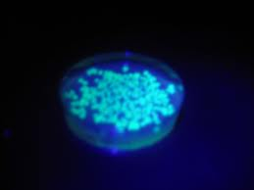
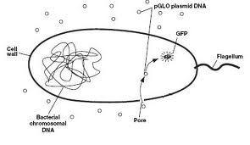
AP Biology and the EDP
Biotechnology & Molecular Biology Lab
Students genetically modified E.coli cells and made them GLOW as a result of inserting green flourescent protein genes from a jellyfish

Slide 4
Key Terms
Biotechnology
Recombinant DNA
Transformation
Plasmid
pGLO
Amp
Ara

Slide 5
Steps of the EDP and our Lab implementation
1. Identify the need or problem
The transformation of an organism (E.coli) to change genetic features
2. Research the need or problem
Students researched existing genetically modified organisms (GMO’s) and methods
3. Develop possible solutions
Transform an organism by inserting a plasmid containing a gene of interest
4. Select the best possible solution
Use the pGLO plasmid to transform E.coli cells

Slide 6
5. Construct a prototype
E.coli that glowed green under UV light
6. Test and evaluate the solution/prototype
Apply UV light and see if the E.coli glows……it does!
7. Communicate the solutions
Lab report
8. Redesign
Modify the E.coli transformation process by changing experimental variables or test organism

Slide 7
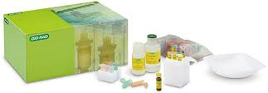
We used the BIO-RAD pGLO Transformation Kit

Slide 8
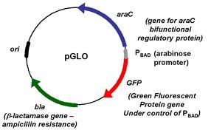
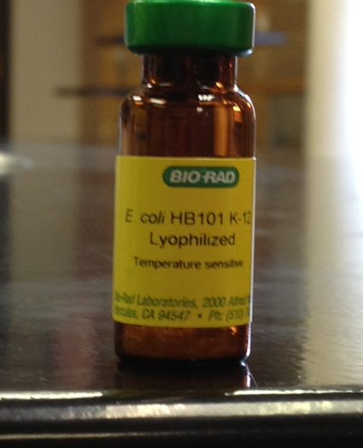
Materials Used
Plasmid – the DNA inserted into E.coli
E.Coli cells

Slide 9
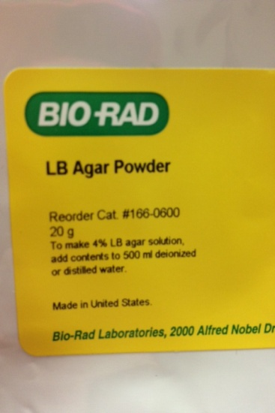
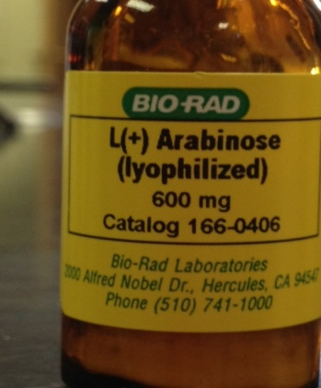
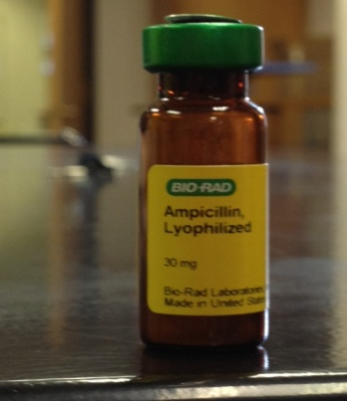
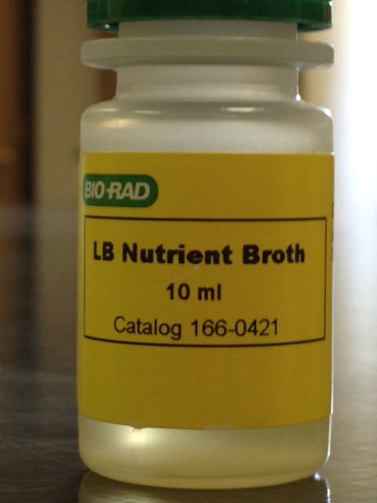
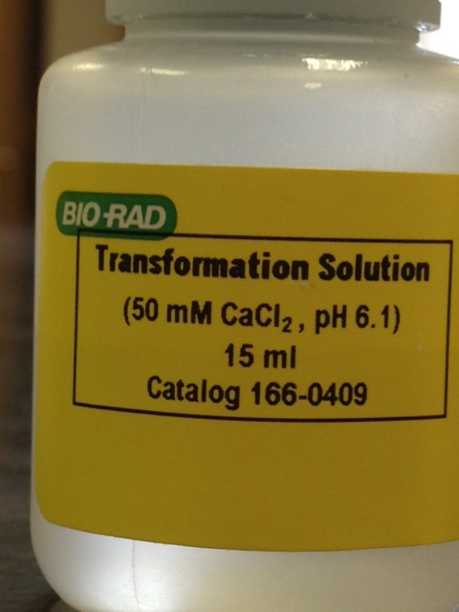
More Materials Used
Components of the growth medium
Transformation solution to
aid genetically modified
E.coli cells to grow

Slide 10
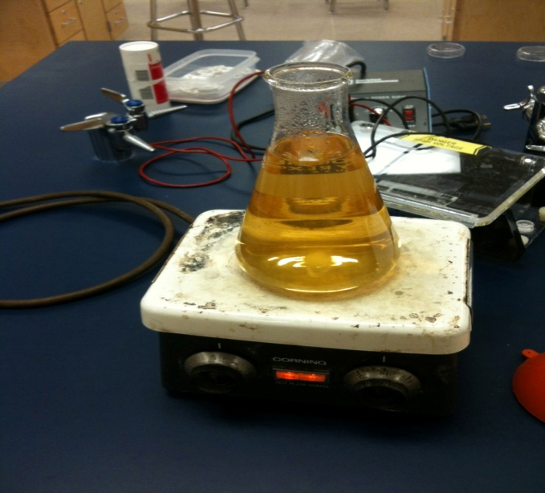
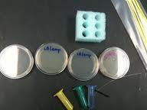
Procedure
In order to grow the E.coli cells students had to prepare the growth medium, label supplies, and spread E.coli

Slide 11
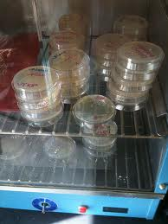
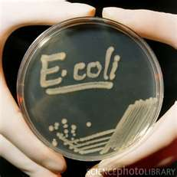
Incubate original E.coli cells
Harvest after 24 hours

Slide 12
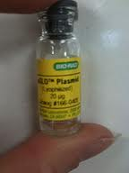
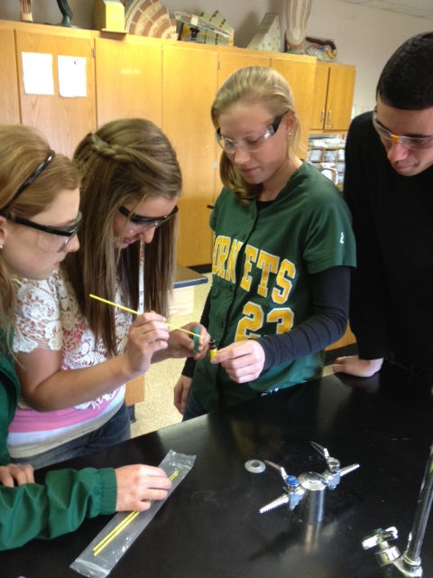
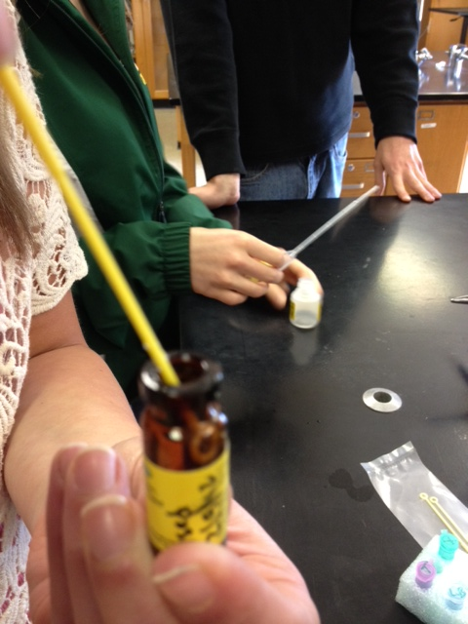
Add pGLO plasmid (jellyfish DNA) to test tube with harvested E.coli cells

Slide 13
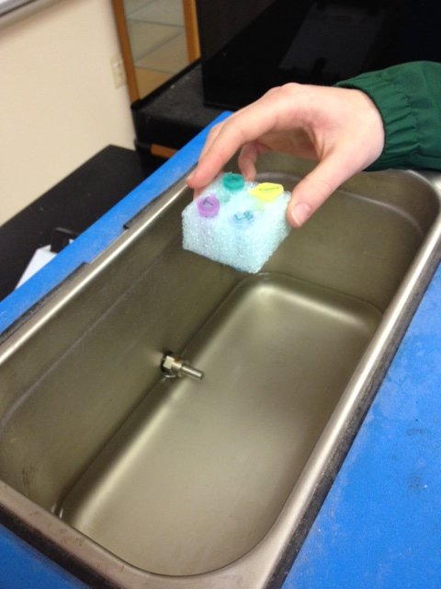
Heat shock to increase cell membrane permeability so that plasmid DNA would enter the E.coli cell
Then cool

Slide 14
Spread the transformed (genetically modified) E.coli
on to the correct petri dish and incubate for 24 hours

Slide 15
Results!
The E.coli cells glow in the presence of UV light.
This organism has been genetically altered from its
original form (can be seen on non-glowing plates)
Note: There were other components of gene regulation and other genes of interest (amp, ara)
in this lab, but in order to focus on EDP and biology I did not include details or discussion
in this presentation

Slide 16
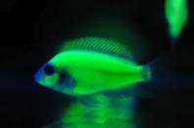
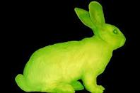
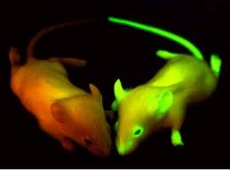
…other glowing animals

