Slide 1





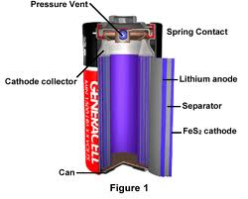
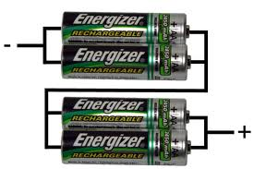
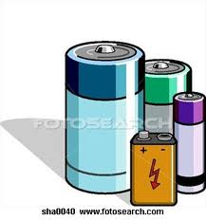

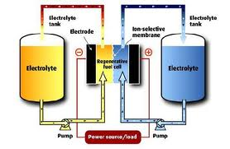
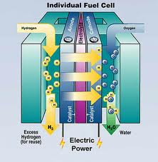


Best Batteries (Voltaic Cells)
Sue Vincent
Brattleboro Union High School
Brattleboro, VT
Project missionIntroduce EDP into Physical Science class
Objective Build the Best Battery voltaic cell prototype
ACTION PLANS
Action plan #1 Research & collect materials needed
Action plan #2 Build test prototype
Action plan #3 analyze & choose best combination of components
Action plan #4 sketch drawings
Action plan #5 present posters & power points
STUDENT deliverables
Research Battery History, components & Uses
Generate list of electrode materials & electrolytes
Plan data collection grid
Build prototype for testing materials
Analyze Voltage output to select best battery components
Scale drawings
Communicate: Poster & power points
Teacher deliverables
Lesson history & components
Grid selection for data → class grid h-o
Materials
Guidance/advice
presentation forum
Project goals
Research batteries
Design & build test prototype
select best battery components
Power point presentations
Poster presentations
WRITE YOUR PROJECT MISSION HERE
EDP (engineering design process)
Implementation Schedule:
STEPS OF THE ENGINEERING DESIGN PROCESS
TASK 3.5 Blocks to research, build, analyze & present | COMPLETION TIMELINE
Students generate list materials to test: Electrolytes, electrodes | Block 1 & hw
Test Prototype development | Blk 2
Data gathering | Blk 2
Team analysis for what “Best” means | Blk 2
Develop presentation posters & ppt | Blk 3-3.5
Examine the current state of the issue and current solutions.
Brainstorm possible solution(s). Articulate the possible solution(s) in two and three dimensions
Future plans
What can our batteries be used for?
Split water (Electrolysis)
run an LCD clock,
fuel cell power…
Step 1
Identify the Need or Problem
Step 2
Research the Need or Problem
Step 3
Develop Possible Solution(s)
Overhaul the solution(s) based on information gathered during the tests and presentation.
Determine the solution(s) that best meet(s) the original need or solve(s) the original problem.
Step 8
Redesign and Reevaluate
Step 4
Select the Best Possible Solution(s)
Create an engineering presentation that includes a discussion on how the solution(s) best meet(s) the initial need or problem
Discuss societal impact and tradeoffs for the solution(s)
Does it work?
Does it meet the original design constraints?
Model the selected solution(s) in two and three dimensions
Step 7
Communicate the Solution(s)
Step 6
Test & Evaluate the Solution(s)
Step 5
Construct a Prototype

