Slide 1




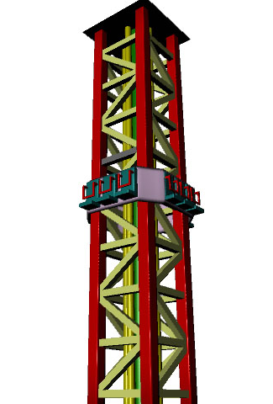
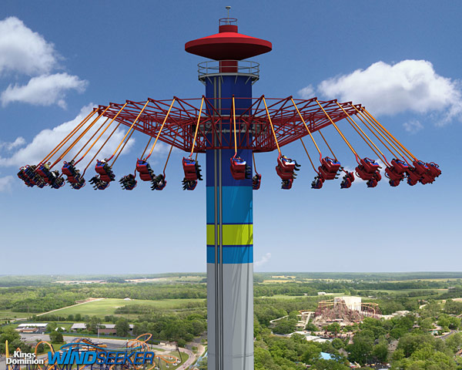
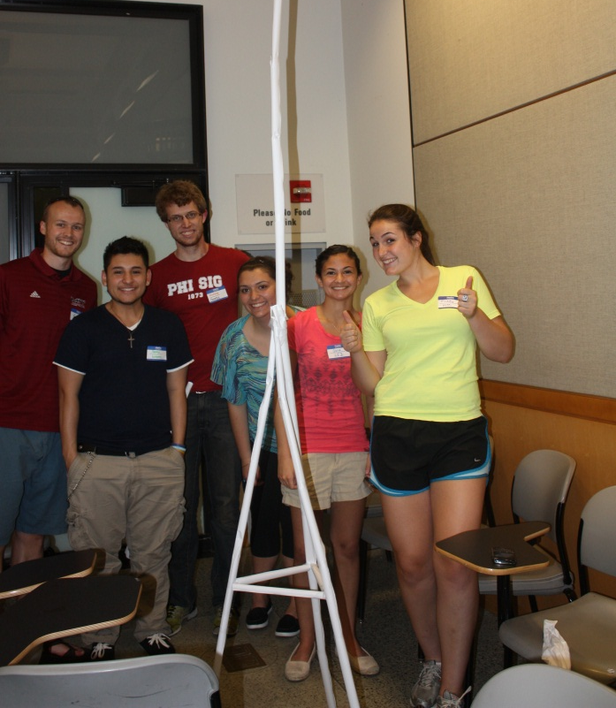
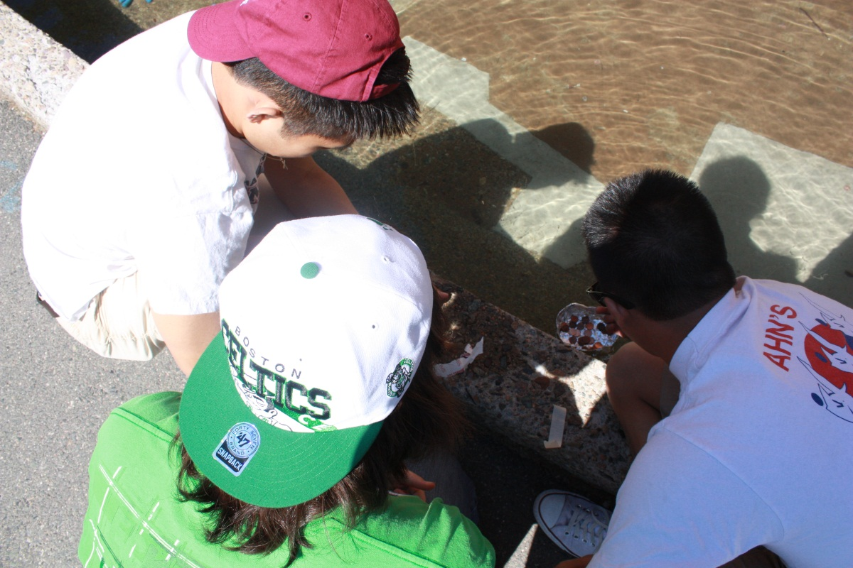
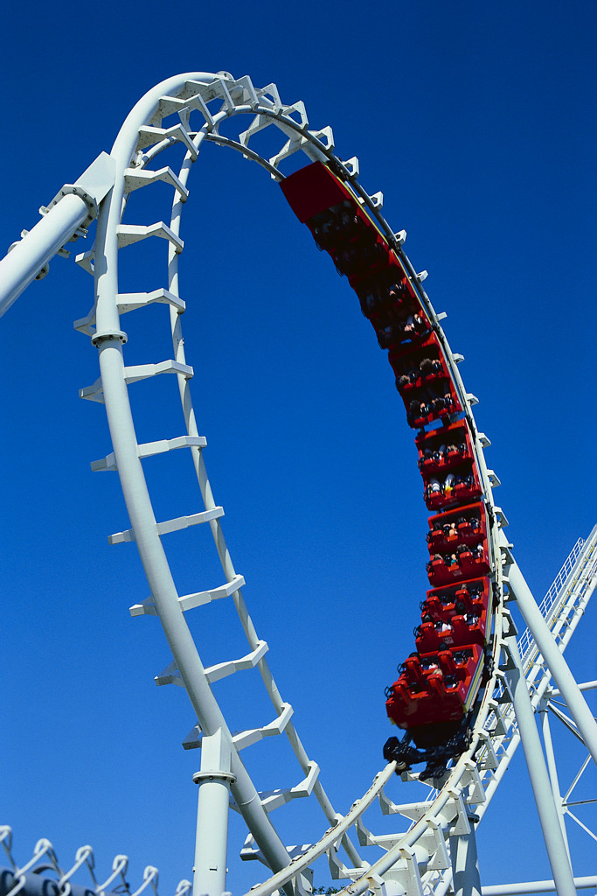
Amusement Park Ride Design
Stacey Allen
11th Grade Physics
Revere High School
Goal
To implement various amusement park ride design projects utilizing the EDP throughout our physics curriculum.
My students often struggle with the relationships between the concepts, the math, and the real world applications of physics, and I hope that through this series of design projects, they will have the opportunity to consolidate all of this knowledge, while using the EDP to see how a real engineer would design the types of rides that they’ve all seen and experienced.
#1: Free Fall Ride (kinematics)
Diagram drawing with measurements and calculations
Full-size decorated poster (2’ x 3’) depicting ride
Completed EDP worksheet
ACTION PLAN &
Implementation schedule
STUDENT Deliverables
What | When | How | Current Status
Introduction to EDP | First week or two of school (beginning of 1st quarter) | Simple group engineering projects (straw towers, paper airplanes, etc.) | READY
“Free Fall / Projectile” Ride Design | After unit on Kinematics – end of first month of the semester (end of 1st quarter) | Students will design a ride incorporating the concepts of projectiles and free fall. These designs will be poster-based only and students will present their designs. | Outlined – need to make student resources
“Circular” Ride | After unit on Circular Motion – end of 2nd month of semester (beginning of 2nd quarter) | Students will design a ride incorporating the concepts of circular motion (ex. swings, ferris wheel, pirate ship, etc.). These designs will be modeled with simple prototypes and presented. | Outlined – need to make student resources & gather materials
Capstone – Roller Coaster Design | During energy unit- completing project throughout final month of semester (end of 2nd quarter) | Students will follow the EDP to design and build roller coasters. They will use various materials to design, build, and then redesign their prototypes. Students will need to use all of the concepts they’ve learned in the course, with a focus on the latest topic (energy conservation). | Need to request materials from $500 NSF grant Appropriate set up of excel spreadsheets Dates outlined - need to make student resources
#2: Circular Ride (UCM)
Diagram drawing with measurements and calculations
Small-scale model depicting ride
Completed EDP worksheet
CONTEXT
Semester-long 11th grade physics (mechanics) class at Revere High School, which all students are required to take. Usually classes are around 25 students (±5).
#3: CAPSTONE
Roller Coaster Design
Diagram drawing with measurements and calculations
Full-size decorated poster (2’ x 3’) depicting ride
Scaled model built with recyclable materials and k’nex
Power point presentation highlighting safety features and fun-factor (10 min)
Completed EDP worksheet
Project components
#1: Free Fall Ride (kinematics)
#2: Circular Ride (UCM)
#3: CAPSTONE – Roller Coaster Design
The course will culminate with a capstone roller coaster design project. The other listed projects (#1&2) will be smaller in scale (only posters or basic models) and prepare the students throughout the semester to successfully complete their capstone project with the roller coasters. I hope to also use these smaller projects to acquaint the students with the EDP and practice applying their math skills and conceptual knowledge to real life engineering projects.
Teacher deliverables
EDP worksheet for students to use while completing the process
Intro activities (Roller Coaster Tycoon, online games)
Math & concept outlines related to each design
Rubrics for each deliverable
Appropriate materials for posters and models
Impact on course schedule
The two smaller ride design projects will take about 2-3 classes each at the end of the kinematics and circular motion units, respectively. These projects will replace a few smaller activities I previously did at the end of these units. The roller coaster capstone will happen throughout our final unit on energy, and take up significantly more class time. It will replace the time spent on a previous ‘final project’.

