Slide 1
Wind Turbine Design capstone project
Newton South High School
Matt Briggs

Slide 2
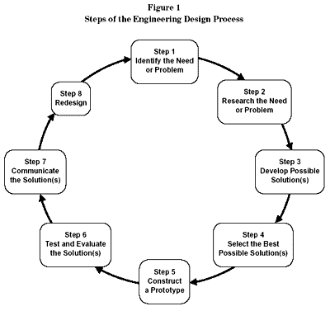
Project Expectations
Students will design a
wind turbine that will provide extra lighting to the graphic design studio
Students will self direct project and break into teams
Students will use the EDP exclusively

Slide 3
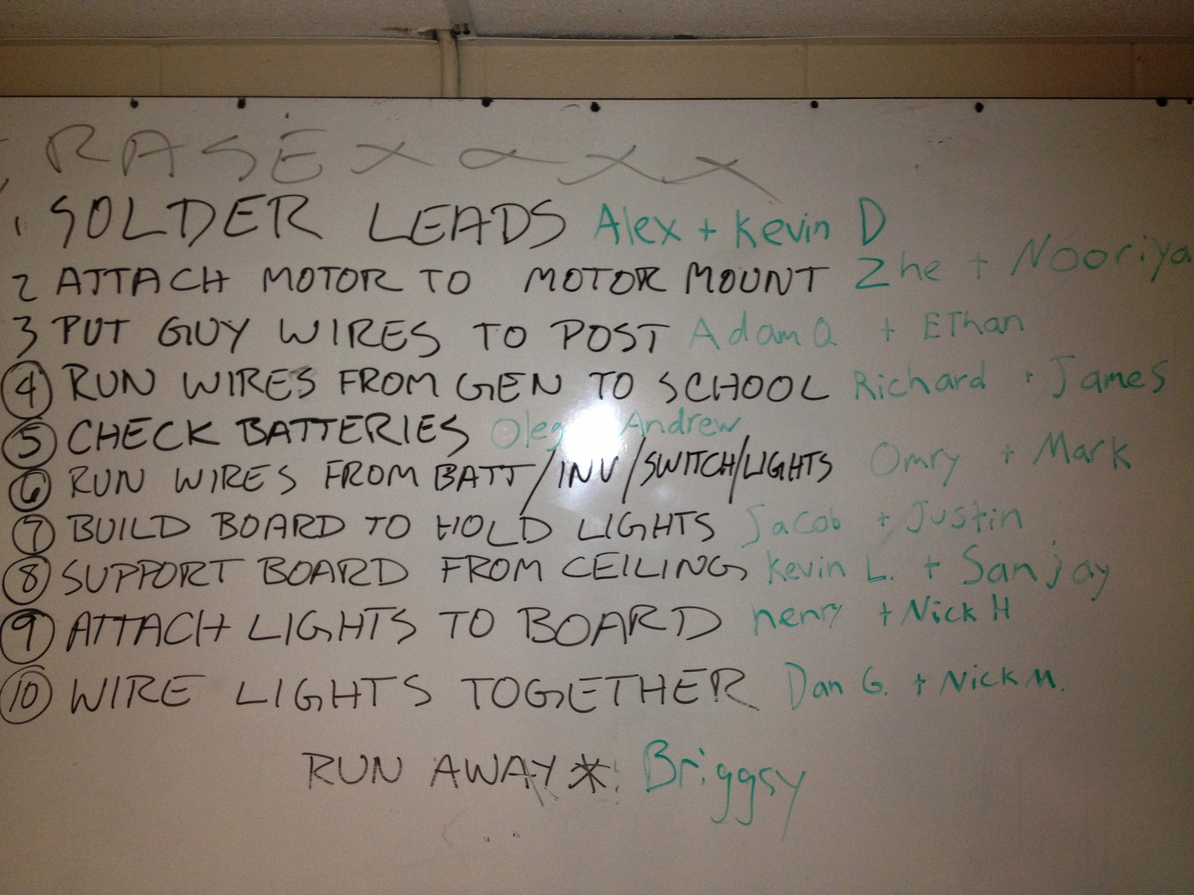
Research and need
Students found plans and met with local people who could lend technical assistance. Also found basic plans for wind turbine that could be built.

Slide 4
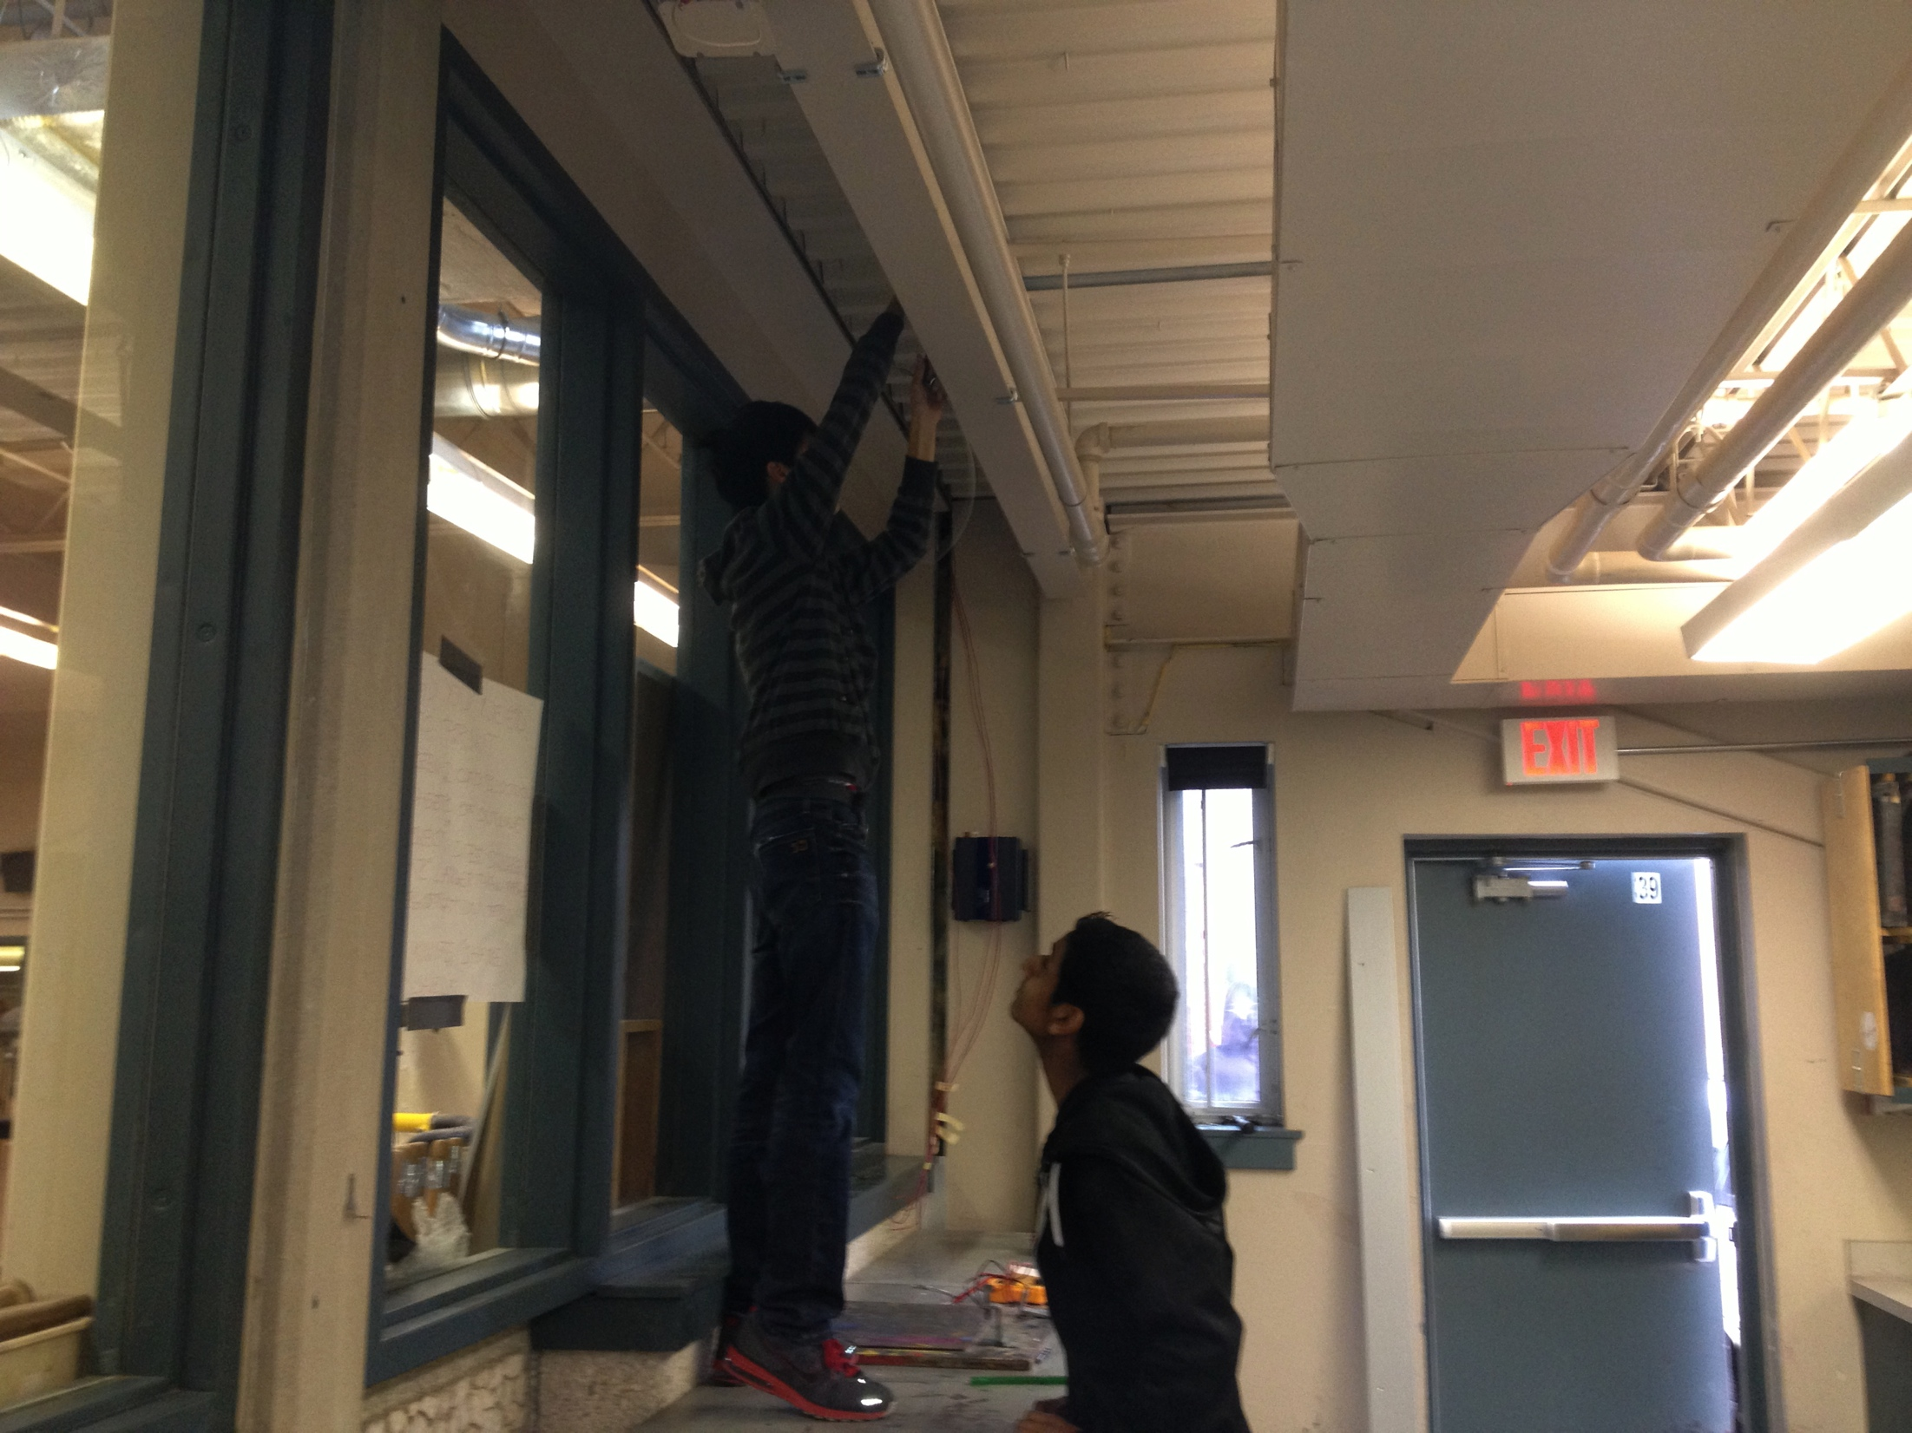
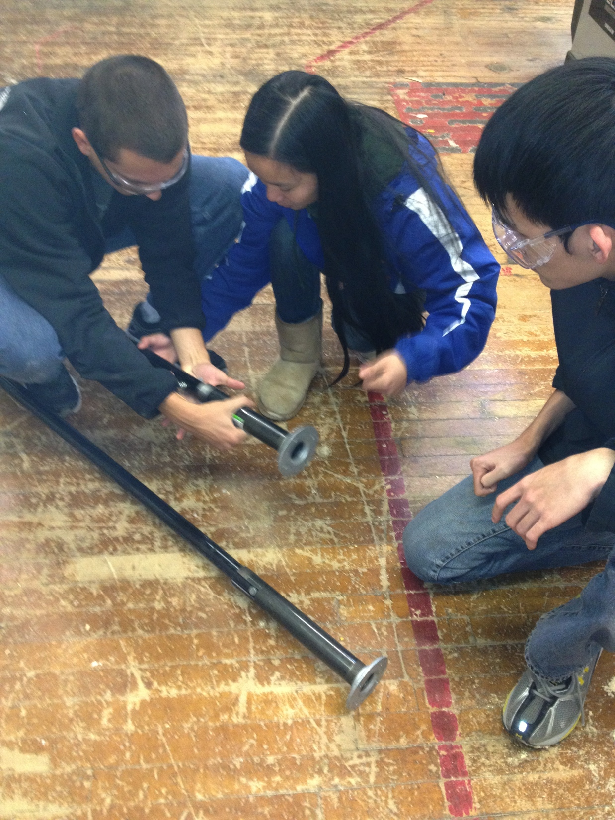
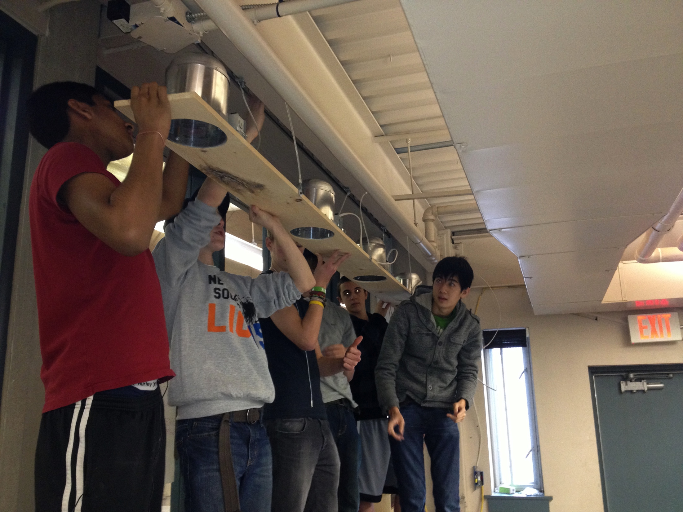
Team communication
Students elect three OPM’s and communicate within adjacent teams

Slide 5
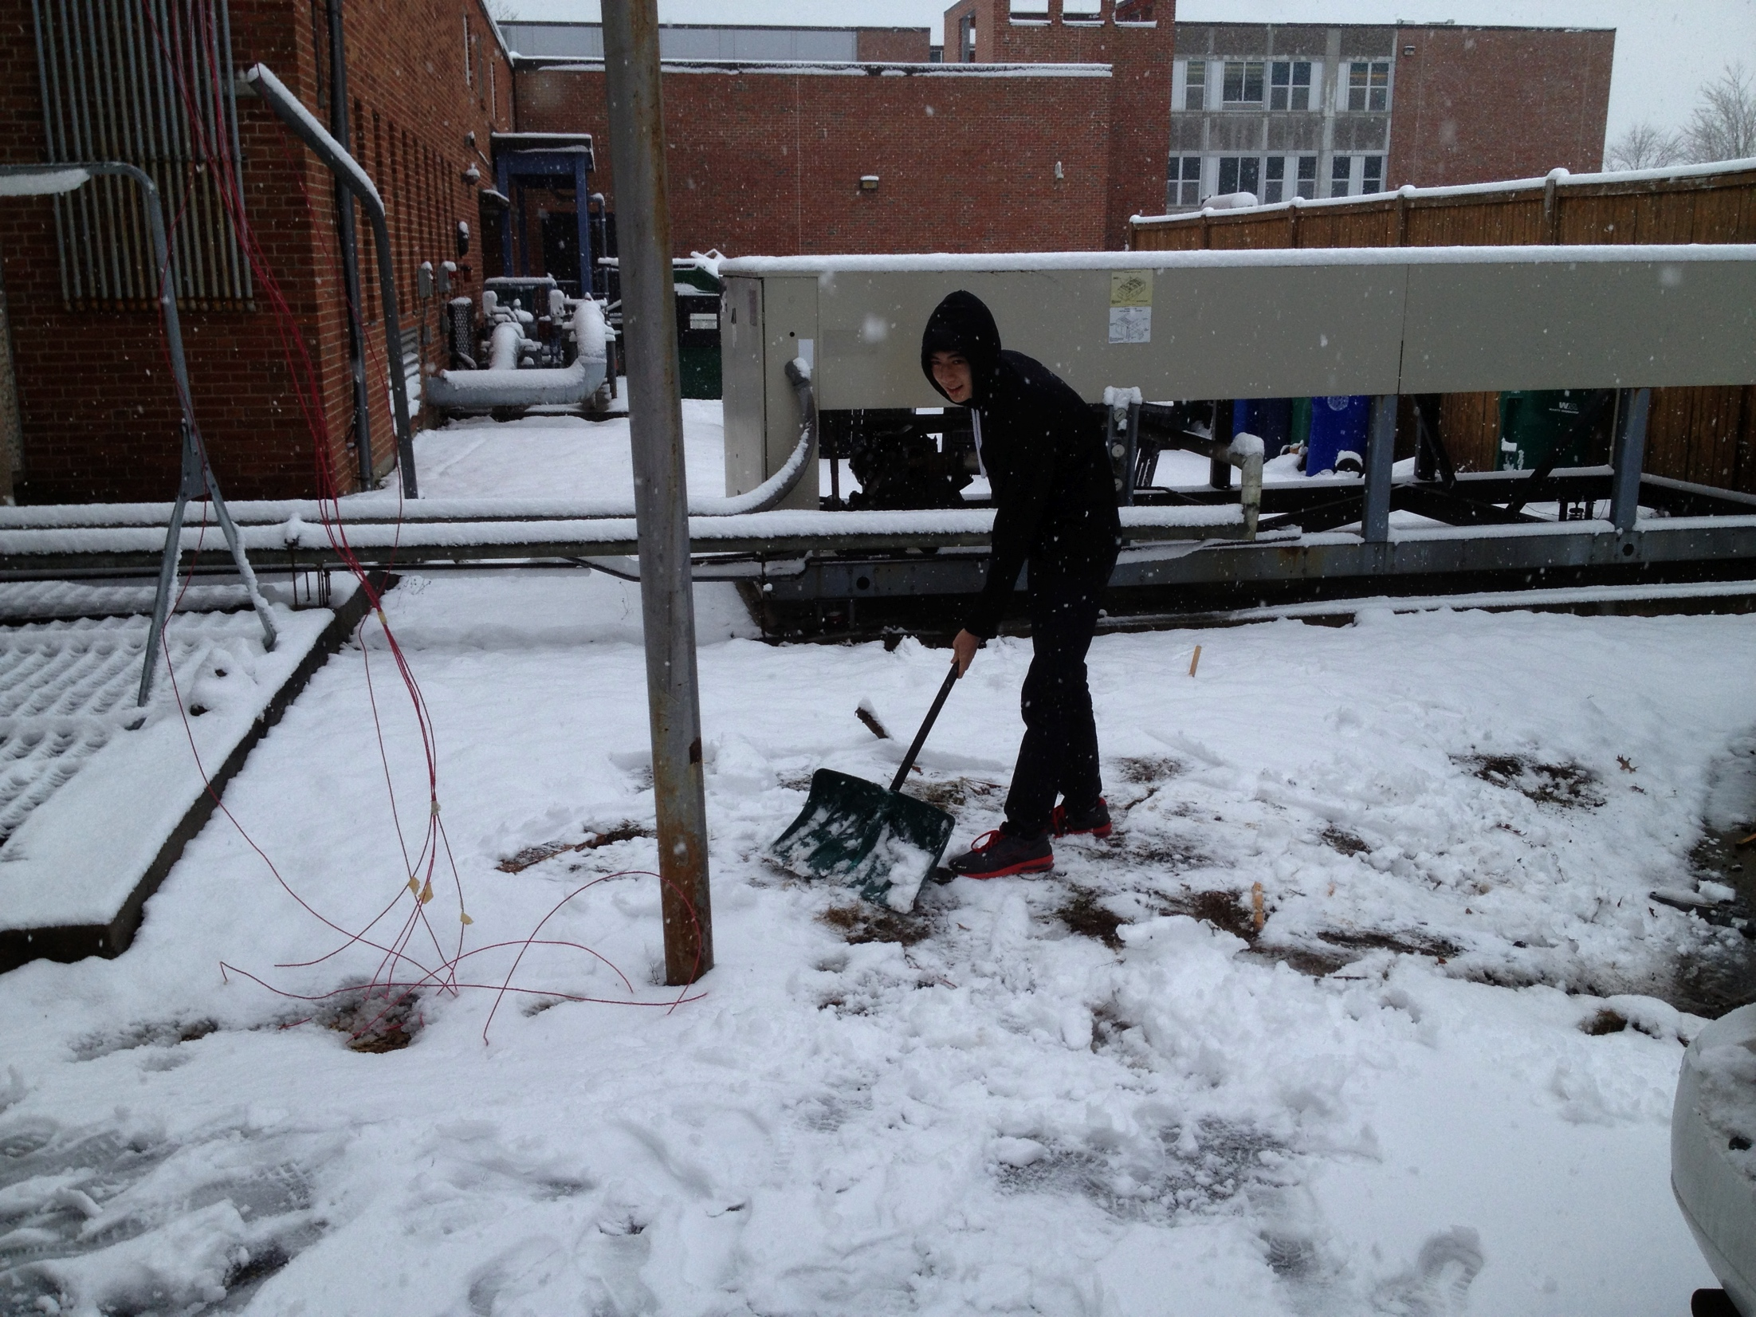
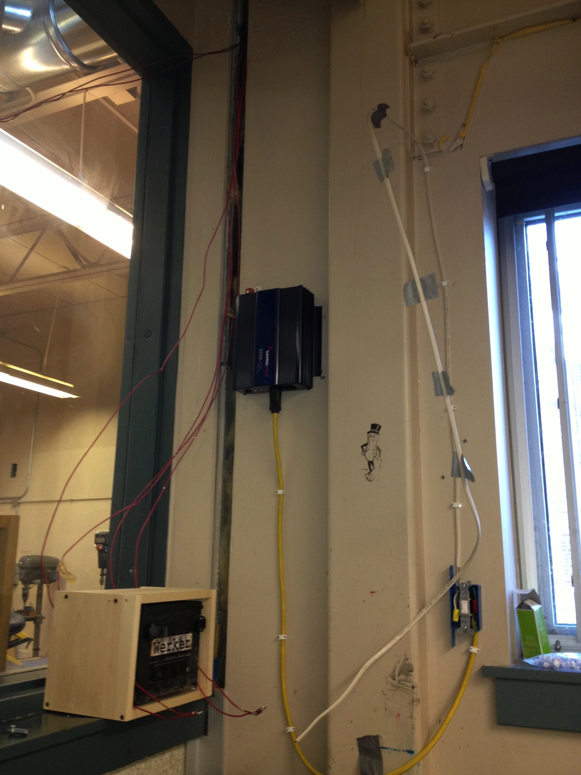
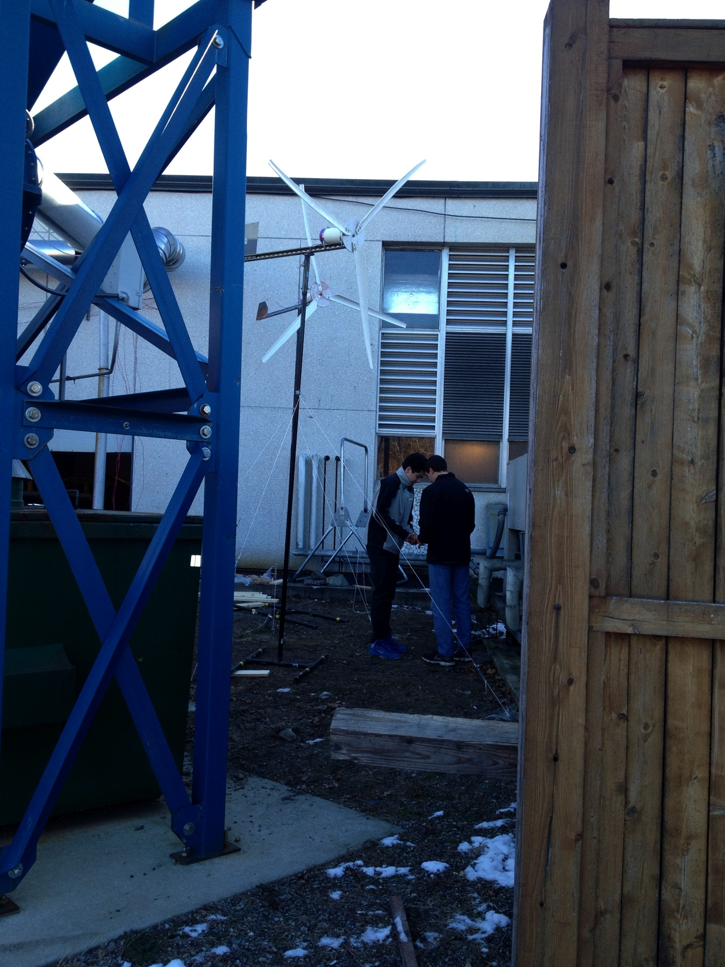
Team communication
inverter
battery
lightswitch

Slide 6
deliverables
Student Deliverables
Identify solution for lighting issues
Develop environmental neutral solution
Teacher Deliverables
Introduce students to local residents to assist
Technical assistance

