Slide 1




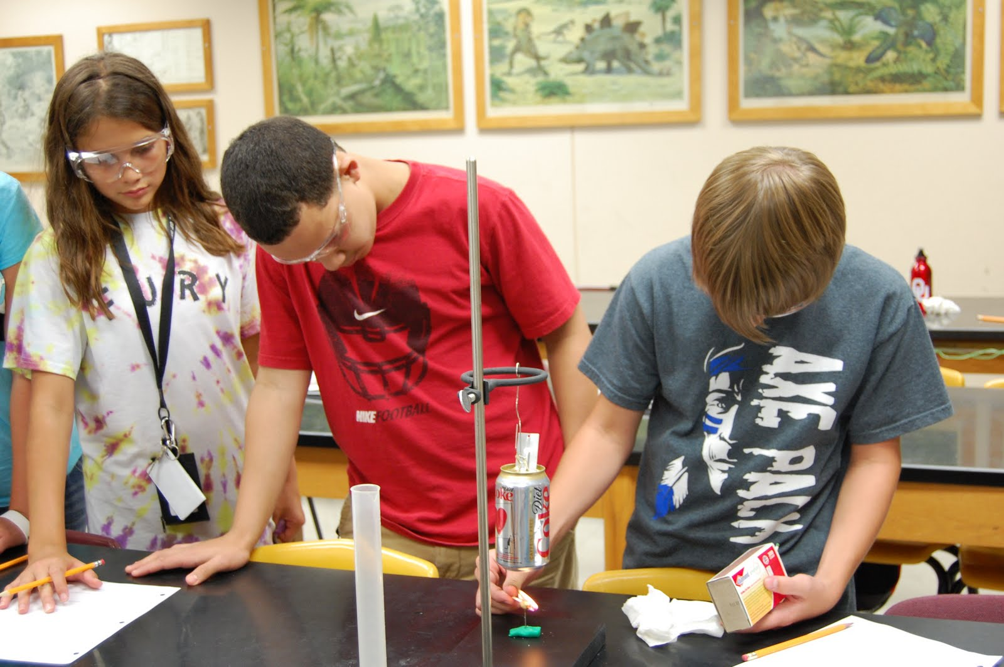
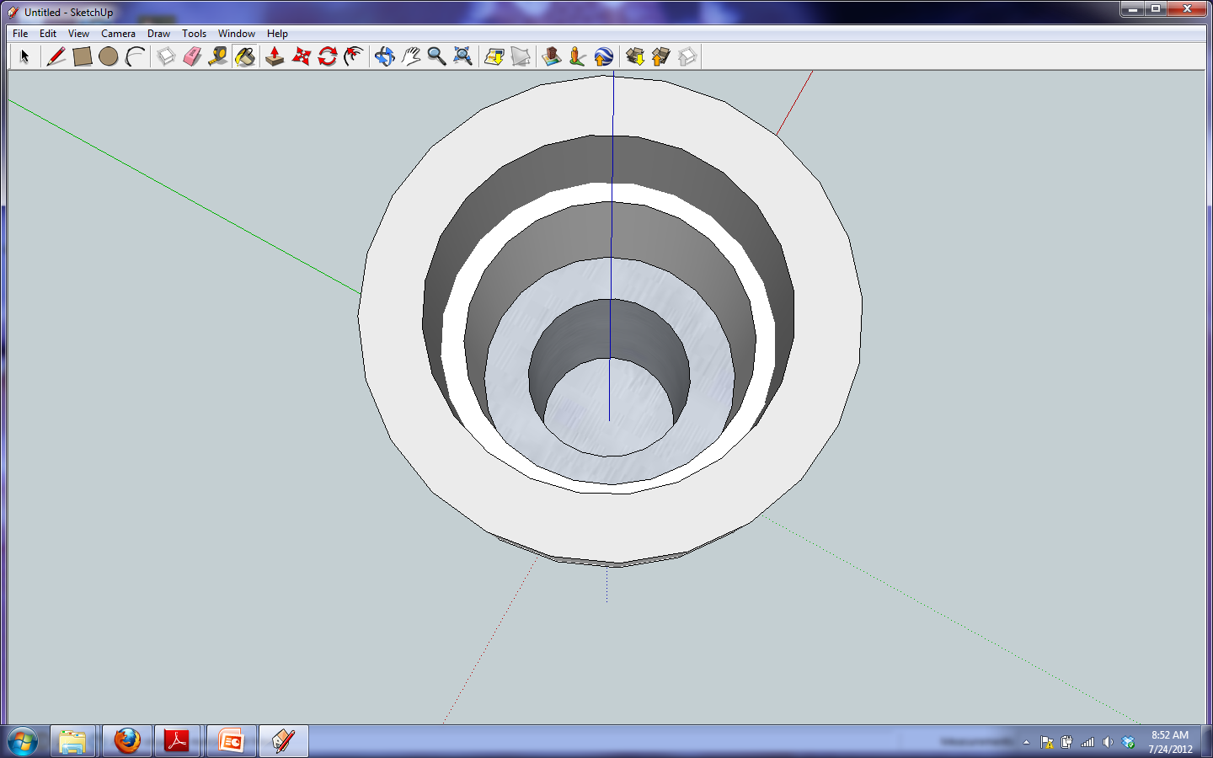
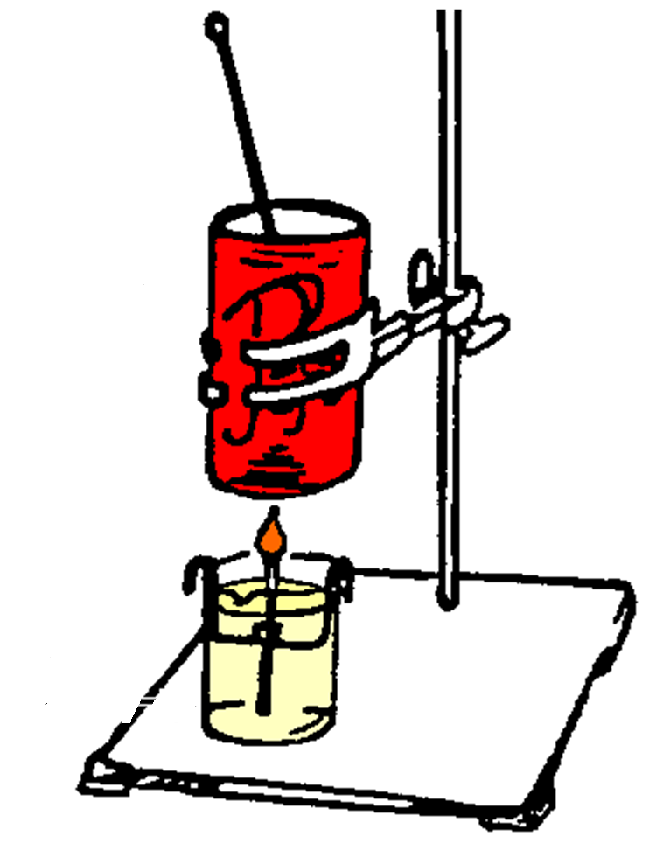

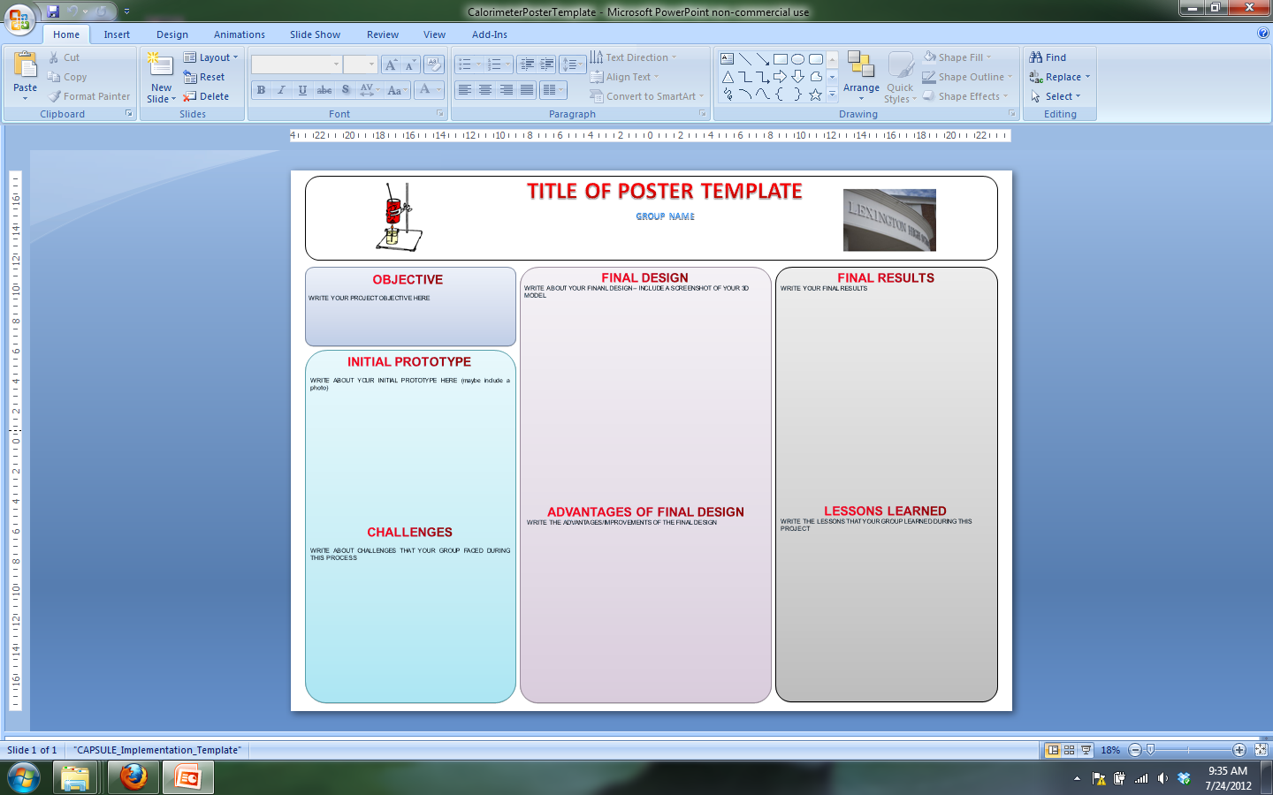
Calorimeter Design Project
Sarah Legge
Lexington High School
Goal/objective
To integrate an engineering project that meets the requirements of a STEM capstone project. The project provides students with the opportunity to work through all the steps of the Engineering Design Process (EDP). Students will have to create a 3D model of their final design using 3D Modeling Software. Students will also apply chemistry concepts and calculations learned during the year. Lastly, students will also improve their communication skills.
ACTION PLANS
Calorimetry Engineering Design Project
Students will complete an initial calorimetry lab in class using a soda can calorimeter. They will then be tasked with improving the design
  Identify and Research Problems with Initial Calorimeter
  Develop a Possible Solution
  Complete a Hand Drawn Sketch of Prototype
  Construct the Prototype
  Test Prototype in class
  Evaluate the Prototype
  Communicate strengths/weakness of Prototype
  Construct Final Design
  Create a 3D Model of Final Design using Google SketchUp
  Test Final Design in Class
  Communicate Results using Poster
STUDENT OUTCOMES
Notebooks
  All ideas, research, data, calculations, analysis, and sketches will be entered in bound lab notebook.
Sketches
  Hand drawn sketch of prototype in notebook
  3D Sketch using Google SketchUp of final design also included in notebook
Poster Presentation
  Utilizing poster presentation structure as culminating activity allowing students to communicate their results
Project components
Students will complete and initial lab in class using an aluminum soda can as our calorimeter. The student’s task in this engineering challenge is to design and build a calorimeter that will allow them to calculate more accurate food Calorie values. The students will follow the engineering design process to complete this task.
Students will work in teams on this project. They will begin by identifying and researching the problem, thinking of several different ways to redesign the calorimeter, and then building a prototype. They will test these prototypes in class, discuss what worked well and what didn’t work well, and then be given one more opportunity to improve upon their design. Their final grade will be based upon the research and design process, and their reflection on that process. The ultimate goal is to improve upon the original aluminum can calorimeter used in class.
An additional requirement for the final design will be a 3D Model created on Google SketchUp. The students will have to present their results to the class using a poster template that includes their 3D design.
Team members
I will consult with the chemistry department at Lexington High School on the modifications to the existing calorimetry project that incorporate 3D modelling and poster presentations.
Teacher outcomes
Create Tutorial for Google SketchUp with sample calorimeter
Compile testing data from Vernier probeware during calorimetry testing
Collect engineering notebooks
Compile student posters and create slideshow
Collect data on project implementation through the use of online evaluations
Present to department use of tablet technology for labs that utilize probeware

