Slide 1
Introduction to Manufacturing
Sagar Kamarthi
Associate Professor Dept. of Mechanical and Industrial Engineering
Northeastern University, Boston

Slide 2
Topics
Product life cycle
Manufacturing
Building blocks of manufacturing

Slide 3
Product Life Cycle
Development
Design
Concept
Product Life Cycle
Production/ Manufacturing
Dispose
Distribution
Reuse/Recycle
Sale
Use

Slide 4
Product Life Cycle

Slide 5
Design Part of Product Life Cycle

Slide 6
Mfg Part of Life Cycle

Slide 7
Topics
Product life cycle
Manufacturing
Building blocks of manufacturing

Slide 8
Manufacturing
Manufacturing is the application of physical and chemical processes to alter the geometry, properties, and/or appearance of a given starting material
To make parts or products, or
To join multiple parts to make assembled products
Manufacturing adds value to the material
When iron ore is converted to steel, value is added
When sand is transformed into glass, value is added
When crude oil is refined into petrol (gasoline), value is added

Slide 9
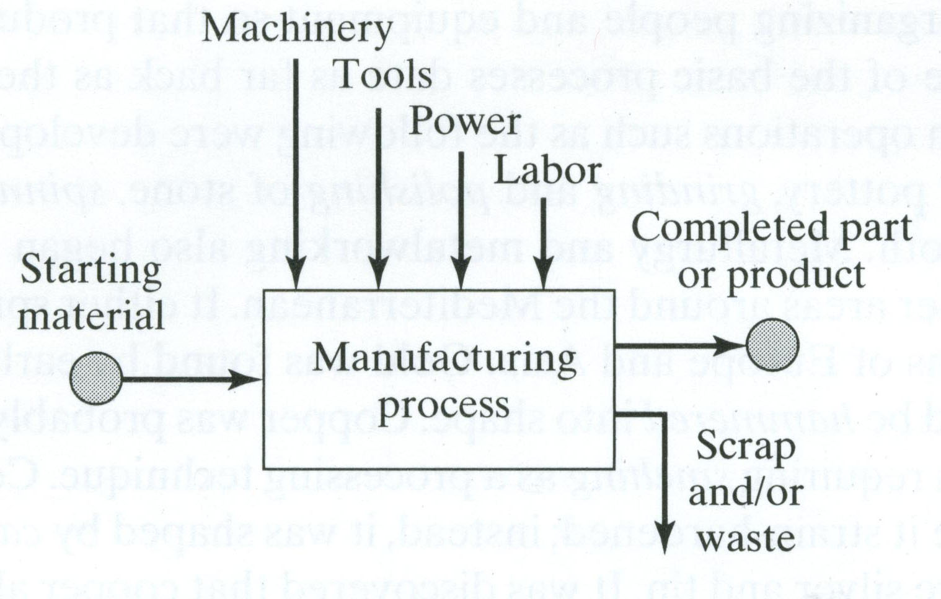
Manufacturing Process

Slide 10
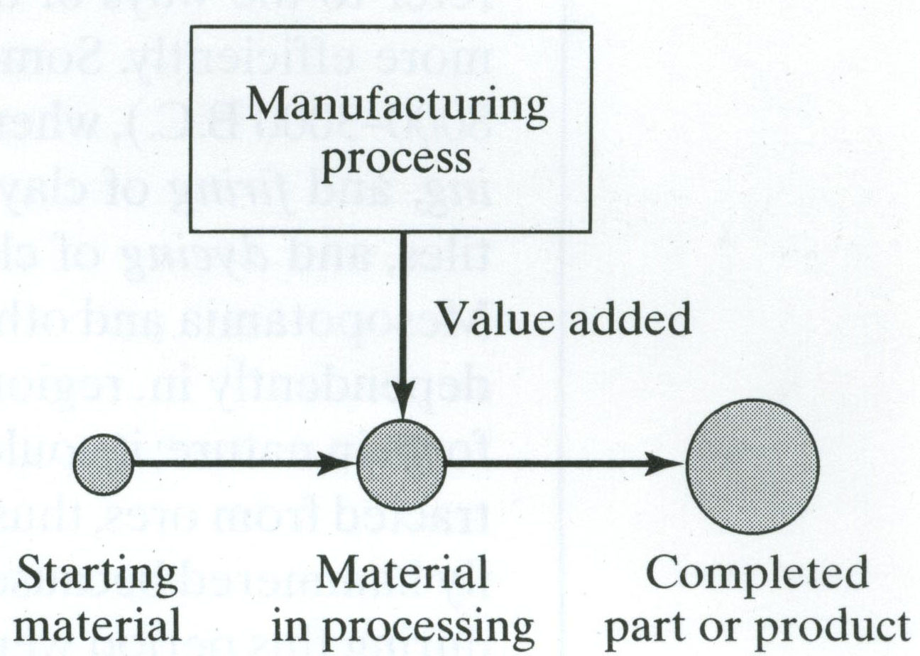
Manufacturing Adds Value

Slide 11
Building Blocks of Manufacturing
Materials
Manufacturing processes
Assembly operations
Manufacturing Automation

Slide 12
Materials
Most engineering materials can be classified into one of four basic categories:
Metals
Ceramics
Polymers
Composites
Mechanical, physical and chemical properties these type of materials are different
These differences affect the manufacturing processes that can be used to produce products from them

Slide 13
Metals
Metals are usually alloys, which are composed of two or more elements, at least one of which is metallic
Two basic groups of metals/alloys are:
Ferrous metals are based on iron
Comprises about 75% of metal tonnage in the world
Steel = Fe‑C alloy (0.02 to 2.11% C)
Cast iron = Fe-C alloy (2% to 4% C)
Nonferrous metals are metallic elements and their alloys of aluminum, copper, magnesium, nickel, silver, tin, titanium, etc.

Slide 14
Ceramics
Compounds containing metallic (or semi-metallic) and nonmetallic elements.
Typical nonmetallic elements are oxygen, nitrogen, and carbon
For processing, ceramics divide into:
Crystalline ceramics
Traditional ceramics, such as clay (hydrous aluminum silicates)
Modern ceramics, such as alumina (Al₂O₃)
Glasses
Mostly based on silica (SiO₂)

Slide 15
Polymers
Thermoplastic polymers
They can be subjected to multiple heating and cooling cycles without altering their molecular structure
Thermosetting polymers
They cannot be reheated because molecules are chemically transformed (cured) into a rigid structure
Elastomers
They shows significant elastic behavior

Slide 16
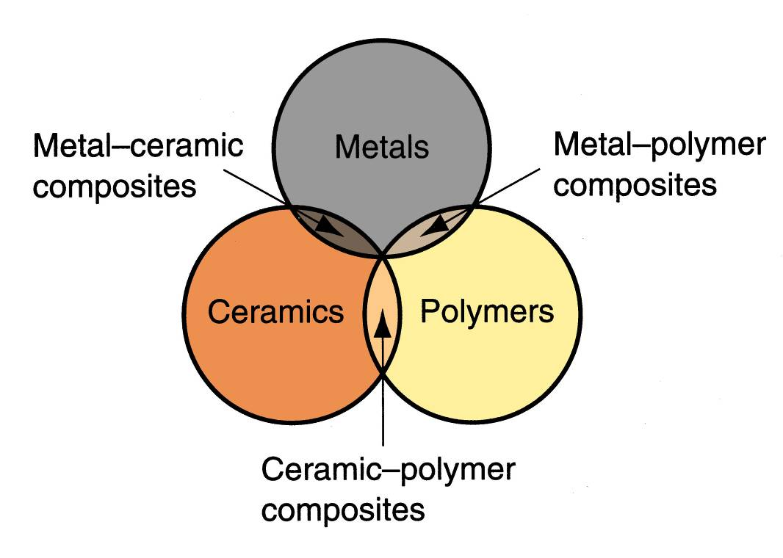
Composites
Nonhomogeneous mixtures of basic materials

Slide 17
Manufacturing Processes
Material removal processes
Starting material is a ductile or brittle solid
Solidification processes
Starting material is a heated liquid or semi-fluid
Particulate processing
Starting material consists of powders
Deformation processes
Starting material is a ductile solid (commonly metal)

Slide 18
Material Removal Processes
Excess material removed from the starting piece so what remains is the desired geometry
Examples: machining such as turning, drilling, and milling, grinding, laser cutting

Slide 19
Material Removal Processes

Slide 20
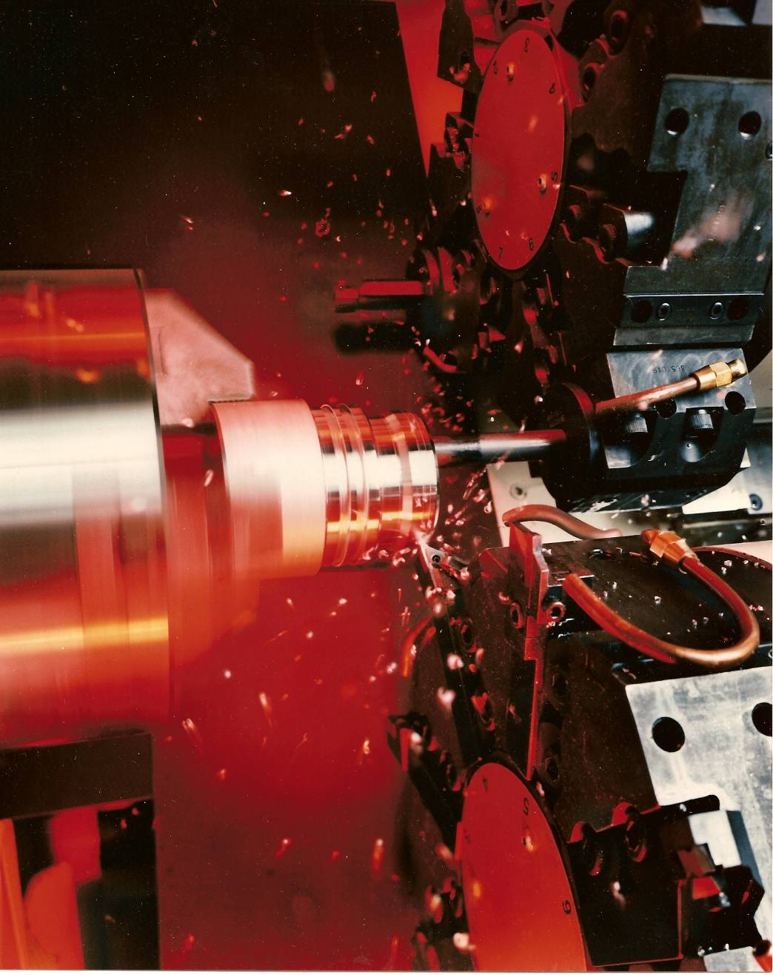
Metal chips fly in a high speed turning operation performed on a computer numerical control turning center (photo courtesy of Cincinnati Milacron).
©2007 John Wiley & Sons, Inc. M P Groover, Fundamentals of Modern Manufacturing 3/e

Slide 21
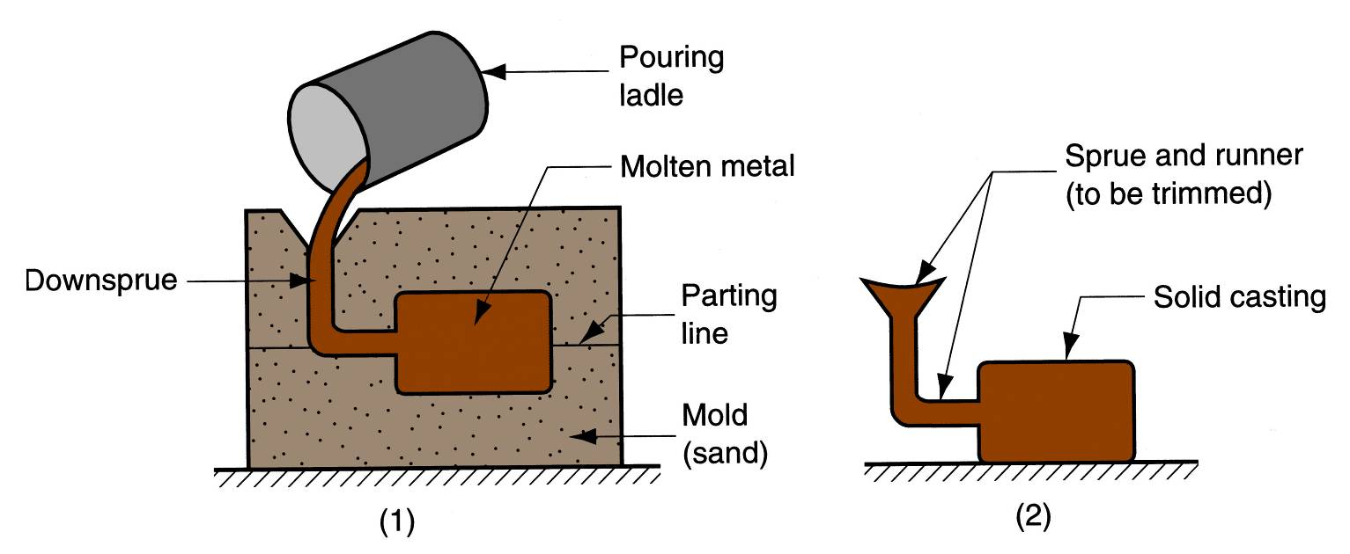
Solidification Processes
Starting material is heated sufficiently to transform it into a liquid or highly plastic state
Examples: metal casting, injection molding

Slide 22
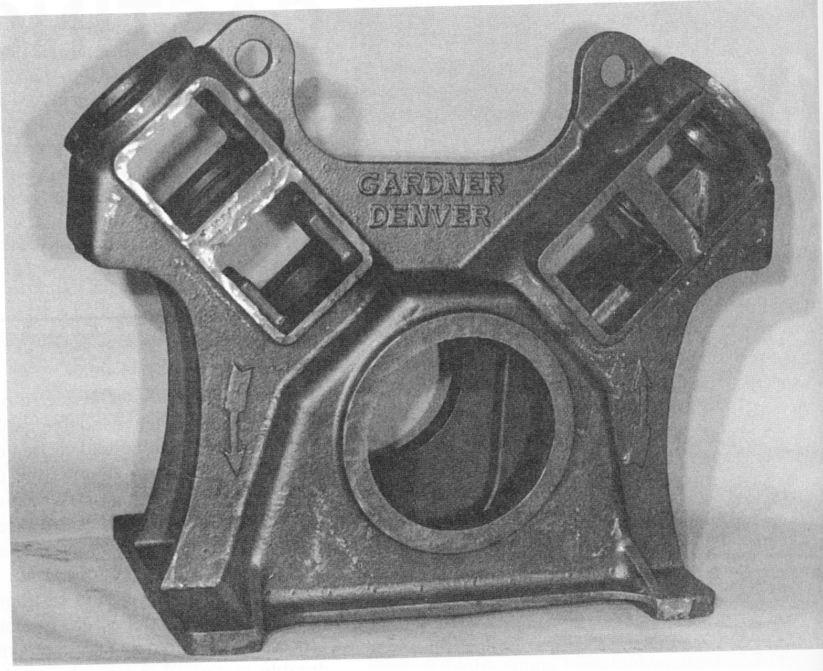
Solidification Processes

Slide 23
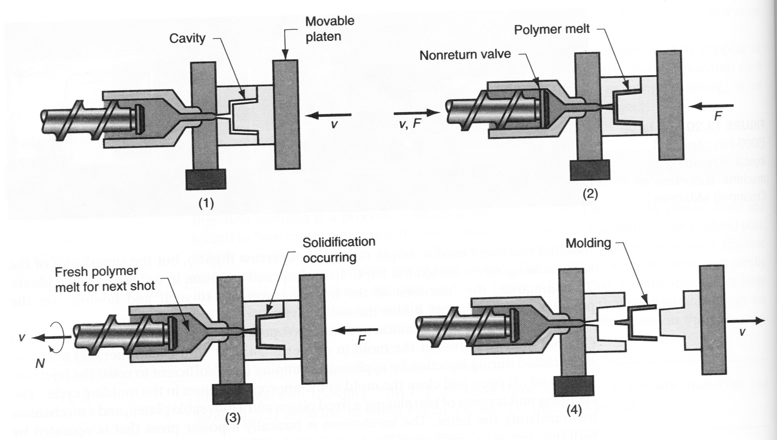
Solidification Processes

Slide 24
A spectacular scene in steelmaking is charging of a basic oxygen furnace, in which molten pig iron produced in a blast furnace is poured into the BOF. Temperatures are around 1650°C (3000 ° F).

Slide 25
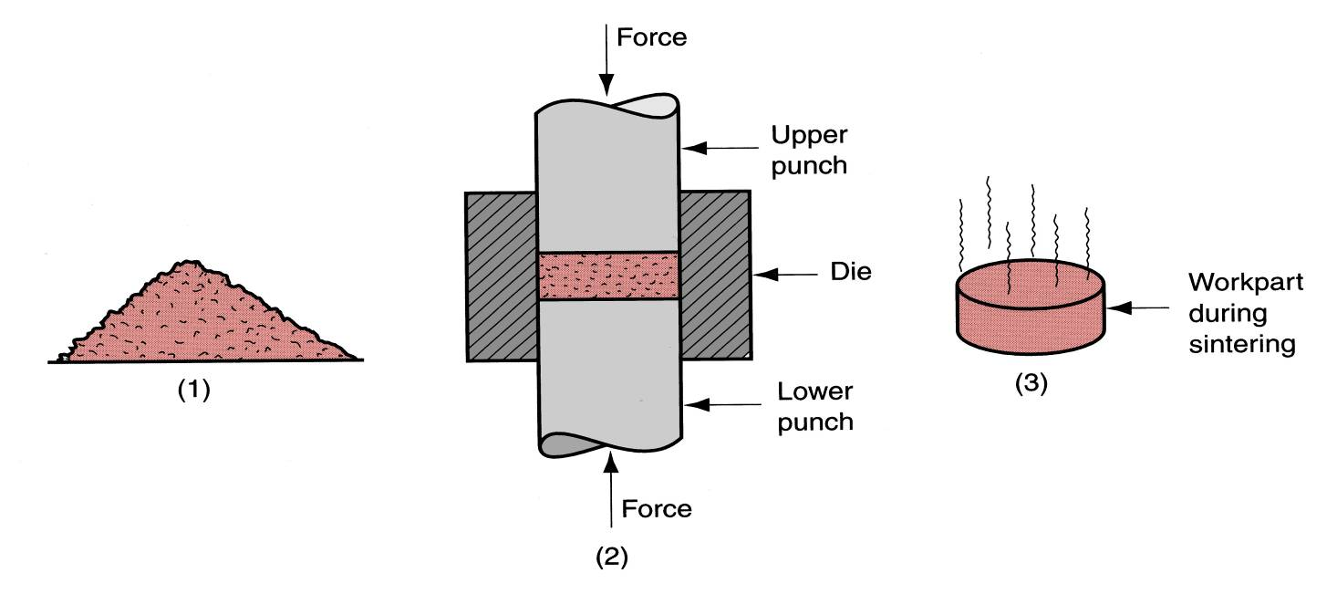
Particulate Processing
Starting materials are powders of metals or ceramics
Usually involves pressing and sintering, in which powders are first compressed and then
Example: Kitchen tiles, ceramic plates

Slide 26
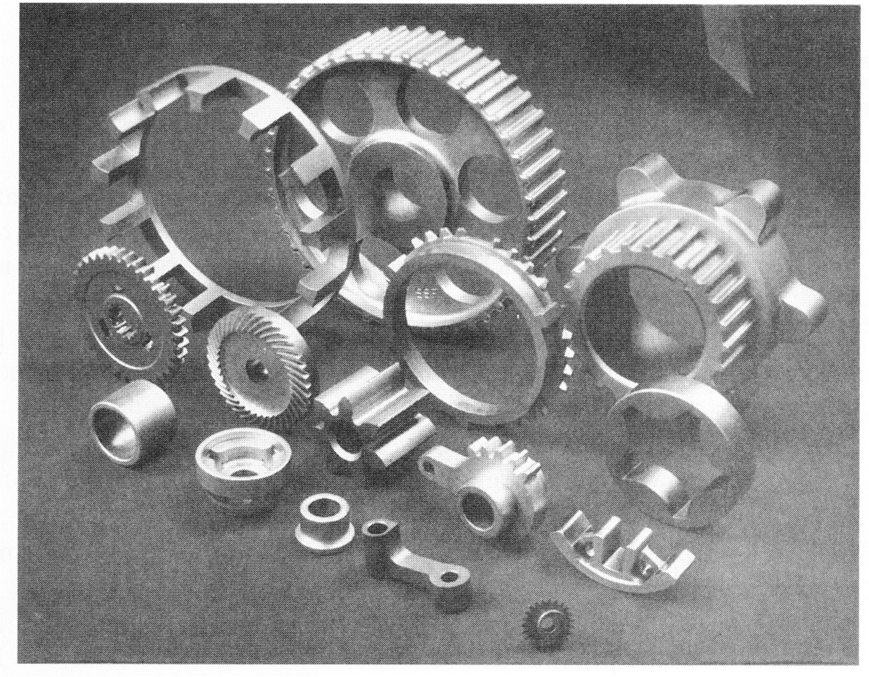
Particulate Processing

Slide 27
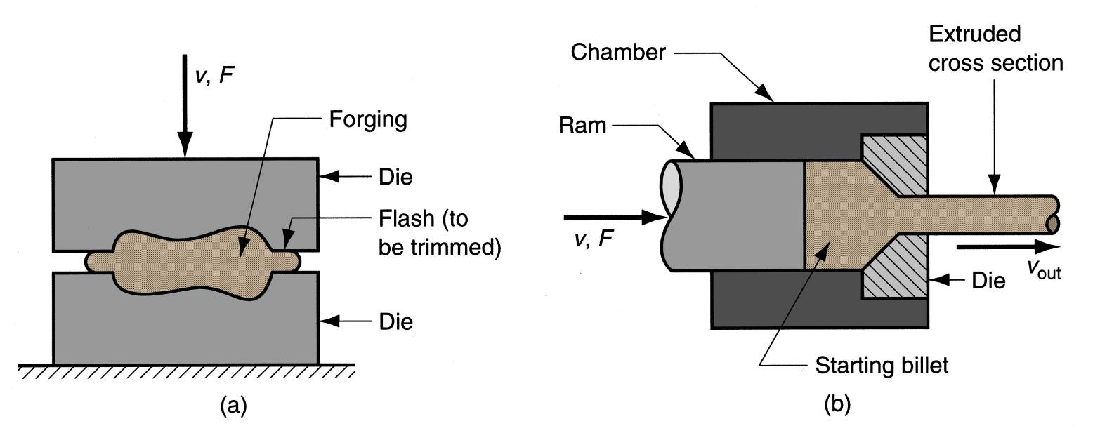
Deformation Processes
Starting workpart is shaped by application of forces that exceed the yield strength of the material
Examples: (a) forging, (b) extrusion

Slide 28
Deformation Processes

Slide 29
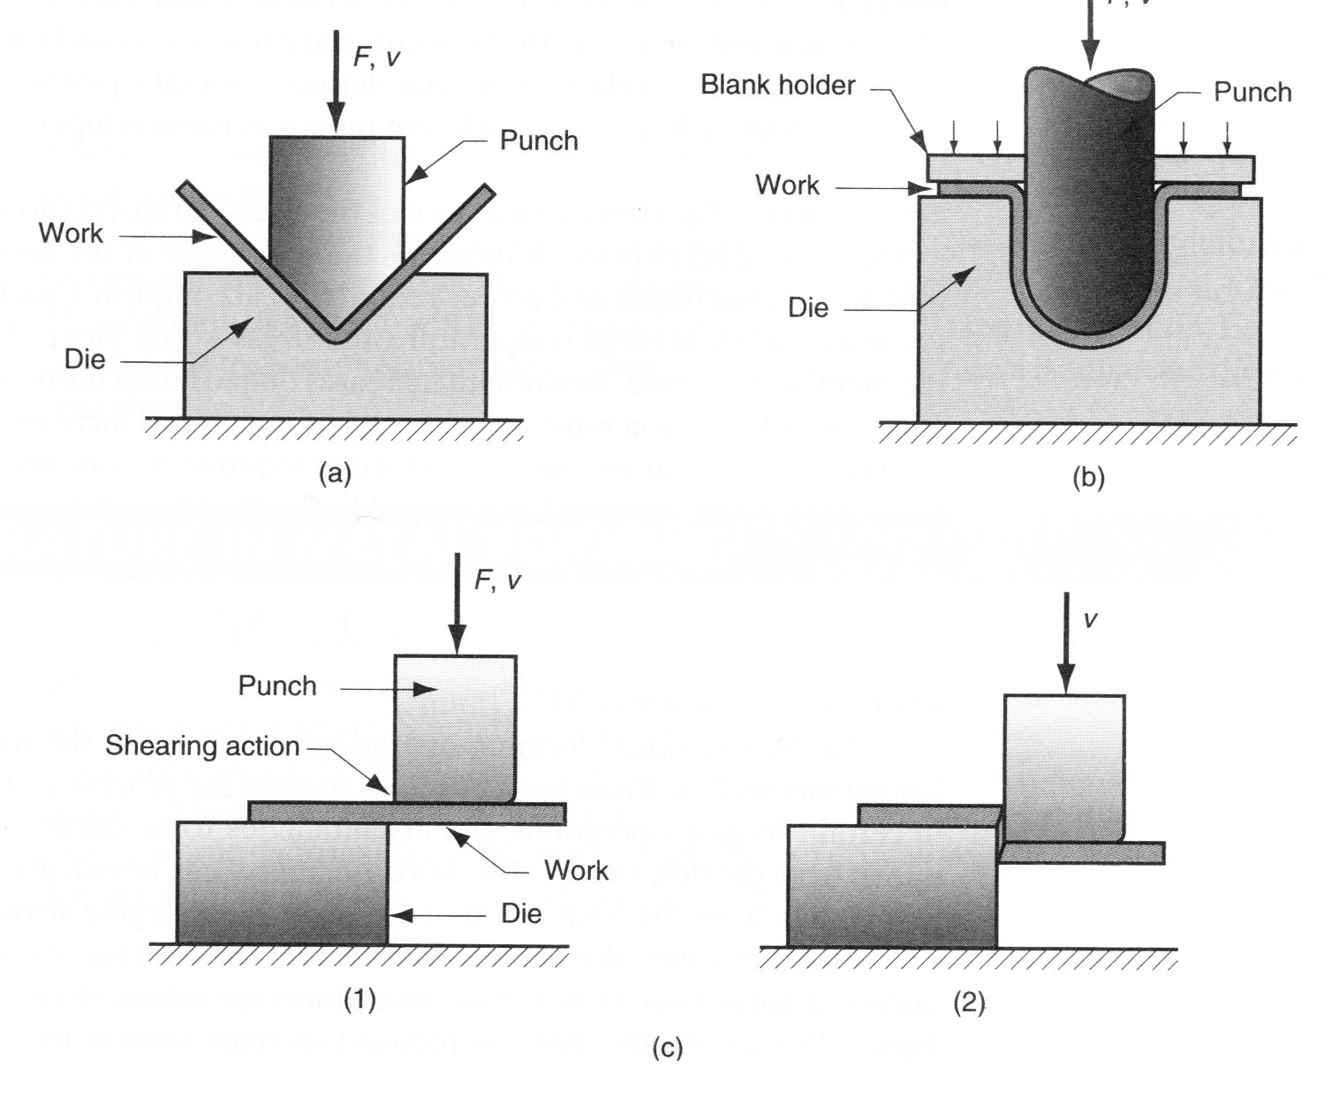
Deformation Processes
Sheet metal work is also a common deformation process

Slide 30
Deformation Processes

Slide 31
Assembly Operations
Two or more separate parts are assembled to form a product
Mechanical assembly fastens parts by mechanical methods
Threaded fasteners (screws, bolts and nuts); press fitting, expansion fits

Slide 32
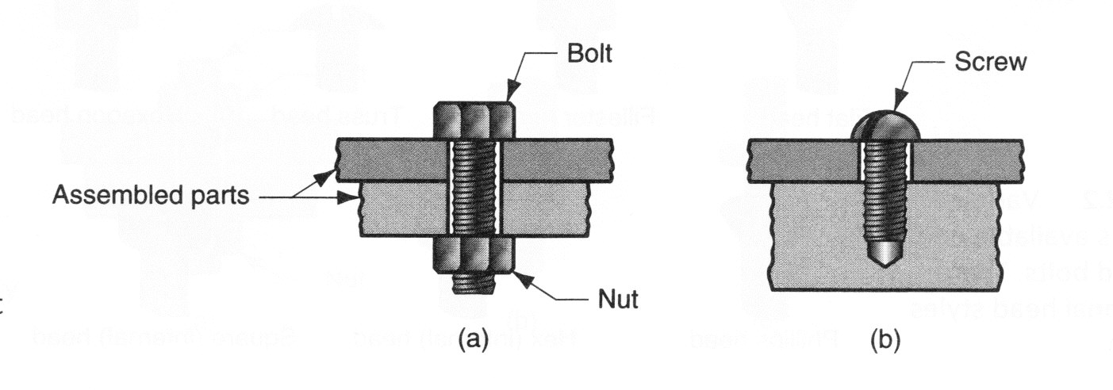
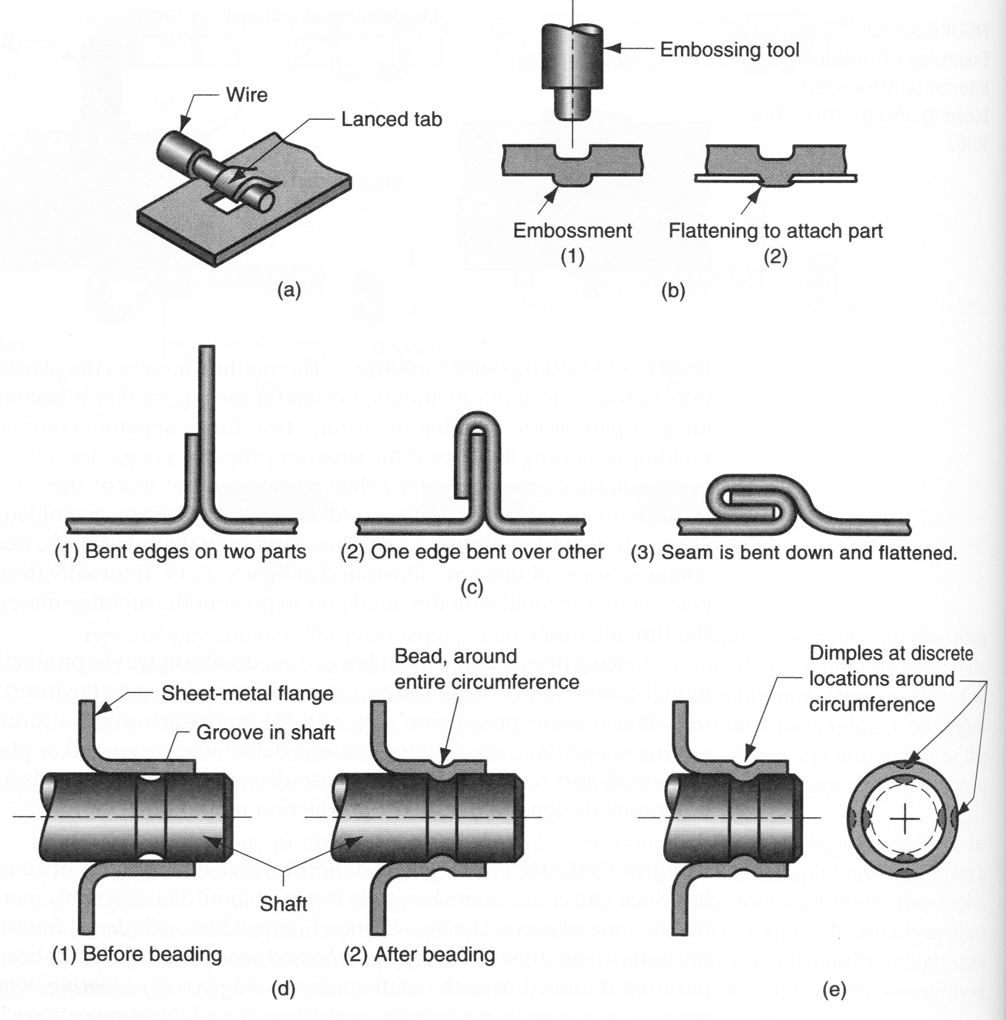
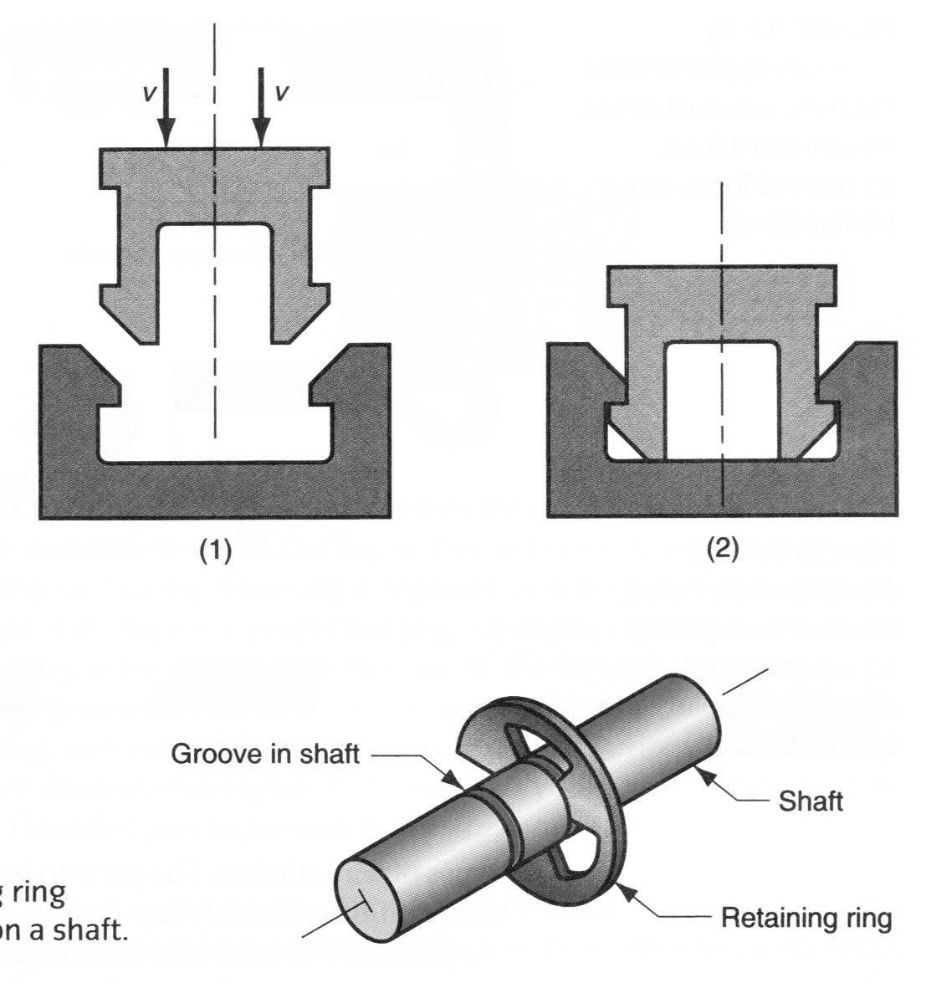
Assembly Operations

Slide 33
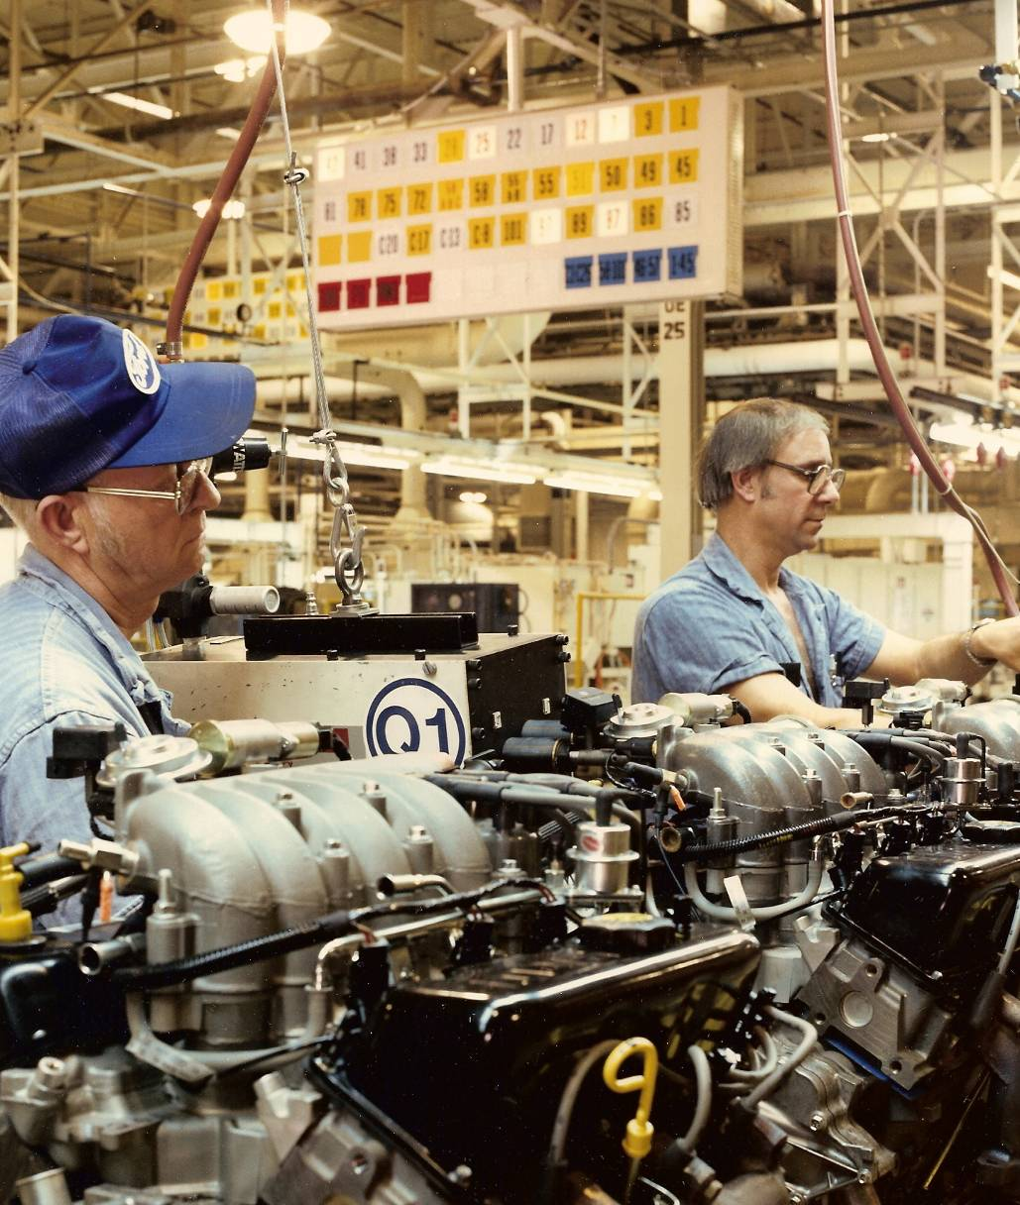
Assembly workers on an engine assembly line (photo courtesy of Ford Motor Company).
©2007 John Wiley & Sons, Inc. M P Groover, Fundamentals of Modern Manufacturing 3/e

Slide 34
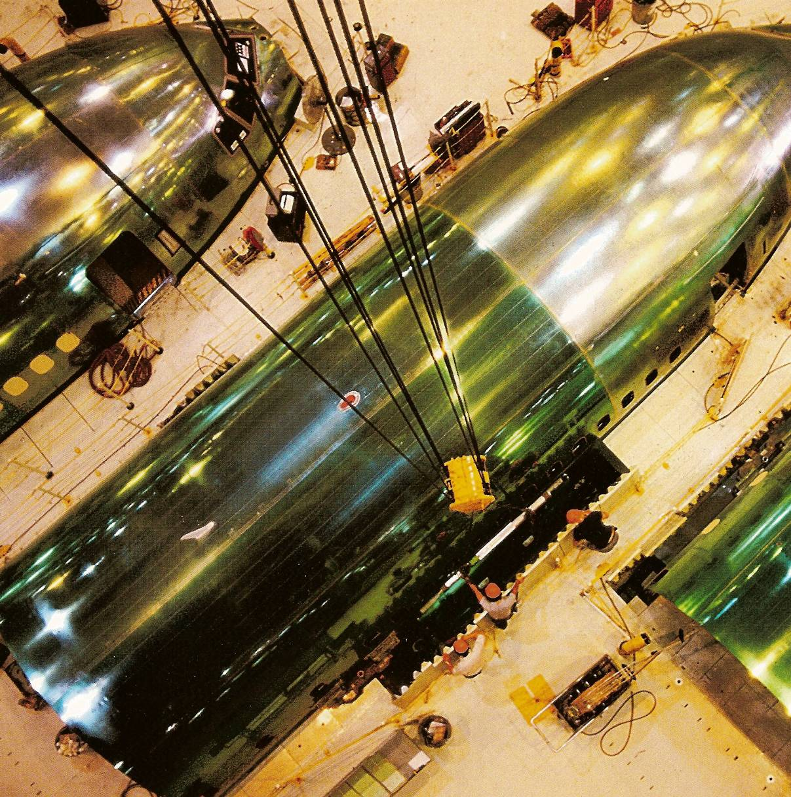
Assembly operations on the Boeing 777 (photo courtesy of Boeing Commercial Airplane Co.).
©2007 John Wiley & Sons, Inc. M P Groover, Fundamentals of Modern Manufacturing 3/e

Slide 35
Automated Mfg Systems
Automated machine tools that process parts
Transfer lines that perform a series of machining operations
Automated assembly
Mfg Systems that use robots to perform processing and assembly operations
Automated material handling and storage systems
Automated inspection systems

Slide 36
Advantages of Mfg Automation
Increase labor productivity
Reduce labor cost
Mitigate the effects of labor shortage
Reduce routine manual and clerical tasks
Improve worker safety
Improve product quality
Reduce manufacturing lead time
Improve manufacturing accuracy and tolerances
Enhance competitive edge

Slide 37
Automation

Slide 38
Automation Vs Production Volume

