Slide 1





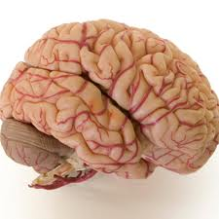
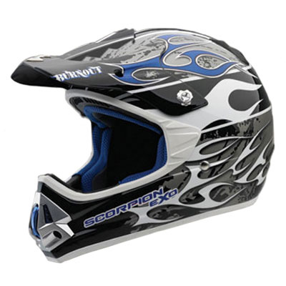

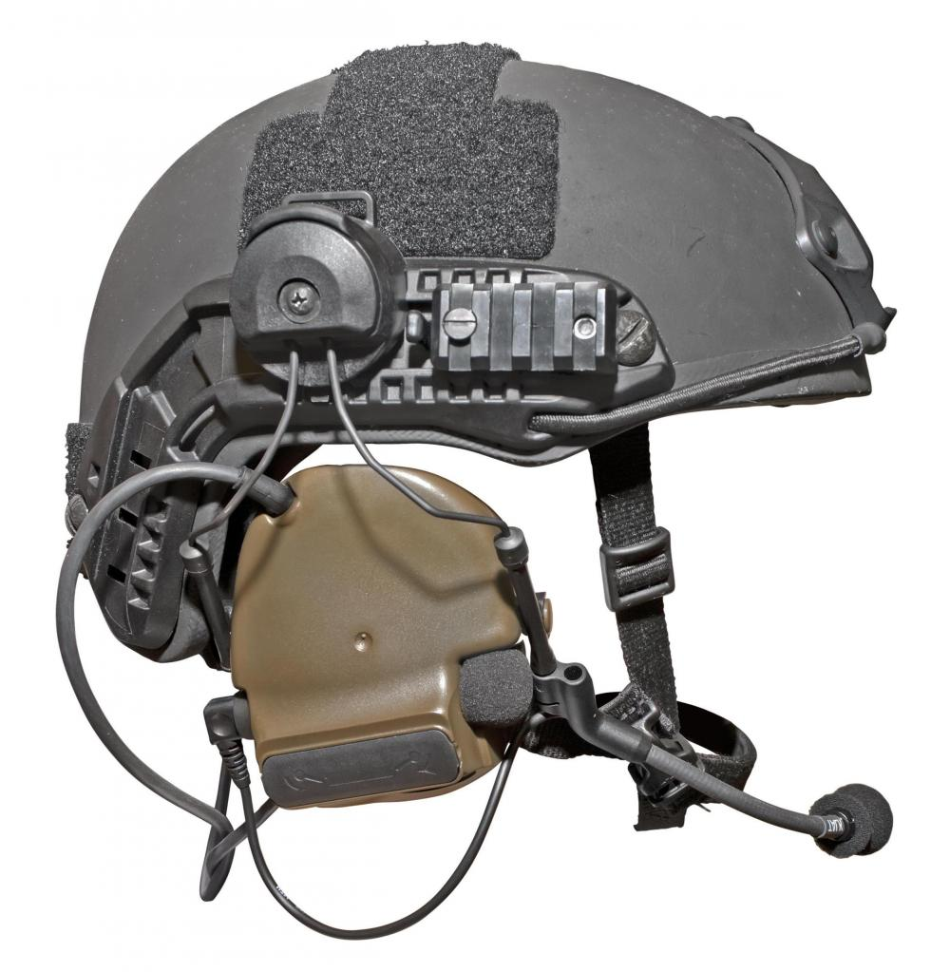


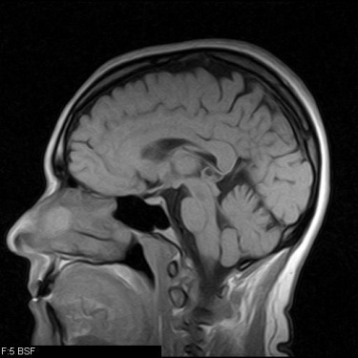

EDP and BIOLOGY: A Multi-disciplinary
Engineering Challenge
ROCCO CIERI, BIOLOGY TEACHER, MEDFORD HIGH SCHOOL
OBJECTIVES
Using the Engineering Design Process, students will carry out 2 EDP projects:
  Design a Gut.
  Design a multipurpose helmet.
ACTION PLAN & implementation schedule
Create the project plan outline and timelines. Provide rationale for incorporation into current unit designs.
  “Design a Gut” – to be implemented with The Chemistry of Life
  “Design a Multipurpose Helmet” – to be implemented with Independent Research Project Requirement
Present the Project Plan and Outline with Timelines to Administration for Approval to move forward with the plan.
Request SolidWorks Software
Request installation of SolidWorks on school hardware/equipment.
Work on student handouts & rubrics (Lesson Planning)
Engage with community partnerships
  Introduction to Brain (Nervous system) and Brain Injury with Boston University.
  Trip to US Army Labs Natick.
  Sample Helmet Investigations with Helmet Industry Manufacturers and design groups.
  Student Team Formation and Enlistment of Mentors (college students in mechanical and industrial engineering).
  Students Design and Conduct Market Surveys.
  Students undergo tutorials for 3-D Modeling Software.
  Students design, model, test using 3-D Software.
  Students redesign, if necessary.
  Students construct prototype. Enlist prototype building at University or Corporate Sponsor sites.
  Students Present their Solutions to an Industry, Community, and University Partners Evaluation Team.
  Wrap up and report out.
STUDENT deliverables
Background Research Paper
  Short Essay for Project 1
  Multipage Paper for Project 2
2) Team Collaboration Reflections
3) Market Survey questionnaire and results(*only project 2)
3) Sketches and Team designs
4) Model and/or Prototype(s)
5) Testing Results
6) Redesign
7) “Communicate your Solution”
Poster and Oral Presentations
Project definition
Biology and Engineering will be connected through a multidisciplinary, hands-on unit-embedded project. Students will be introduced to the Engineering Design Process in the first unit of the year, The Chemistry of Life. As they learn about Organic Molecules and Enzymes, students will carry out an engineering-based learning project where they will “design a gut”.
Then, students will engage in a multi-disciplinary, team-based engineering challenge where they will design a multi-purpose helmet. Students will be introduced to the project, they will experience a field trip, guest speakers, and learn to use new tools for the design and construction of a prototype. Then, they will finalize their solution and present it to a panel of judges.
Performance monitoring
PROJECT SPECIFIC:
Team collaboration rubric
Evidence of the EDP: Background Research, Brainstorming, Market Survey design/results, prototype or model, testing, redesign, communicate solution
Poster
Oral Presentation
Capsule SPECIFIC:
Student Surveys
Video
Implementation Reports for Callbacks
Teacher deliverables
Lesson Plans
Student Worksheets (Handouts)
Rubrics and Project Timelines
Material Lists (activity boxes)
In-project student monitoring, Feedback, and Oversight

