Slide 1
Performance Metrics of Manual Assembly Line
Sagar Kamarthi
Associate Professor Dept. of Mechanical and Industrial Engineering
Northeastern University, Boston

Slide 2
Objectives
Cycle time (T_{c})
Production rate (R_{p})
Uptime efficiency (E)
Manufacturing lead time (MLT)
Work in process (WIP)
Per piece manufacturing cost (C_{p})

Slide 3
Manual Assembly Line

Slide 4
Products Made on Manual Assembly Lines
Audio equipment | Microwave ovens
Automobiles | Personal computers &peripherals (printers, monitors, etc)
Cameras | Power tools (drills, saws, etc)
Cooking ranges | Pumps
Dishwashers | Refrigerators
Dryers (laundry) | Stoves
DVD Players | Telephones
Electric motors | Toasters and ovens
Furniture | Trucks, light and heavy
Lamps | Video game consoles
Luggage | Washing machine (laundry)

Slide 5
Typical Operations Performed on Manual Assembly Lines
Application of adhesive | Printed circuit board assembly
Application of sealant | Riveting and eyelet applications
Arc welding | Shrink fitting applications
Brazing | Snap fitting of two parts
Cotter pin application | Soldering
Crimping | Spotwelding
Expansion fitting applications | Stapling
Insertion of components | Stitching
Press fitting | Threaded fastener applications

Slide 6
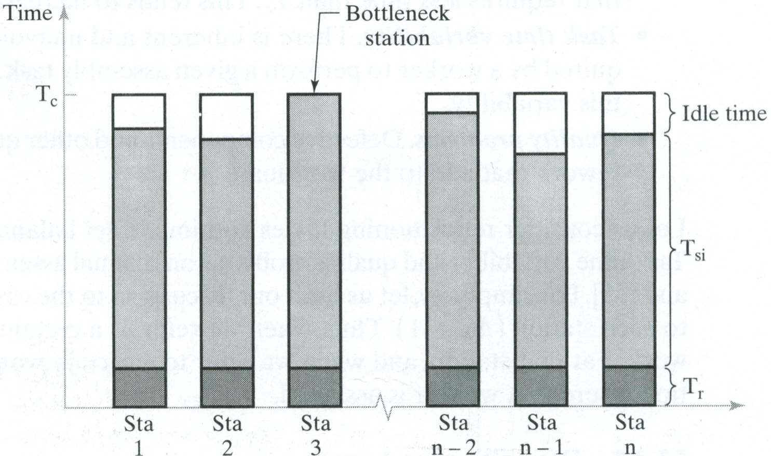
Service Time(T_{si}) and Cycle Time (T_{c})

Slide 7
Work Elements in Clock
Work Element | Work Element Description | T_{ek} (Min)
1 | Assemble motor
2 | Assemble stand
3 | Assemble spacer
4 | Assemble face
5 | Assemble washer
6 | Assemble nut
7 | Attach decorative squares
8 | Attach hour and minute hands
9 | Wind clock to noon
10 | Attach decorative plastic strips
11 | Insert battery into the motor case
12 | Inspect the clock by listening to clicks

Slide 8
Manual Assembly Line for the Clock
Station 1
Station 2
Station 3
Station 4
Base
Part
Finished Product
Elements 1, 2, 3, 4, 5, 6
Elements 7
Elements 8, 9, 10
Elements 11, 12
T_{s1} =
T_{s2} =
T_{s3} =
T_{s4} =

Slide 9
Production Run
Position participant at each workstation
The operator at station 1 introduces the work unit into the system
All work units introduced at station 1 into the system are considered WIP
A work unit may only be passed on to the next workstation when that operator is not currently performing operations on the work unit
The operator at station 4 may put his/her work unit in the finished good storage upon completion
If the system-time keeper calls a workstation breakdown, the specified station stays dysfunctional for 2 minutes, before resuming the operation
The system-timekeeper takes measure of work unit movement time and counts WIP. The workstation-timekeepers take measurements of processing time and transfer time (Date recording sheets are provided)
Repeat steps 4-5 until all material is processed

Slide 10
Question to Answer
Compute cycle time (T_{c})
Compute production rate (R_{p})
Compute uptime efficiency (E)
Compute manufacturing lead time (MLT)
Compute work in process (WIP)
Compute per piece manufacturing cost (C_{p})

Slide 11
Notation of Variables
FC = Annual cost ($/year)
H_{s} = Hours per shift
n = Number of workstations
Q = Annual quantity or work units produced (pieces/year)
F = Downtime frequency (line stops/cycle)
S_{w} = Shifts per week
T_{d} = Average downtime per line stop (min/line stop)
T_{ob} = Total period observation (hr)
T_{p} = Average production time per work unit (min/piece)
T_{r} = Transfer time to move part from one workstation to the next (min)
T_{si} = Service/processing time at workstation i (min/cycle)
VC = variable cost ($/piece)
W_{a} = working weeks per year

Slide 12
Cycle Time

Slide 13
Production Time

Slide 14
Production Rate

Slide 15
Uptime Efficiency

Slide 16
Manufacturing Lead Time (MLT)

Slide 17
Per Piece Manufacturing Cost

