Slide 1





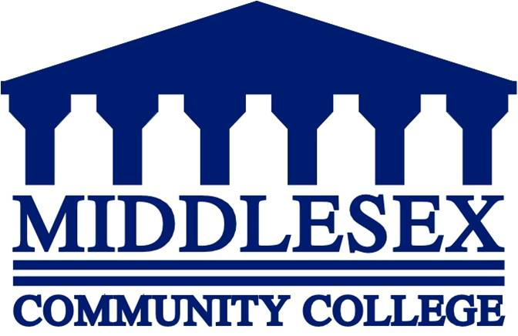
Preventing Combined Sewer Overflow from Entering the Merrimack River
Lauren Thistle &
Bridget Burgermeister

Slide 2
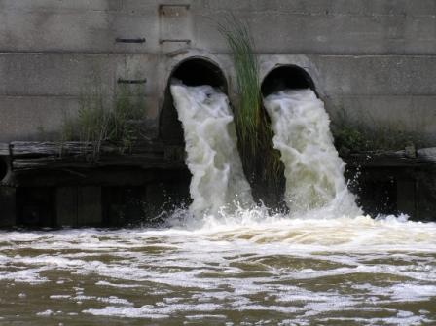
CSO

Slide 3
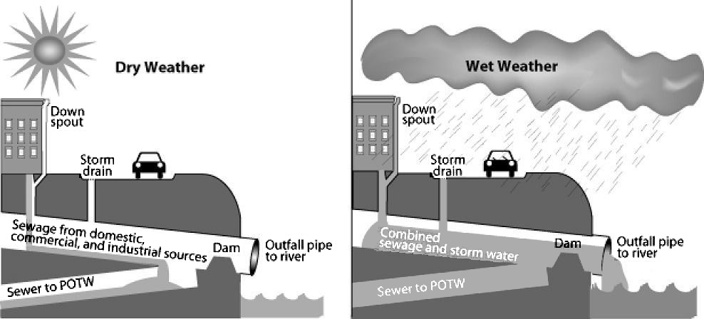
What is a CSO?

Slide 4
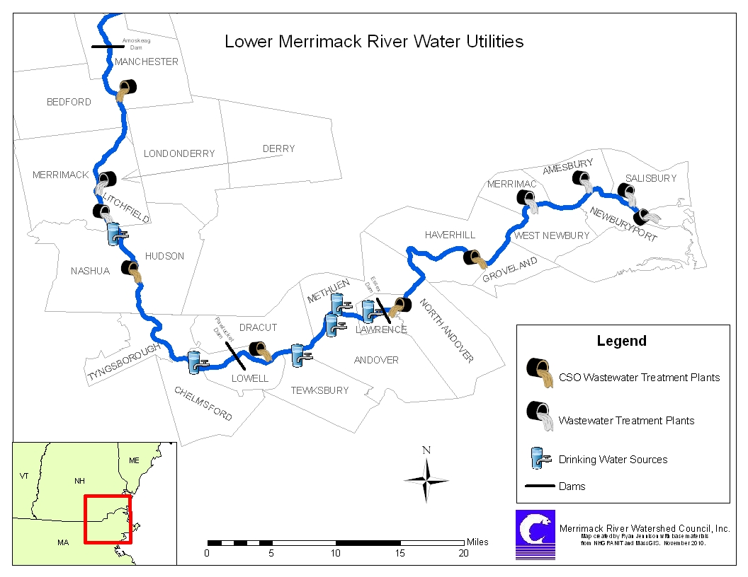
How Do CSOs Impact Humans?

Slide 5
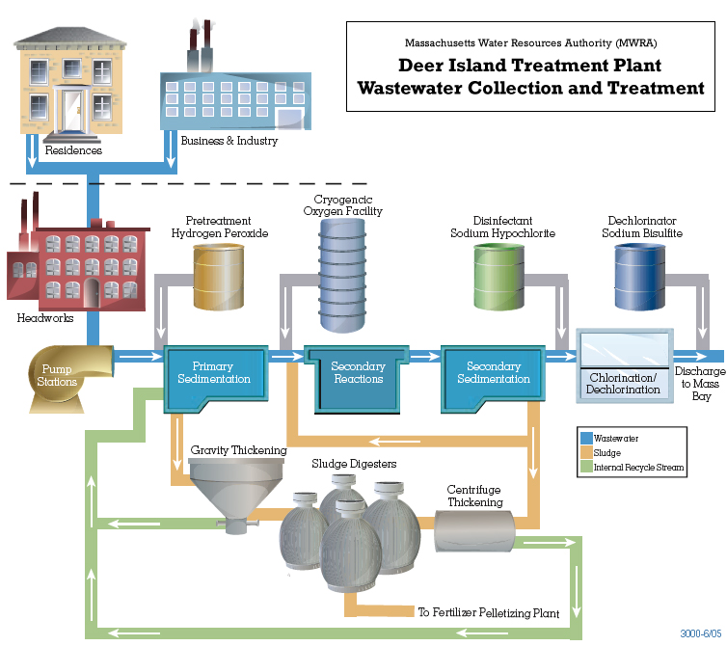
Wastewater Treatment Plant

Slide 6
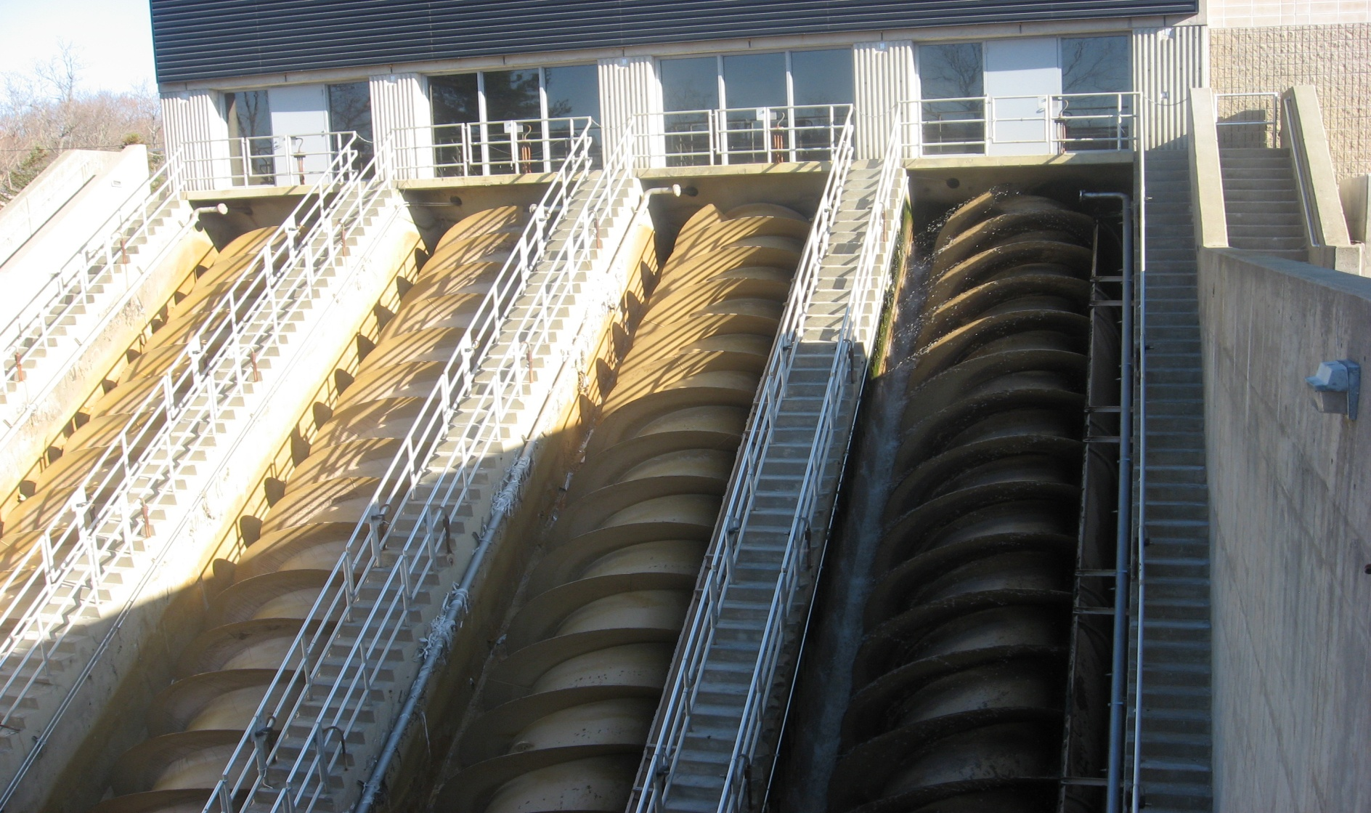
Bar Screens

Slide 7
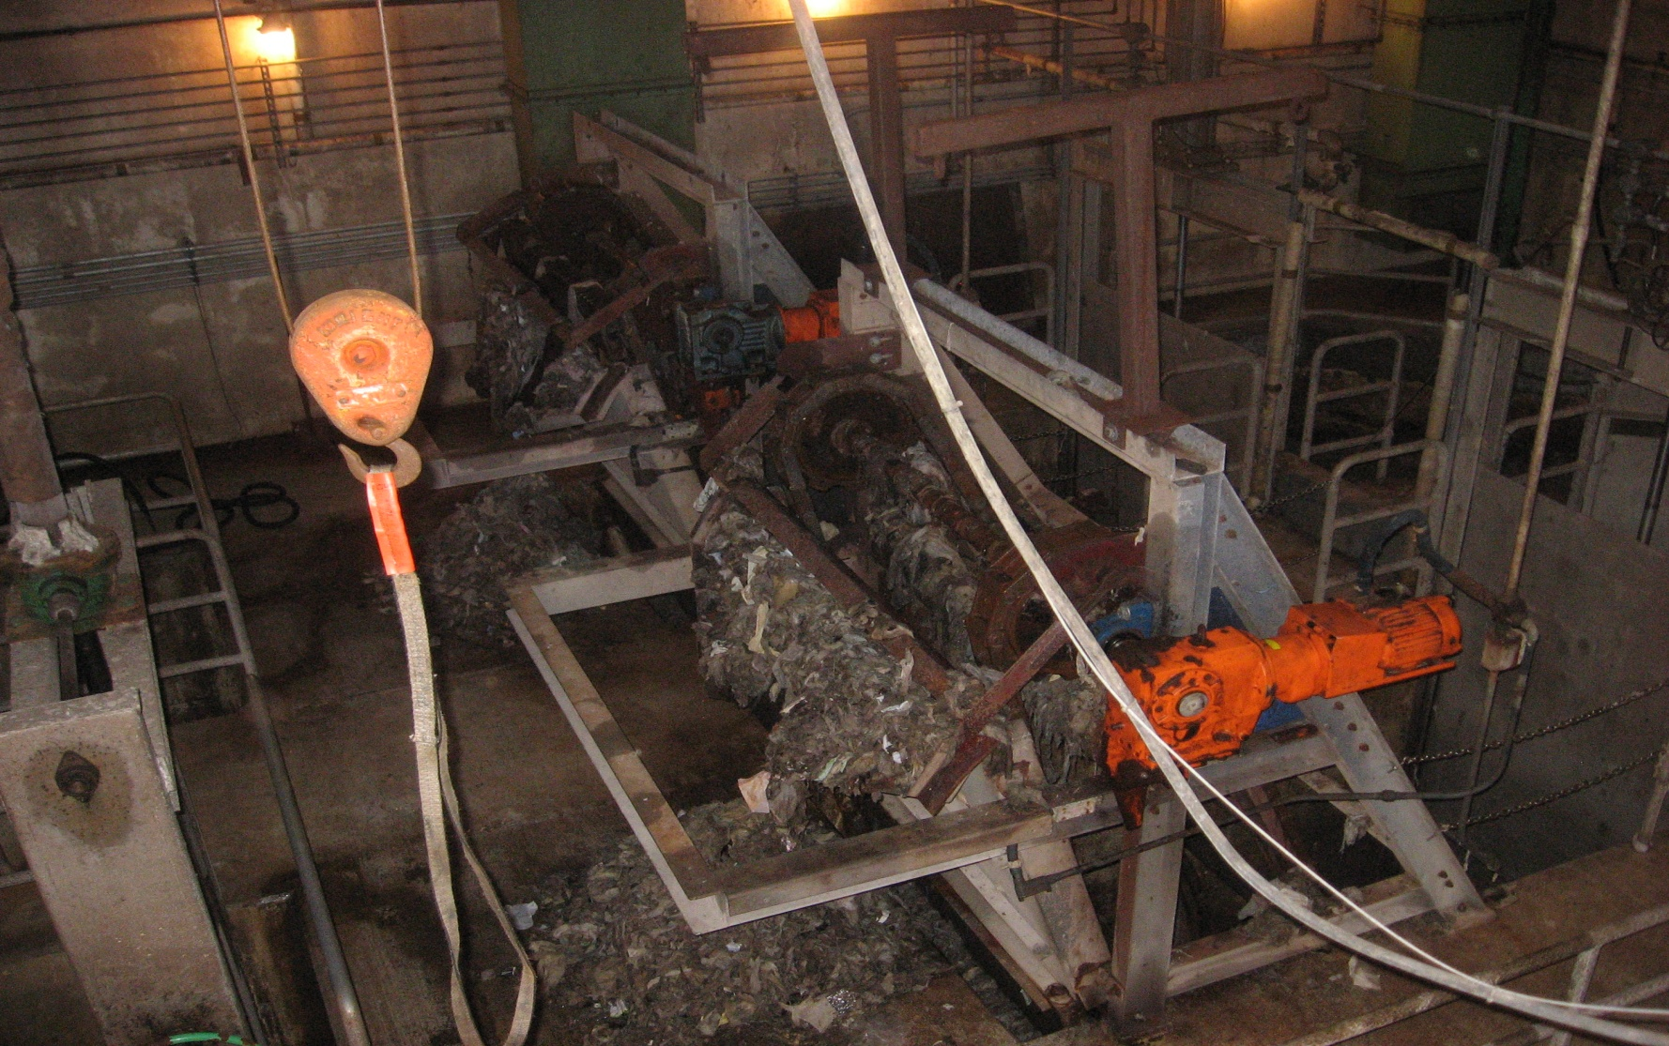
Sludge Removal

Slide 8
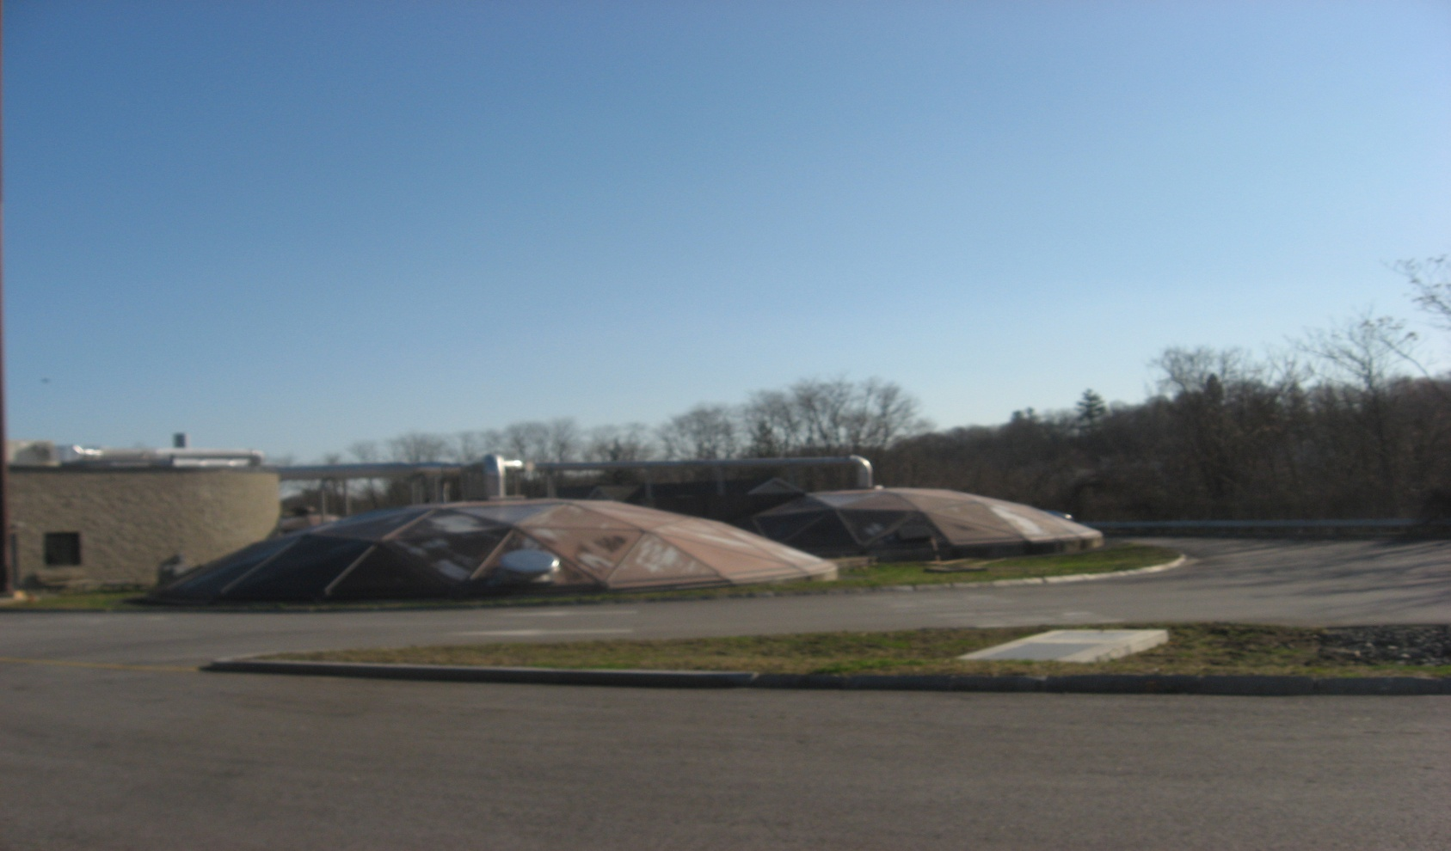
Sludge – Gravity Thickening

Slide 9
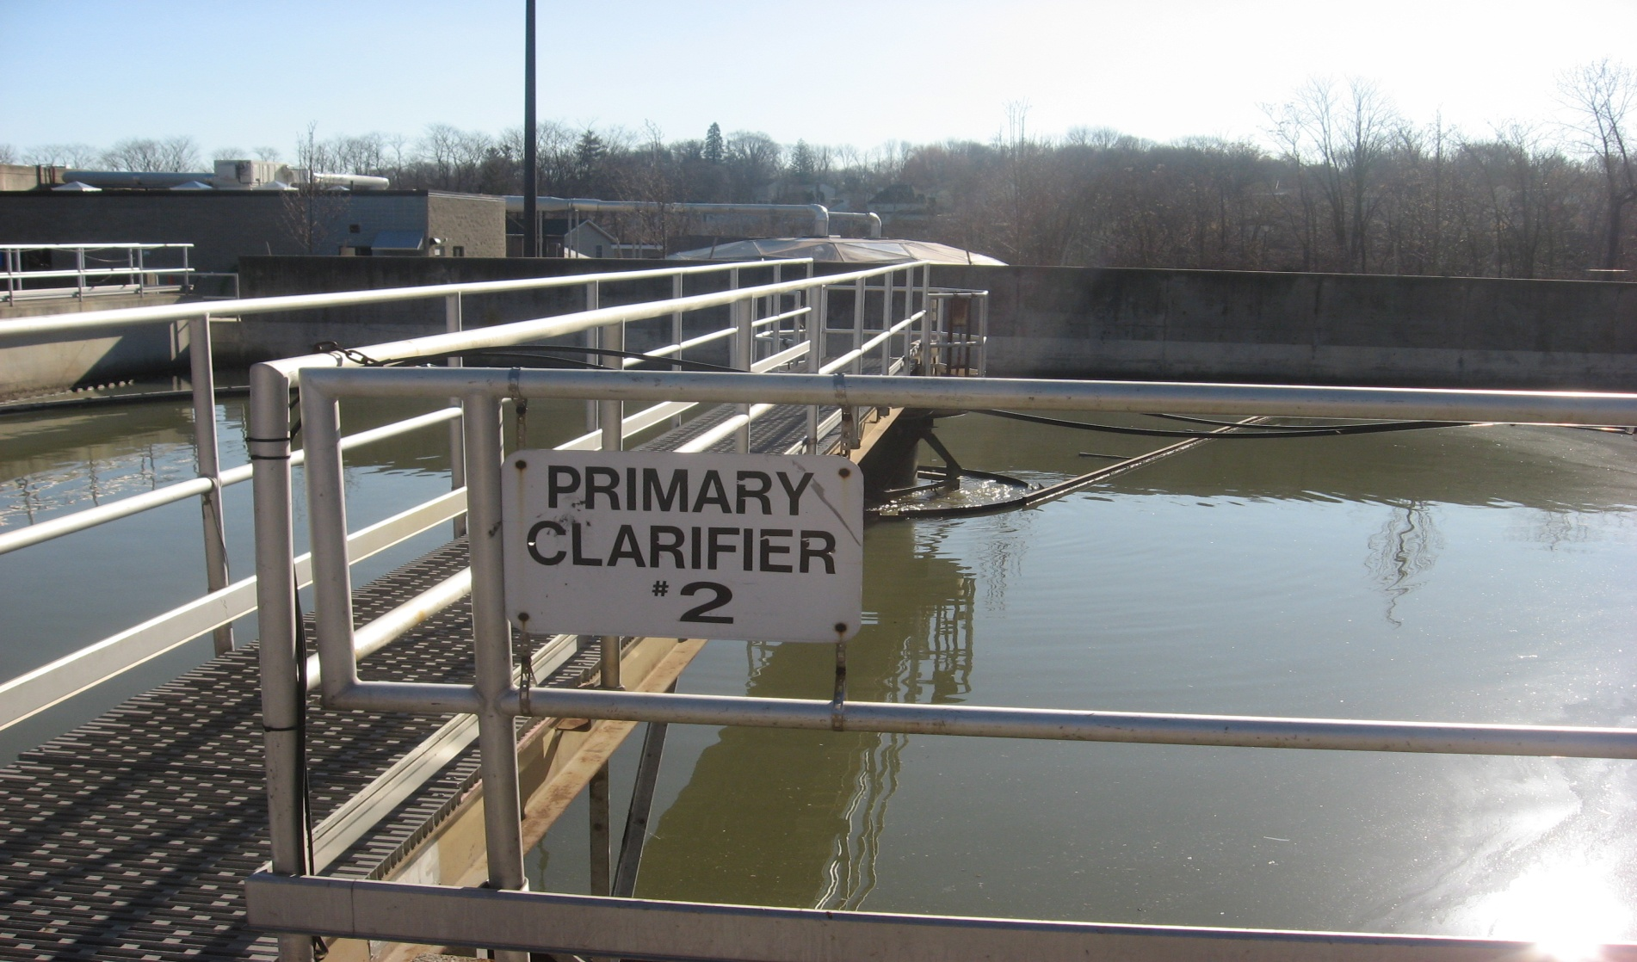
Primary Clarifiers

Slide 10
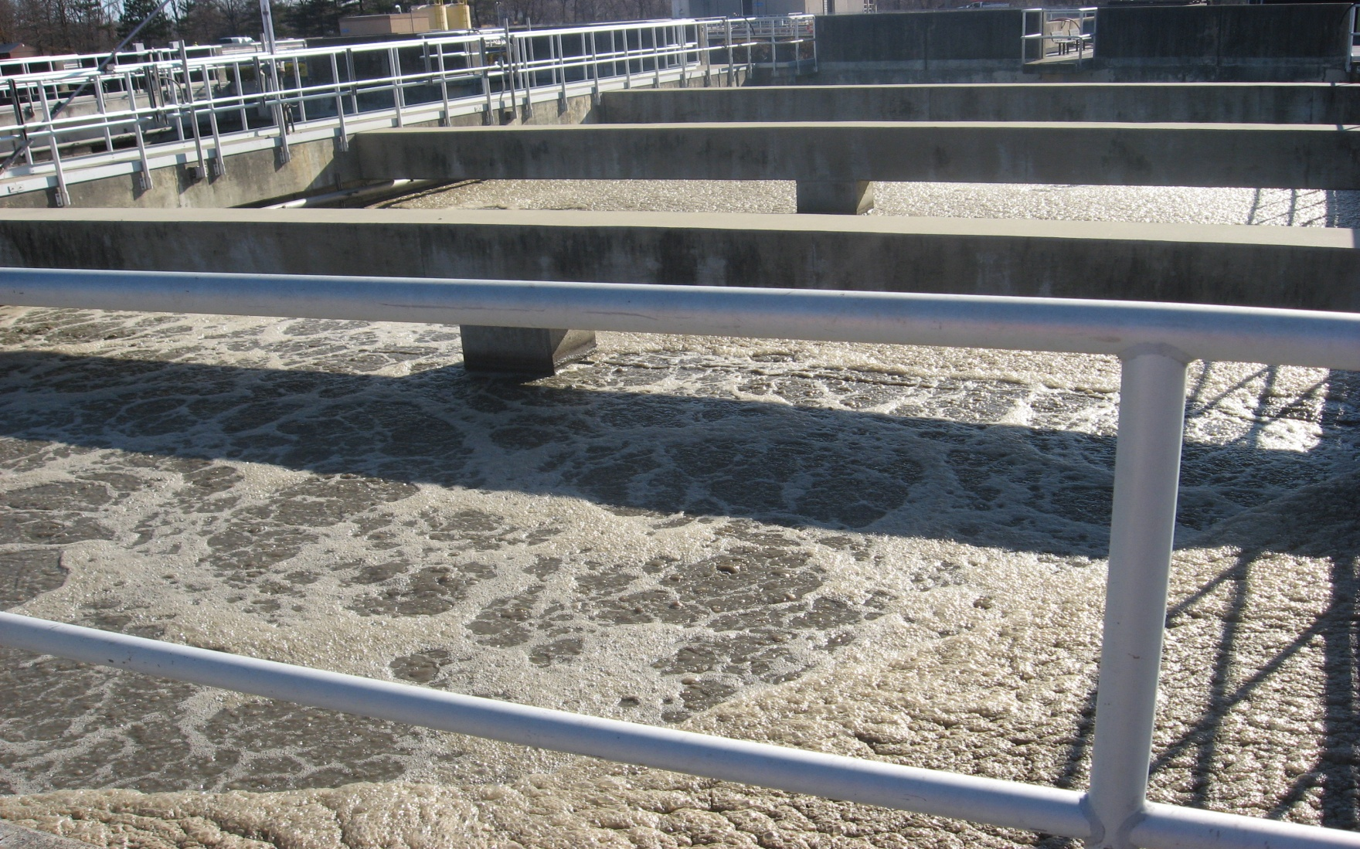
Aeration Tanks

Slide 11
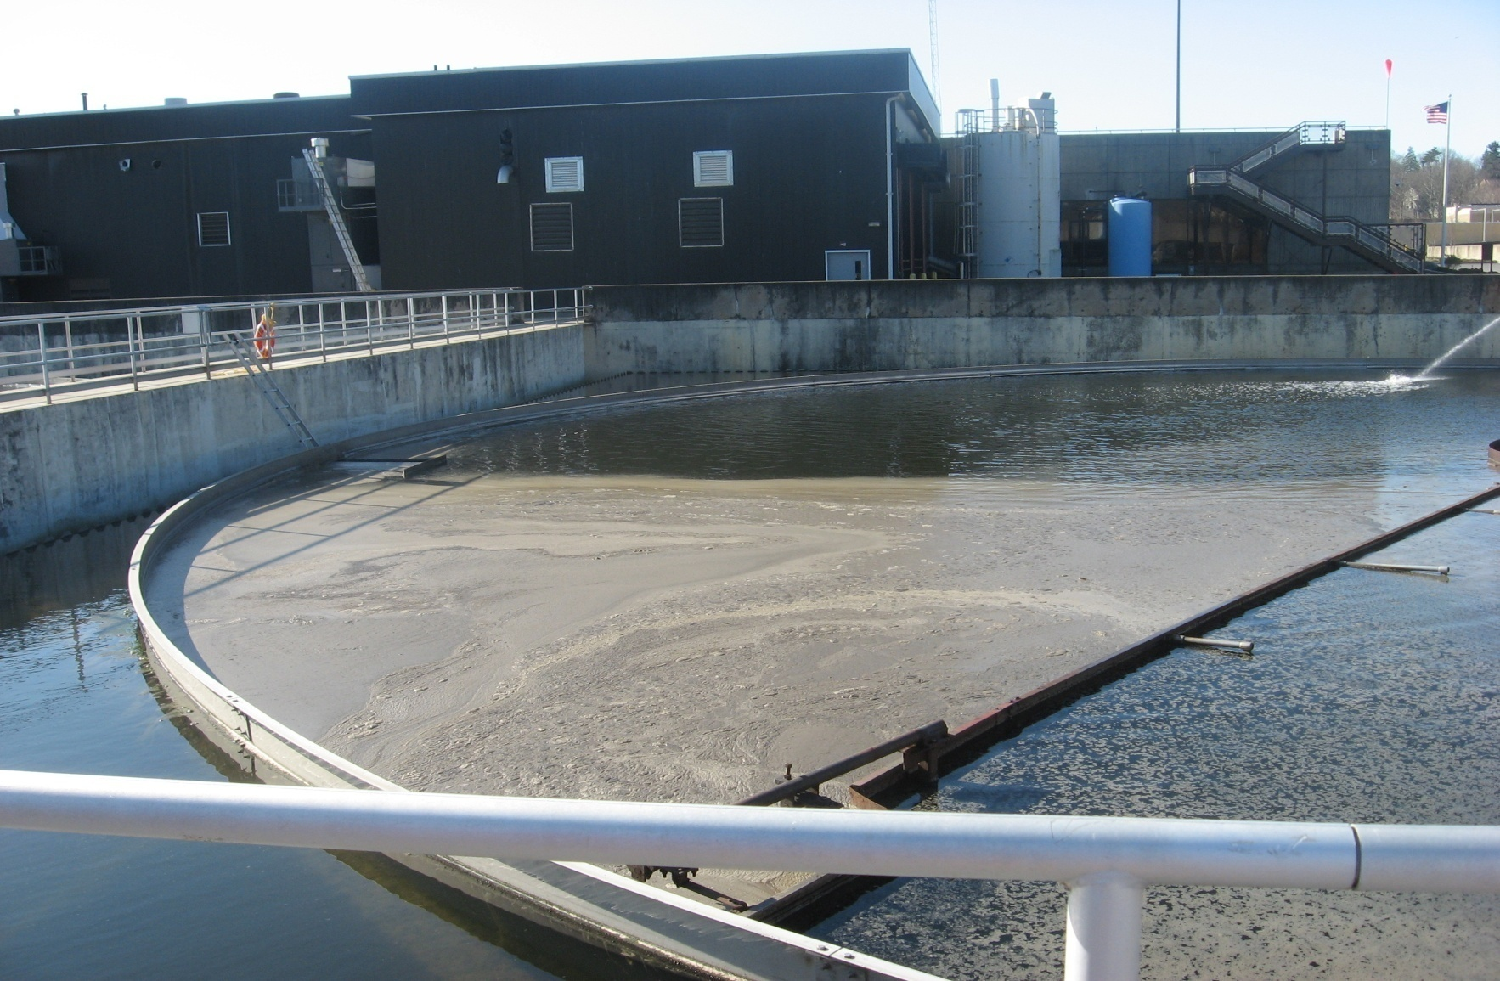
Secondary Clarifiers

Slide 12
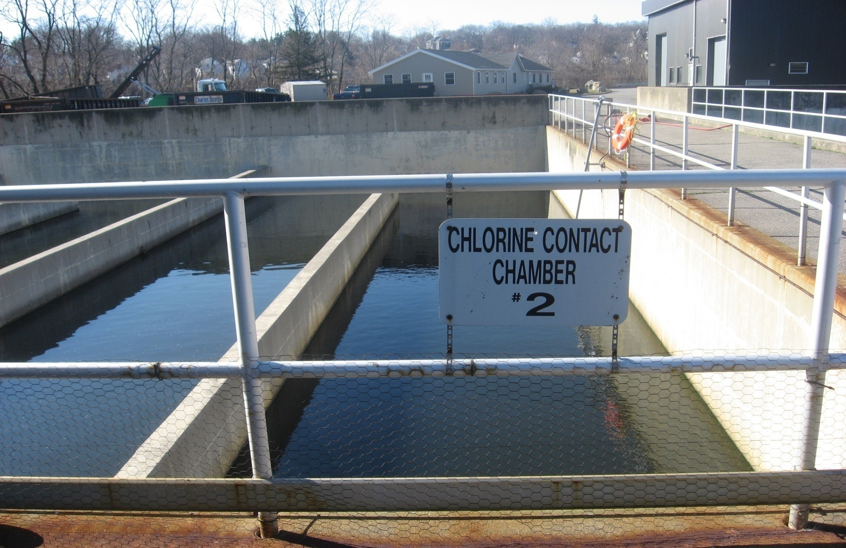
Chlorination

Slide 13
Developments to Eliminate CSOs
Why…
Clean Air Act
Administrative Order

Slide 14
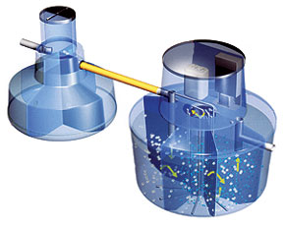
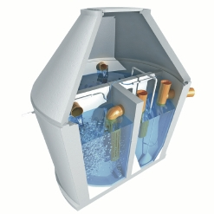
Mini Treatment Plants

Slide 15
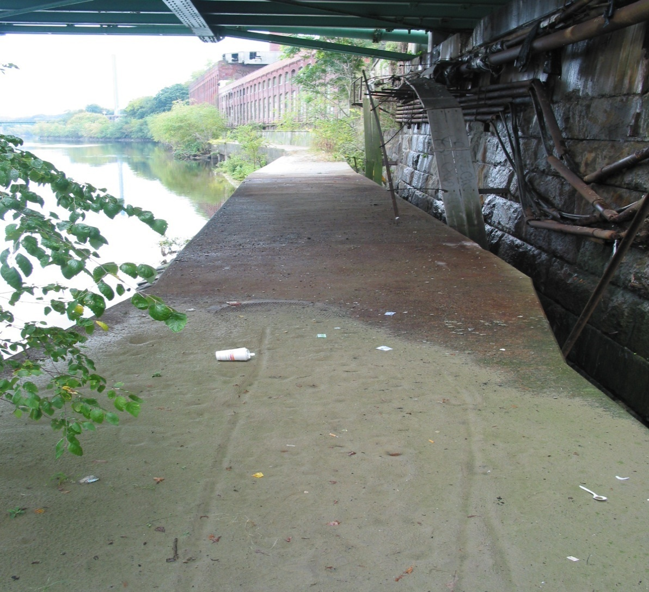
Lowell Riverwalk

Slide 16
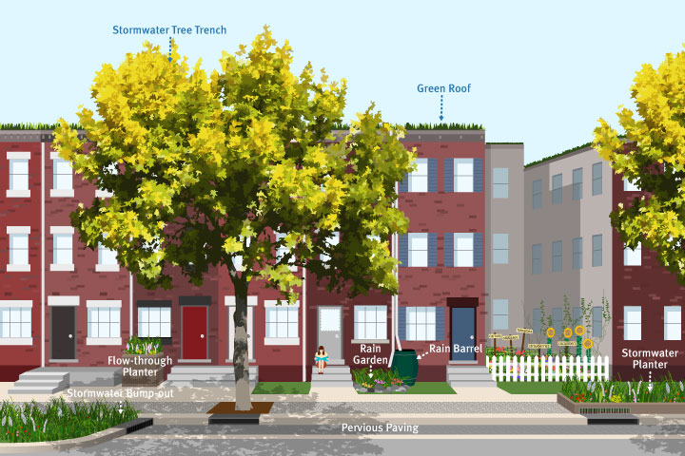
Green Stormwater Infrastructure (GSI)

Slide 17
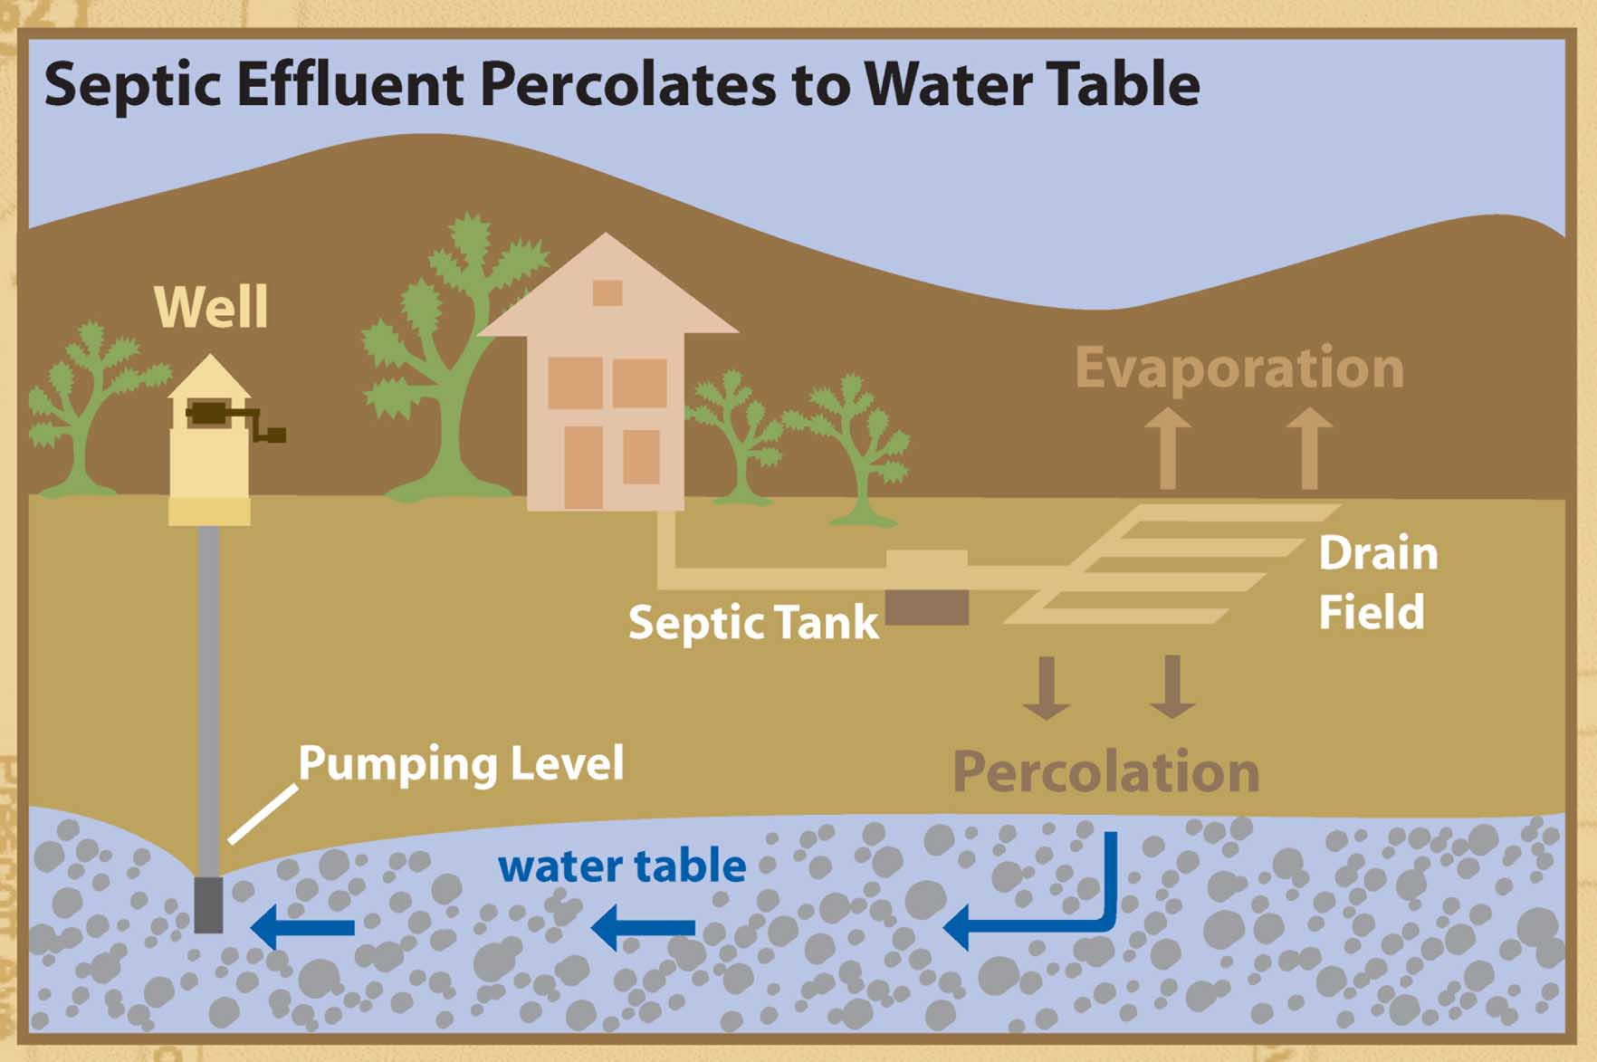
Septic System

Slide 18
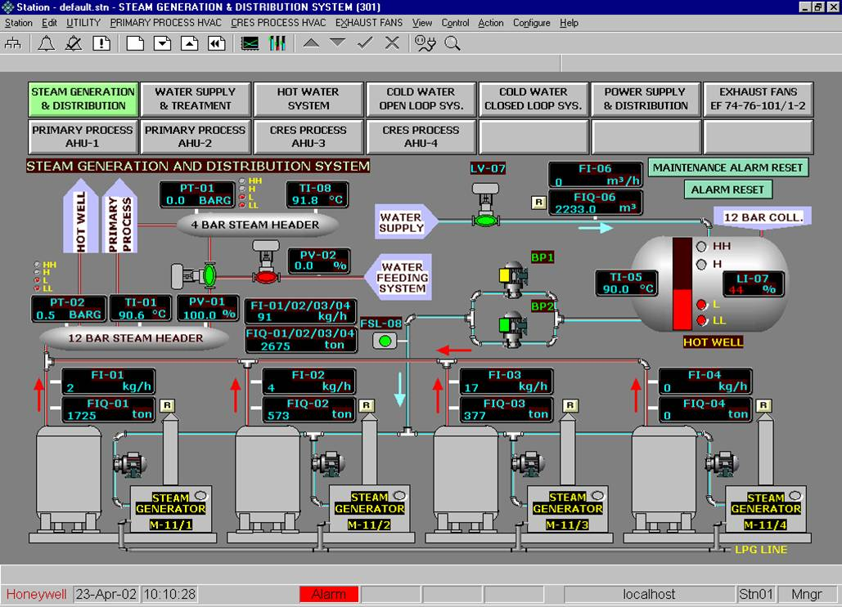
SCADA

