Slide 1
Space Telescope Engineering Project
Leslie Garrison
West Boylston High School
1/25/2013

Slide 2
Context
Astronomy class
26 students
11th and 12th grade
Heterogeneous – honors level through special education students
Limited technology – computers not capable of SolidWorks
Worked in groups of 1 to 3 students

Slide 3
Project Objective
Design a space telescope to study a specific type of object in space
Student selected object as goal
Examples:
Black holes
Exoplanets
Newly forming stars
Supernova explosions

Slide 4
Background Technical Information
Curriculum provided students with much of this:
Electromagnetic radiation and causes of emissions at specific wavelengths
Instrumentation used by astronomers: imagers, spectrometers, and others
Telescope design features
Orbit characteristics and types of rockets used to launch satellites

Slide 5
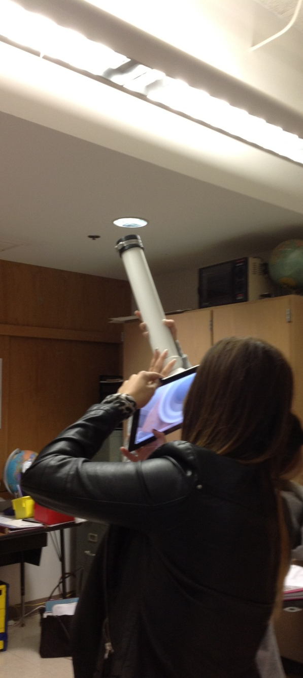
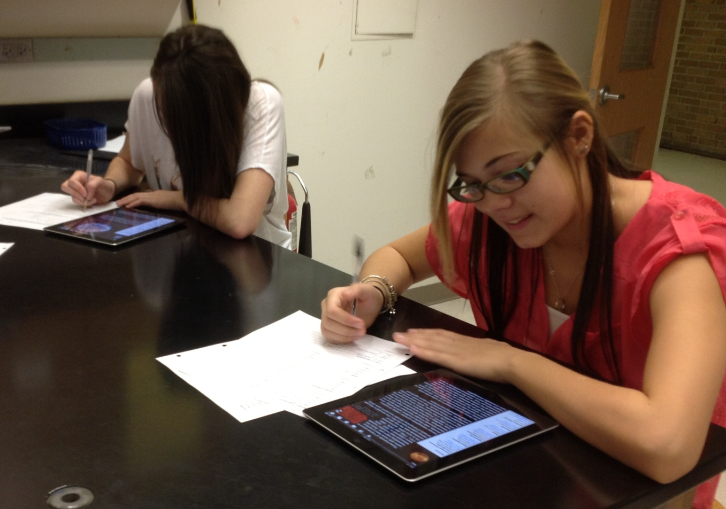
iPad Pilot Program
Best technology resource

Slide 6
Physical Design Product: 3D Sketch
Google/Trimble Sketch-Up free software
Student designs ranged from elaborate to simple
All had feasibility issues

Slide 7
Rest of Design Product
Specific instrumentation and wavelength range
Source of power
Rocket used for launch, selected from NASA’s existing capabilities
Orbit altitude, shape, and speed

Slide 8
Design Product - Challenges
Students were required to provide reasoning for all of their choices
Easiest when they could compare to an existing telescope
More challenging to explain:
Components of physical design
Instrumentation and wavelength
Emphasis on “why”, not “right” or “wrong” choices

Slide 9
Testing the Design
Students were given data at their specific wavelengths to evaluate
Utilized data from NASA educational game “Build It Yourself: Satellite”
Key question: How well did it meet your objective?
Data from
IR Imager and Spectrometer

Slide 10
Redesign
All groups needed to identify two potential problems with their design and recommend future work
Hard to avoid easy-to-fix issues
Asked “Why can’t you change that now?”

Slide 11
Final Product
Powerpoint and oral presentation

Slide 12
Project Notebook
Used each day working on project in class
Title
Day’s objective with step(s) of EDP
Notes and other record of work
Brief summary including work remaining on objective
Signature and date
Graded weekly

Slide 13
Key Learnings
Weave project steps into regular curriculum
Frequent monitoring and feedback on student progress
Project notebooks (weekly)
Draft slides turned in for most sections
Time-consuming to do well

