Slide 1




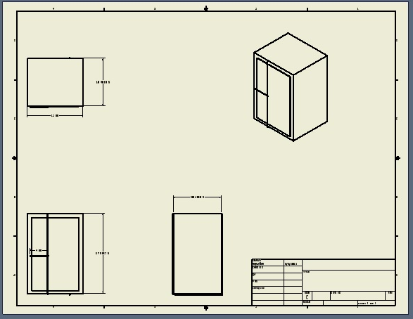
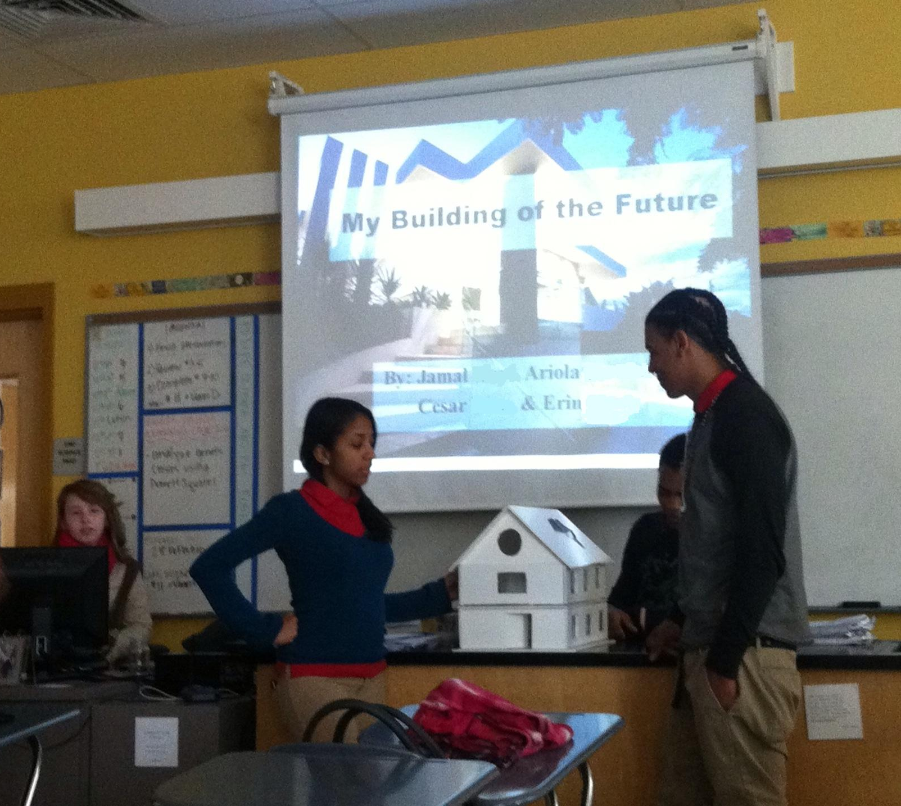
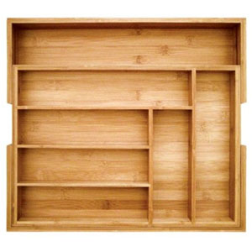
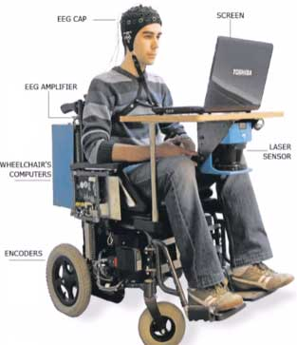
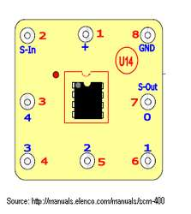
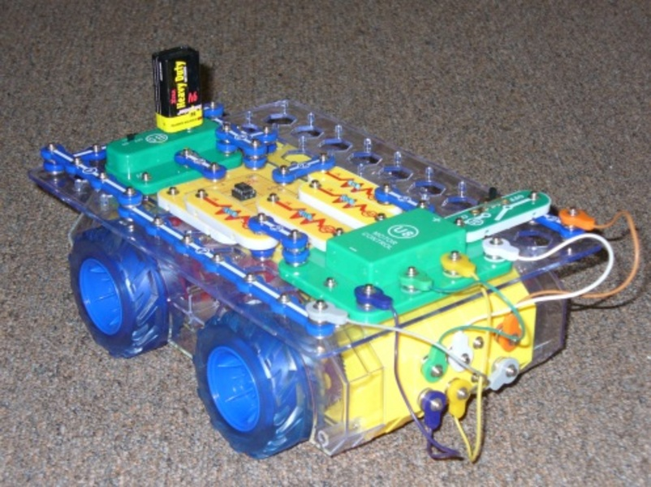
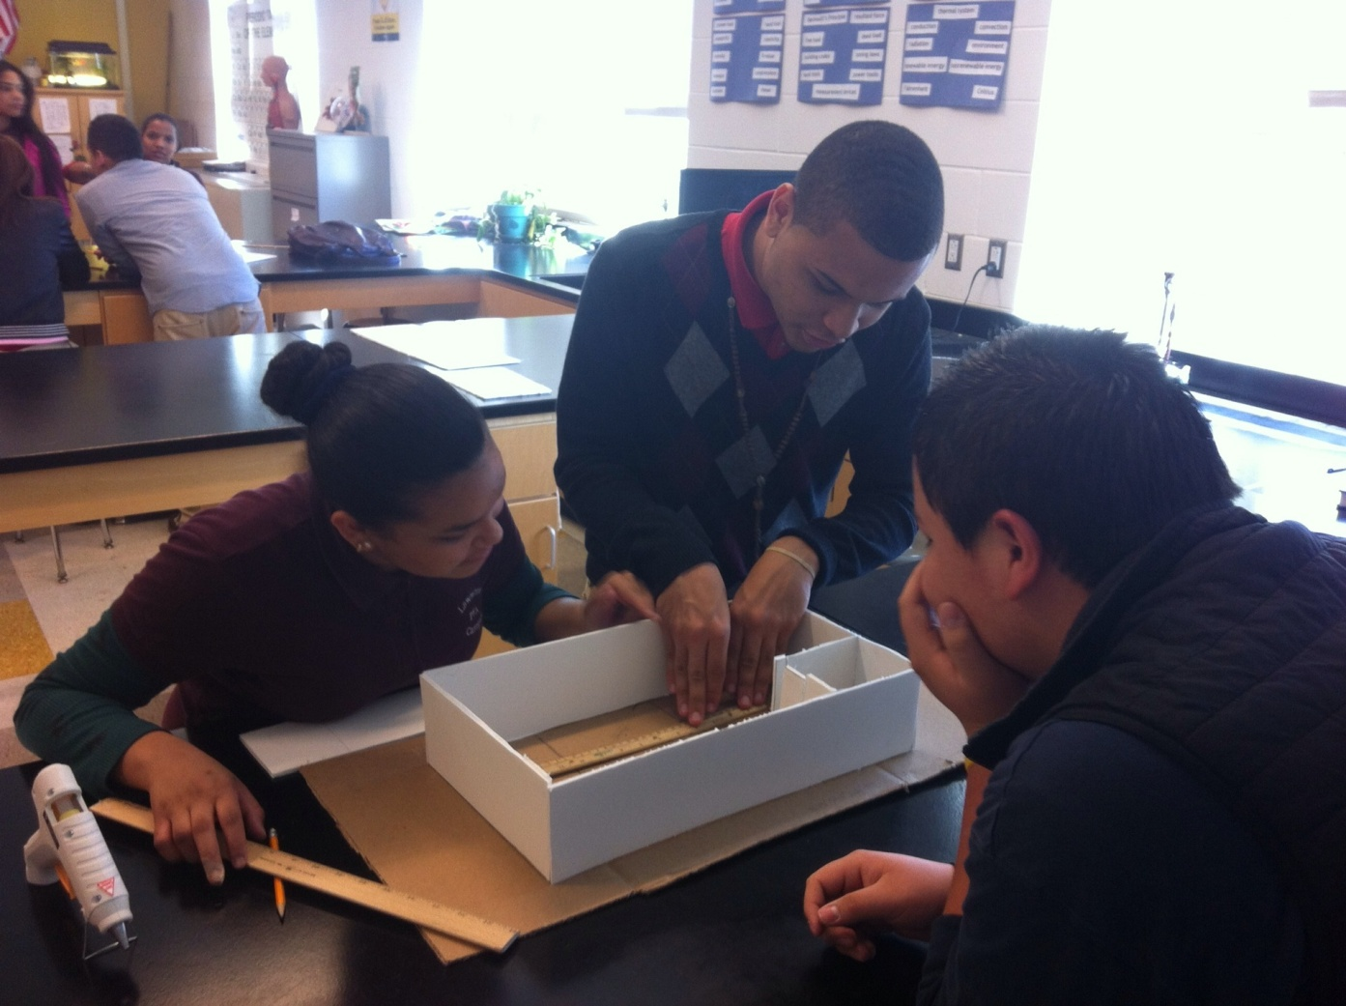
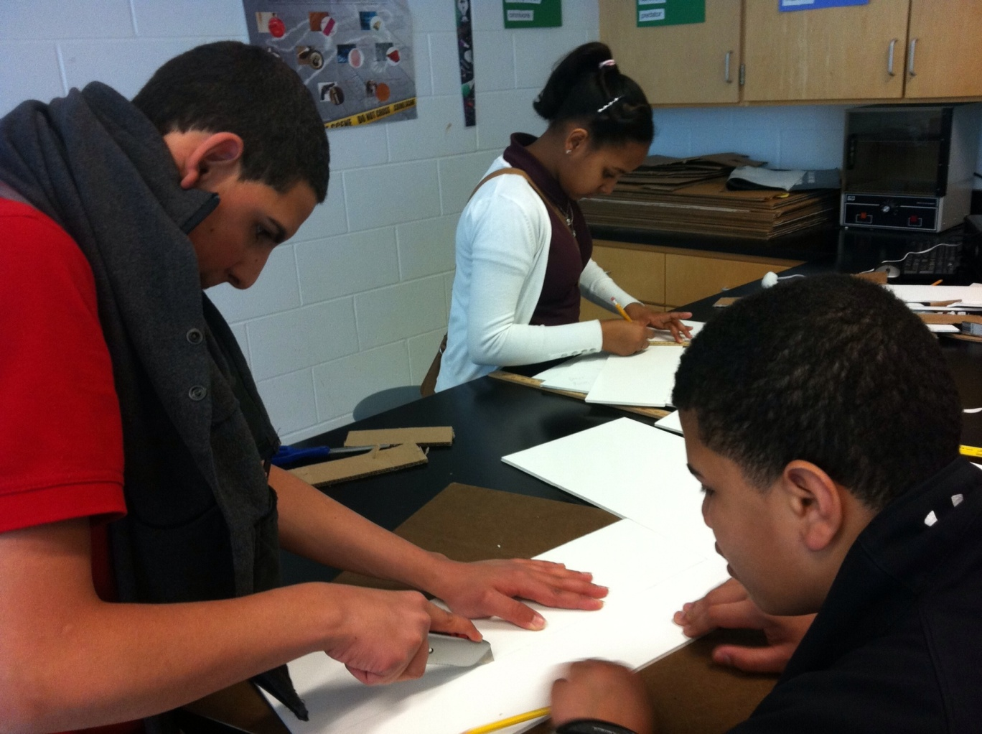
Design Technology to Improve Lives
Marguerite Marcoux
Performing & Fine Arts High School Lawrence, MA
Objectives
Use the EDP to solve problems.
design an “organizer” that can be used in the home
design and program a voice-activated wheelchair
Use computers to research, design technology, and communicate solutions.
perform tasks using CAD/BASIC
create detailed presentations of their process
Apply knowledge of Technology/Engineering frameworks when designing new technology.
describe tools and processes used to manufacture products
create working circuits that include communication components
ACTION PLANS
IMPLEMENTATION TIMELINE
ACTION PLAN #1: HOUSEHOLD ORGANIZER
ACTION PLAN #2: VOICE-ACTIVATED WHEELCHAIR
STUDENT deliverables
Working prototype &
Multimedia presentations that includes:
Definition of problem, criteria/constraints
Research related to problem
Evidence of brainstorming (sketches/ideas)
Technical drawing and description of chosen solution
Model of final solution including description of parts and manufacturing processes required (including documentation of programming as necessary)
Demonstration that the solution works
Summary of the work completed and future implications
Suggestions for redesign/improvement
TASK | COMPLETION DATE
Develop project definition | July 27, 2012
Identify learning outcomes | July 27, 2012
Develop key rubrics for project assessment points | Aug. 2012
Develop team membership matrix | Aug. 2012
Develop presentation material | Feb-March 2012
CONTEXT
I teach Technology & Engineering to (primarily) 9th graders . We utilize the ‘Engineering the Future’ curriculum and the students take the MCAS at the end of the year. Class size is ideally 24 or fewer students.
Students are placed in this course based on data related to their math ability. They are generally taking pre-algebra concurrently. More than 50% of the students have IEPs and require accommodations. Literacy skills vary. Most students speak a language other than English at home and some are recent immigrants (within 2 years.) Few students have computers with reliable internet access at home.
I have found that most students taking the course embrace the hands-on work, especially projects where they get to use “real” materials and tools. Most of the students are curious about technology and how it works. As an arts-themed high school, the students have a variety of interests including music, dance, photography, sculpture, and TV production.
TASK | COMPLETION DATE
EDP – Define and research organizer Problem | Sept. 7, 2012
Technical Drawing – CAD Brainstorm and sketch/design a household organizer | Sep. 28, 2012
Tools & Manufacturing Processes – Build and test an organizer prototype | Oct. 19, 2012
Communicate solution and suggestions for redesign | Nov. 2, 2012
#1
#2
TASK | COMPLETION DATE
Define and research wheelchair problem – Circuit components and diagrams | Nov. 23, 2012
Communication components - Brainstorm and sketch wheelchair designs (CAD) | Dec. 14, 2012
Build & test a prototype (BASIC) | January 11, 2012
Communicate solution and suggestions for redesign | January 25, 2012
Teacher deliverables
Lessons:
Using CAD to design parts and simple assemblies.
Identifying tools, materials, and processes used to build prototypes and manufacture products.
Building working circuits and simple communication devices.
Using BASIC to program a robot.
Project information:
Background information, criteria and constraints for each problem.
Guides for completing research.
Inventory of materials needed to complete each project.
Guide for using technology to create a presentation.
Rubrics for each project.
Team members
School:
Math teachers (Bridges to Algebra) will be used as a resource for helping students master measurement, geometry, and scale. Art teachers (Visual arts) will be used as a resource when teaching technical drawing. They will also present information related to creativity & design.
Community:
Students will visit a local business to learn about engineering, product design, & manufacturing. Those working in or studying engineering or related fields will be invited to class to help guide student projects. Community members as well as members of the faculty and administration will be invited to the presentation of student work.

