Slide 1






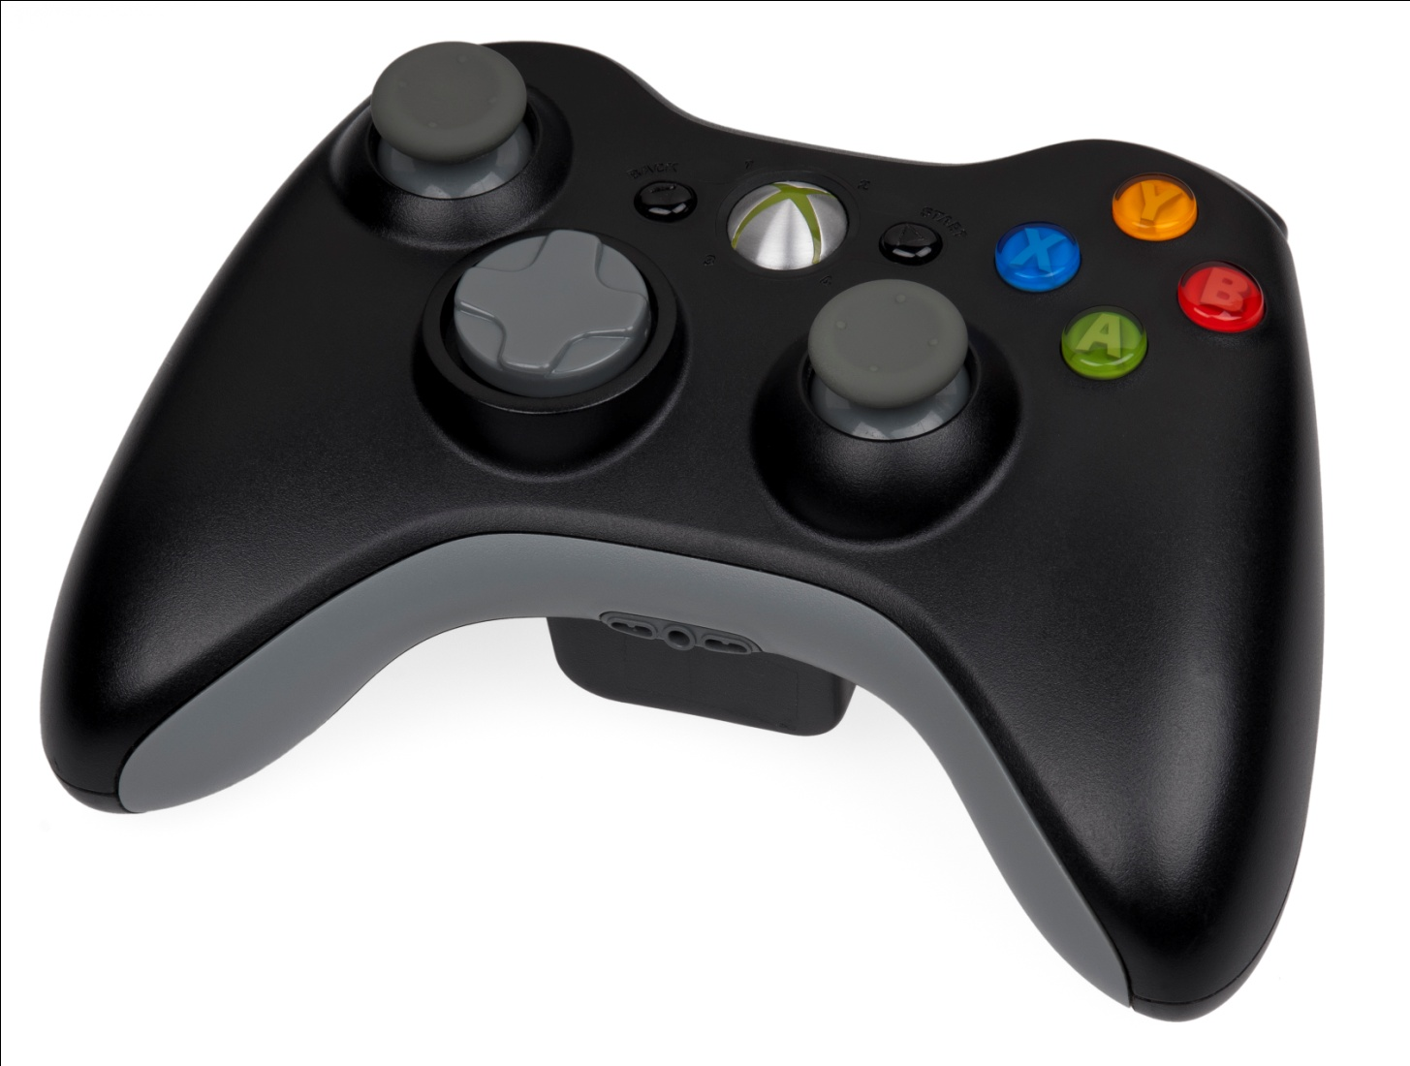
“Games with Physics” STEM Capstone Project
Nathan Largesse, Algonquin Regional High School, Physics
With Dan Forhan, Algonquin Regional High School, Computer Science/Math
Introduction
My students will utilize the Engineering Design Process in addition to content knowledge to solve two problems. The EDP will be introduced through an Egg Catching Device activity. The EDP will be fully realized in an interdisciplinary project with Game Development students to create an interactive Physics game or challenge.
Action plans
Action Plan 1: Egg Drop
Students are given challenge and brainstorm designs for homework.
Students meet in groups, share ideas, are given material restrictions, and choose best design.
Students construct two identical prototypes.
Students test prototype one. Students observe with high-speed camera.
Students have limited time and resources to revise prototype.
Students conduct second test.
Students draw conclusions and complete deliverables.
Action Plan 2: Physics Game
Students are assigned groups and physics concept(s), given an outline of the project, and given grading rubric/expectations/deliverables.
Students research their respective concepts and skills.
Students brainstorm game models utilizing communication technology.
Students determine their best game design utilizing communication technology.
GD and Physics students in each groups collaborate to complete working Physics game.
Students test their Physics game for errors and bugs and may collaborate with people outside of their work group for feedback.
Students present their Physics game to their class and receive further feedback.
Students revise and improve their Physics game utilizing the constructive feedback.
Students complete and collect deliverables.
Student deliverables
Action Plan 1: Egg Drop
Brainstorm sketches
Primary design sketches
EDP Worksheet completed (problem ID, justification for chosen design, data, analysis, revisions, etc).
Action Plan 2: Physics Game
Report including evidence of use of EDP, communication between group members, and reflections.
A working Physics game or puzzle.
Definitions and goals
Action Plan 1: Egg Drop
Students are introduced to and utilize the Engineering Design Process to design, build, test, and revise a device of restricted materials to catch an uncooked egg dropped from a specified height such that the egg retains structural integrity after landing.
Goals:
Students are introduced to and utilize Engineering Design Process.
Students practice teamwork, leadership, and communication skills.
Students utilize and reinforce learned concepts regarding projectile motion, forces, and momentum.
Action Plan 2: Physics Game
This project will be a multi-disciplinary Capstone experience where students from a physics class and a computer programming class will collaborate. Students will be given a problem to solve using the Engineering Design Process. The task is to design/create a working XBOX game or puzzle that demonstrates and accurately utilizes various physics principals.
Goals:
Students design and create an XNA program that will demonstrate one or more of the following concepts: 1D motion, 2D motion, Forces, Energy Conservation, Momentum Conservation, Static Electricity, Circuits, Magnetism, Electromagnetism, Wave Behavior, Sound, Light, and Optics.
Students utilize Engineering Design Process.
Students practice teamwork, leadership, and communication skills.
Students utilize modern communication technology potentially including email, online forums, shared documents, online voice, and online chat.
Teacher deliverables
Action Plan 1: Egg Drop
Obtain materials
Project outline handout
EDP/Physics worksheet
Action Plan 2: Physics Game
Project outline handout
Grading Rubric
Demonstrations
extensions
Action Plan 1: Egg Drop
Students could study the motion of the egg using the high-speed camera and calculations.
Students could describe how the principals evident in this project apply to other real-life everyday devices.
A follow up project could be to build a device to surround the egg and be dropped with the egg, accomplishing the same thing.
The EDP, now introduced, could be applied to other projects.
Action Plan 2: Physics Game
Students could design their games such that they can be combined into a larger, more complete experience.
Students could integrate Biology or Chemistry concepts into their game along with the Physics.
Students could submit their games to Xbox Live Marketplace.
Students could create modifications or “Mods” to existing games they play at home in which they adjust physical laws to affect gameplay.

