Slide 1

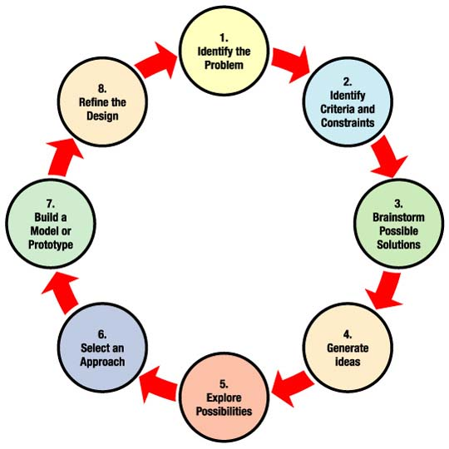
Environmental Studies
Capstone Projects Spring 2012
Barbara Eddy Lowell High School

Slide 2
Expectations!!!
Develop a new dual enrollment course
that required a STEM Capstone Project.

Slide 3
Environmental Studies
Goals!!!
Students become independent learners
Provide students with an environmental engineering / chemistry inquiry-based experience
The projects are student driven
Students engage the Engineering Design Process (EDP).
Enjoy learning
Notes:
It became obvious that since it was student driven, I had to provide them with resources to meet the diverse needs of the class.

Slide 4



Networking is the key to success.
Students were introduced
to mentors from several organizations.

Slide 5
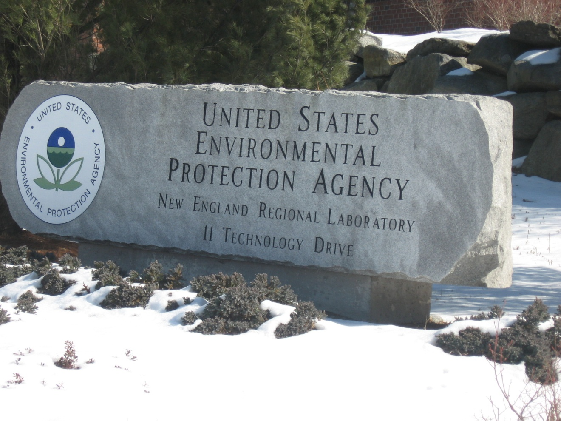
Spring 2012 EPA Visit
Students were assigned EPA mentors to assist them in their research

Slide 6
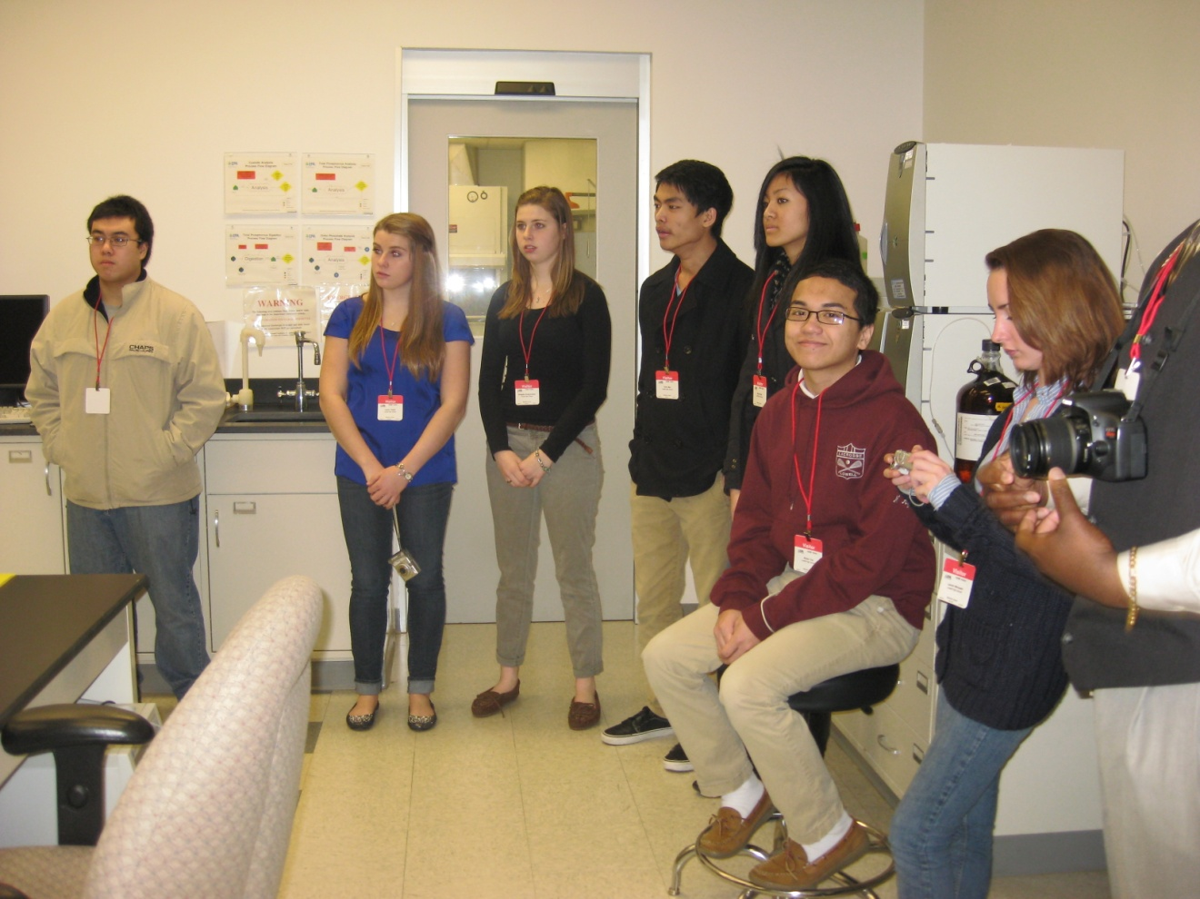
Organic Analysis Laboratory
“Impressive technology and modern facility”
One scientist does all this?

Slide 7
CAPSTONE PROJECTS
Bourin You
Do you have money to throw away?
Reducing Residential
Air Pollution Emissions
Bridgette Burgermeister & Lauren Thistle
How do CSO's affect you?
Preventing the Release of Sewage into the Merrimack River

Slide 8
Kevin Mao & Jessica Srey
What is the problem with road salt? Eco- Friendly Road Salt
Patrick Macellus
Would you like a Fat CAT in your car?
Improving catalytic converters
Paul Phan & Lauren Michaels
Eco Friendly industrial cleaners.
Can lemons be used as an effective metal degreaser?

Slide 9
Deliverables
Student Deliverables
Identify an environmental issue of concern.
Research current solutions and choose best solution to explore.
Create a poster and present findings at STEM poster session at Middlesex Community College and Lowell High
Teacher Deliverables
Provide students with resources to engage the EDP process.
Provide students with opportunities to extend their current knowledge.
Guide students to follow through and meet their goals (keep them on task)

