Slide 1




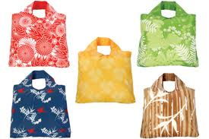
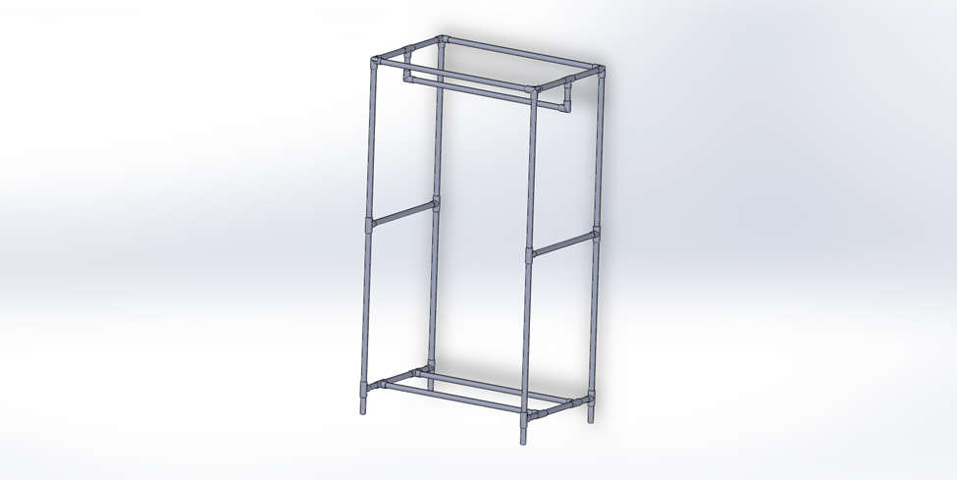
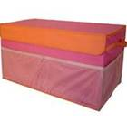
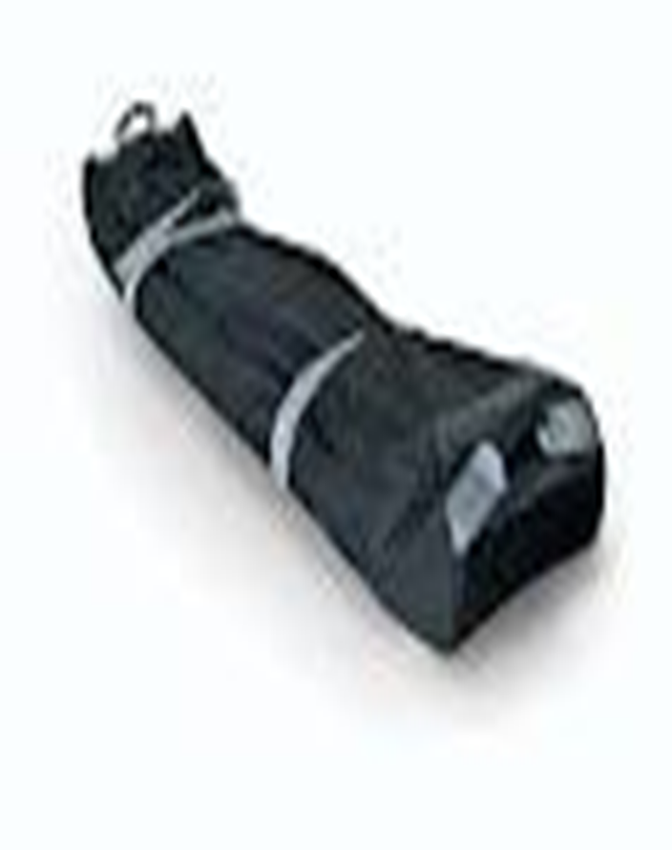
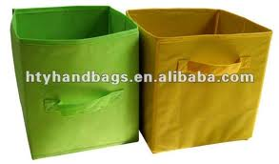
Maximize and Mobilize Your Storage Options
CloseTek Inc.
Daniel Forhan, Ann Kaiser and Jennifer Stephens
Project Mission
We are committed to developing low cost, mobile storage for today’s space challenged College students
POSSIBLE SOLUTIONS
Overall configuration
Rectangular vs. rounded
Acceptable depth
Rigid or collapsible
Mobility considerations
Minimal weight
Size for transport
Wheel or lift
Material considerations
For the outer shell
vinyl sheet
metal sheet
correx
Cardboard
reusable grocery bag material
For the framework
6061 al alloy tubing
steel tubing
fiberglass rod
pvc pipe
LESSONS LEARNED
Think outside the bag-
Make a closet !
Give customers choices
Ideal materials are usually not the cheapest choice-design often means compromise
Know your customer!
Project GOALS
OUR CLOSET is designed to BE
COLLAPSIBLE TO ALLOW FOR EASY RE-LOCATION
Customizable to meet individual needs in terms of exterior design and interior stage
A cost effective solution to the space and organizational challenges faced by today’s students
TAKE AWAYS
Identify the problem , customer, constraints
Be flexible; design is an organic process
Edp provides an excellent framework for group work
Project PLAn
Choose from design alternatives; focus on collapsible, easy-to-move alternative. use rectangular design to permit maximum storage.
Research light-weight, strong tubing for framework.
Research material for outer covering. for ease of printing and sourcing
Determine interior configuration to allow for multiple storage information.
FINAL SOLUTION
a collapsible rectangular closet.
stores longer items as well as those that are shorter . Customizable drawer configuration provides storage flexibility for shoes, jewelry, etc.
collapses for transport
poles are stored in a cylindrical bag along with the outer shell.
Shelving and drawers are easily move in a rectangular box.
The outer shell is Made from non-woven polypropylene (grocery bag material). The material is readily available, durable and can be customized by printing.
The framework is constructed from 1 inch pvc pipe with correx shelving.
Product constraints
Overall weight less than 25 lbs.
Cost of less than $100.
High stability
Sustainable design

