Slide 1




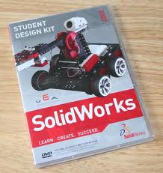
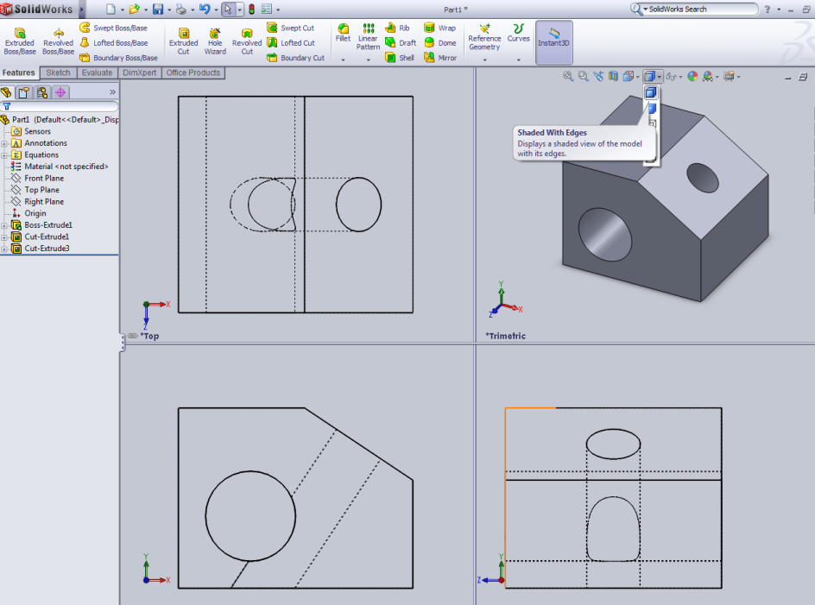

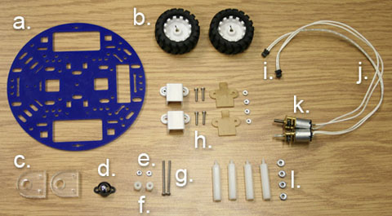
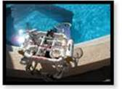
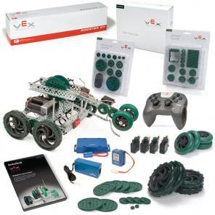


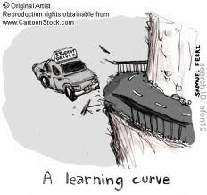
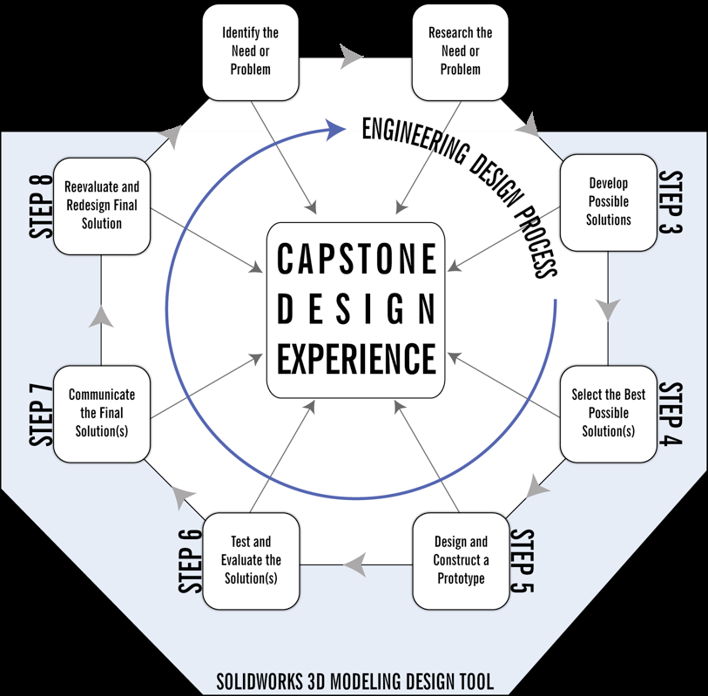

Integrating EDP
Diana Cost
Design and assemble a robot or underwater ROV
using CAD and the EDP.
ACTION PLANS
High School Robotic Engineering Designs
STUDENT Deliverables
High School Robotic Engineering Designs
Goal
Goal 1 High School Robotic Engineering Designs
Goal 2 Grade Seven Life Science
Use the EDP to design an artificial heart.
Week 0 - Obtain materials/Kits
Week 1 - Introduce EDP with mini problem
Week 2 - Research week
Week 3 – 4 CAD program instruction and student designs
Weeks 5 - 6- Build and programing
CAD
Sea Mate kit
Vex robot kit
Artbotics kit
Computers
SolidWorks
Capstone poster template
Project
High School Robotic Engineering Designs
http://artbotics.cs.uml.edu
Mate RoOV 2012
http://www.vexrobotics.com/
By connecting my instruction on the robotics to a real world engineering project students will experience EDP and how it relates to the science and math they are learning at school. This project will be introduced as part of the Robotics engineering design program which our high school is new to Global this year. Students will be using the EDP to “Create a robot which will perform a useful service within the New Bedford Community using”
Grade Seven Life Science
Grade Seven Life Science
CAD design
Capstone poster
Data graphs of heart rates
Prototypes.
All clip art in Discovery Education's Clip Art Gallery created
by Mark A. Hicks, illustrator.
Grade Seven Life Science
By connecting my instruction on the cardiovascular system to a real world engineering project students will experience EDP and how it relates to the science and math they are learning at school. This project will be introduced as part of the circulatory system which grade seven is learning this year. Students will be using what they learn in didactic and student centered labs to research and solve the problem, “Create a low cost improved artificial heart for people who cannot be matched with donor hearts”.
thisnext.com
Week 0
Administration approval and support, installation of SolidWorks, Community connections for the class speakers all need to be addressed prior to teaching the unit.
Design didactic lessons for circulatory system, EDP, and SolidWorks instruction.
Week 1 –
Students will be given didactic lessons and activities on the circulatory system.
This may include notes, research, and/or labs. The central problem will be given to them at the beginning to engage them.
Week 2 –
Students will be given lessons in Solid Works so they can design their hearts and time to work on their projects.
Week 3-
If time allows students will build a working models of their heart.
TEAcheR Deliverables
High School Robotic Engineering Designs
Performance Monitoring
High School Robotic Engineering Designs
Capstone action plan
Poster
Grade Seven Life Science
Performance Monitoring:
Pre and Post surveys
Rubrics for group work and participation
Walkabouts during project development and design phases.
Poster/powerpoint presentations of cad design.
Completion of a robot or ROV that matches student CAD design
Action Plan Poster
Lesson film (if allowed by school)
Grade Seven Life Science
Jessica Chin
Performance Monitoring:
For didactic information tests, lab reports.
Rubrics for group work and participation
Walkabouts during project development and design phases.
Poster/powerpoint presentations. .
Pre and Post surveys
References
Massachusetts Frameworks
Next Generation Science Standards
SolidWorks
http://www.abiomed.com/
Abiomed, Danvers, MA
dinodirect.com

