Slide 1





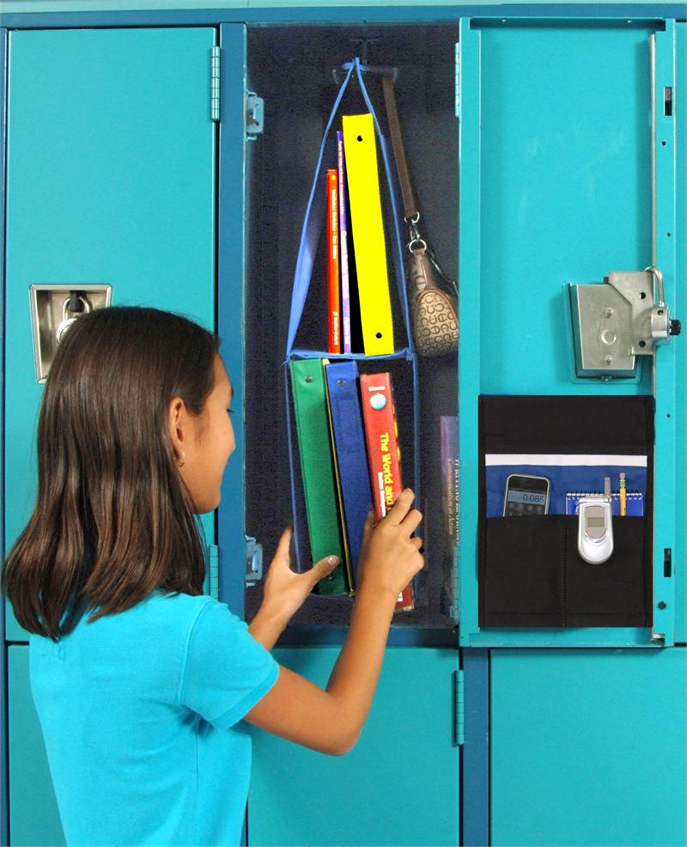
TITLE OF POSTER TEMPLATE
INEXPENSIVE HIGH SCHOOL LOCKER ORGANIZER: W Lee
Project goal
DEVELOP A LOWCOST LOCKER ORGANIZER USING FREE, RECYCLED MATERIALS HELD TOGETHER WITH DUCT TAPE, ETC. STUDENTS WILL WORK IN GROUPS OF FOUR.
Action plans lessons
Lesson 1, Week 1 Day 1
OVERVIEW OF ENGINEERING DESIGN PROCESS:
Differentiate between the EDP and the Scientific Method
EDP SCI METHOD
PROBLEM QUESTION
RESEARCH RESEARCH
SOLUTIONS HYPOTHESES
CHOOSE BEST SOLUTION BEST HYPOTHESIS
DESIGN AND BUILD PROTOTYPE DESIGN & RUN EXPERIMENT
TEST PROTOTYPE ANALYZE / EVALUATE DATA
(REDESIGN) DESIGN NEW EXPERIEMENT
COMMUNICATE PUBLISH
( FOLLOW EGINEERING ETHICS CANONS. USE CHALLENGER DISASTER.)
(Perhaps Really Stupid Cats Prefer Tasting Rodents Con Escarabajo. PRSCPTRCE).
Discuss the importance of group work with the five C’s of communal problem solving :
Collaboration Creativity
Coordination Concentration
Communication
Lesson 2. WEEK 2 Day 5
BRAINSTORM AND DISCUSS POSSIBLE RECYCLED MATERIAL ITEMS FOR LOCKER ORGANIZER
OLD BAND-AID TIN, ALTOIDS TIN, OATMEAL BOX, SHOE BOX LID, SMALL CEREAL BOX, DOUBLE SIDE TAPE, REFRIGERATER MAGNET, SCRAP CLOTH, SMALL FLOWER POTS, PRESCRIPTION BOTTLES,)
HAVE STUDENTS DISCOVER POSSIBLE ITEMS AT HOME OR SCHOOL, AND HAVE THEM CREATE A BULLETIN BOARD WITH DESCRIPTIONS OF ITEMS, DRAWINGS, OR ACTUAL ARTICLES TO SHARE WITH OTHER GROUPS.
Student LESSONS LEARNED
WHAT ARE THE STEPS OF THE EDP AND HOW DO YOU APPLY THEM IN SOLVING AN ENGINEERING PROBLEM? HOW DOES EDP DIFFER FROM THE SCIENTIFIC METHOD?
WHAT IS MEANT BY ENGINEERING ETHICS AND IN WHAT WAY IS THIS PROJECT FOLLOWING THE ETHICAL CANONS?
WHY DOES AN ENGINEERING PROJECT HAVE TO BE ON TIME, IN SPEC AND WITHIN COST.?
SOME MANAGERS WANT PROJECTS TO BE COMPLETE D FASTER, BETTER, AND CHEAPER. IS THERE A POSSIBLE CONFLICT WITH THESE THREE SIMULTANEOUS DEMANDS?
CAN WE SOLVE PART OF THE ENVIRONMENTAL PROBLEM WITH WASTE AND GARBAGE BY FOLLOWING THE OLD NEW ENGLAND MANTRA :
USE IT UP
WEAR IT OUT
MAKE IT DO
DO WITHOUT
STUDENTS HAVE RECYCLED WASTE TO MAKE A USABLE ITEM. EXPLAIN
THE PHRASE
“ONE PERSON’S TRASH IS ANOTHER PERSON’S TREASURE”.
Planning this project made me realize the importance of allowing freedom in inquiry so that the students
Learn not about engineering, but how to think like a n
Engineer. I should not teach students how to think, but
rather coach them in HANDS ON, INQUIRY BASED ACTIVITIES where they learn how to thi8nk AT A HIGHER ORDER.
Project definition
RESEARCH, BRAINSTORM, DECIDE, DESIGN AND BUILD A PROTOTYPE LOCKER ORGANIZER IN FOUR WEEKS. THE ORGANIUZER MUST NEATLY HOLD ALL SCHOOLBOOKS, NOTEBOOKS, PENS, PENCILS, CALCULATORS, LUNCH
CONTAINERS AND JACKETS.
BEST SOLUTION
HAVE THE STUDENTS COMMUNICATE THEIR PROJECTS WITH AN ADVERTISING POSTER ALONG WITH THEIR TESTED PROTOTYPE
Teacher TAKE AWAYS
Project PLAN
WEEK 1: EDP, PROJECT GOAL, RESEARCH , SOLUTIONS
WEEK 2: MATERIAL SAMPLES, CHOOSE BEST SOLUTION,. DESIGN
WEEK 3: BUILD PROTOTYPE
WEEK 4: TEST PROTOPTYPE, COST OF MULTIPLES, COMMUNIICATE

