Slide 1
CAPSULE. STEM EDUCATION
NORTHEASTERN UNIVERSITY
RACHID JOSEPH FARHAT

Slide 2
Geometry

Slide 3
Project: 3D Geo House
Purpose: This project serves students in applying geometric standards to real world application. For many students, it allows them the ability to show case their creativity as they build a project with their own hands.
Requirements: Students are to create with their choice of materials (Styrofoam board, balsa wood, cardboard, etc.) a 3 dimensional geometric house. The design must include to a minimum three rooms. Each room must state the perimeter, area, and volume in its design. Students must state a scale used to convert their model house to a realistic home and convert the perimeter, area, and volume using the new dimensions found in the conversion.

Slide 4
The Challenge
Students at The Everett High School experience the power of 3D with cutting-edge Autodesk® 3D design software.
The biggest teaching challenge I faced is finding ways to keep coursework relevant and engaging for all students. I combated the issue by integrating software included in the Autodesk .
My students were so enthusiastic about designing a model home with the software that many of them spent extra hours working from home. This experience inspired more students than I had ever seen before. It’s definitely a favorite class project in all my five classes.

Slide 5
ENGINEERING & MATH

Slide 6
Auto Desk

Slide 7
AutoCAD Layer Manager

Slide 8
AUTOCAD

Slide 9
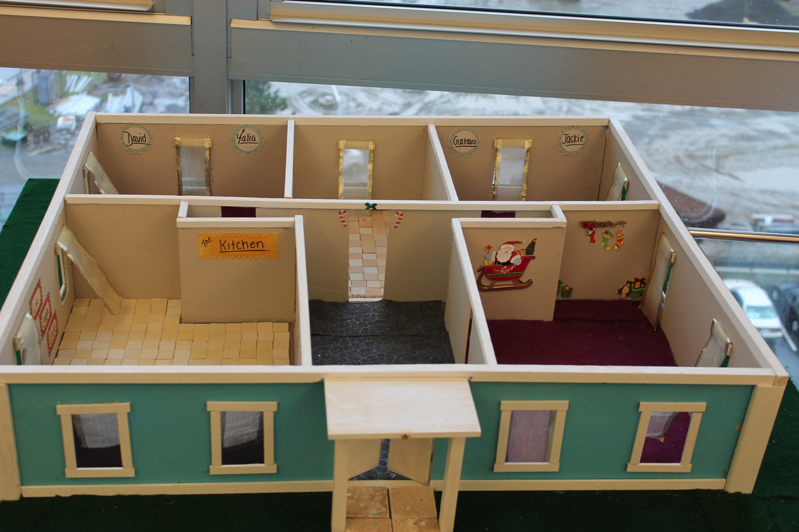

Slide 10
THE DREAM TEAM WITH THE DEPARTMENT HEAD

Slide 11
REMOVABLE FLOORS

Slide 12
COOL DESIGN

Slide 13
OREO TEAM

Slide 14
COMPETITION

Slide 15
HALLWAY GAP

Slide 16
What did we they learn
Developed ability to apply concepts and principles to new problems.
Developed analytic skills.
Developed public speaking skills
Developed problem‐solving skills
Developed the ability to synthesize and integrate information
Developed the ability to think holistically
Developed the ability to distinguish between fact and opinion
Developed the ability to use evidence to support an argument or thesis
Improved mathematical skills

Slide 17
What did I learn
STEM is essentials
Teach for understanding
Management is clueless
I have a lot to learn
I will always aspire to be a great teacher and a constant learner

