Slide 1
Going Mobile (Closets by Design)
Telescoping Solutions Inc.
Diana Cost – Global Learning Charter Public School
Nathan Largesse – Algonquin Regional High School
Rachid Farhat – Everett High School
Stacey Allen – Revere High School

Slide 2
Project Mission
Our mission is to design a multi-purpose closet that is not only sturdy and durable, but also mobile and environmentally-friendly. An inexpensive closet of this type is in high demand, and we are seeking to fill the void in the market."

Slide 3
Project GOALS
Design a durable and sturdy multi-purpose closet to store clothes, jewelry, and personal goods.
Create a product that is both customer and environmentally-friendly.
Keep the cost down and the quality up.
Provide aesthetically pleasing and unique design options.

Slide 4
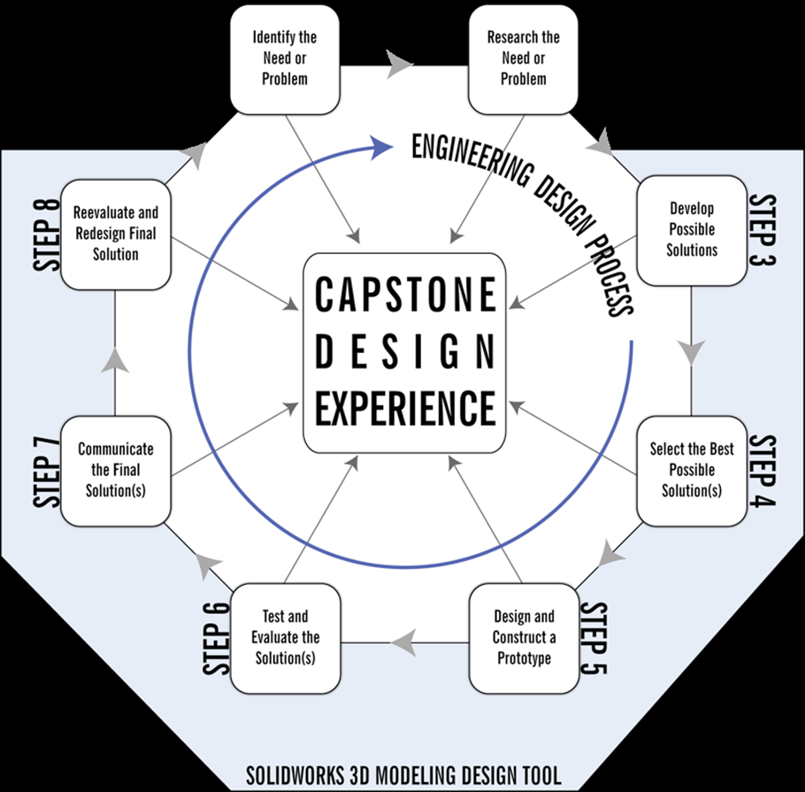
Project PLAN
Our plan was to use the EDP to create a well-designed, cost-effective, and unique mobile closet.
After researching possible solutions, team members brainstormed new ideas. Work was then broken into individual tasks which were carried out overnight. On the following day we came together, reviewed the work, and proceeded to CAD to design the closet.

Slide 5
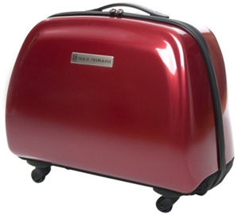
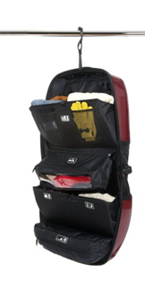
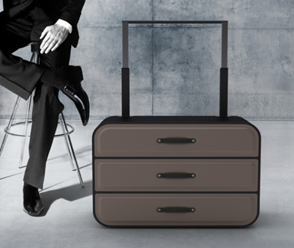
POSSIBLE SOLUTIONS
Idea #1: Suitcase Closet
Suitcase on Wheels
Closes up into a regular suitcase
Good for business travel
Wheels for easy mobility
Separate designs / models for separate sizes
Holds only clothes that can fit in suitcase
Expensive materials
Models on the market are bulky and expensive

Slide 6
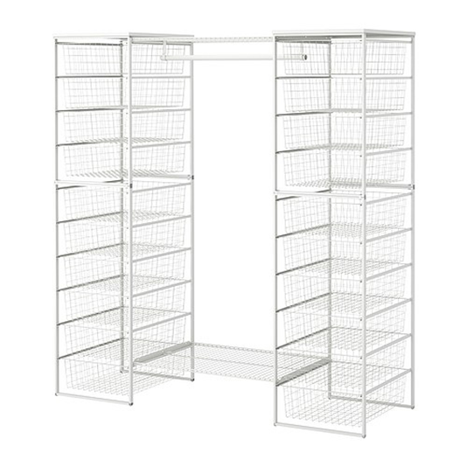
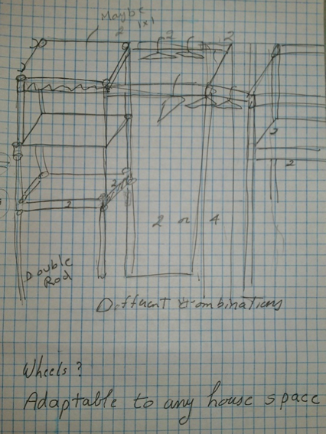
POSSIBLE SOLUTIONS
Idea #2: Modular Closet
Can be broken down into smaller pieces
Option for wheels
Can construct (variable shape and size) based on preference
Assembly required
Inexpensive
Few raw materials necessary
Many variations exist on the market already

Slide 7
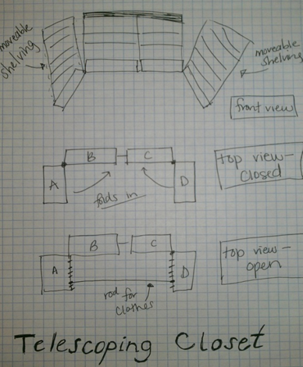
POSSIBLE SOLUTIONS
Idea #3: Telescoping Closet
No assembly required
Closes down into smaller box
Handle for easy mobility
Few materials necessary
Pull up handle to different heights for different sizes
No telescoping closet on the market right now

Slide 8
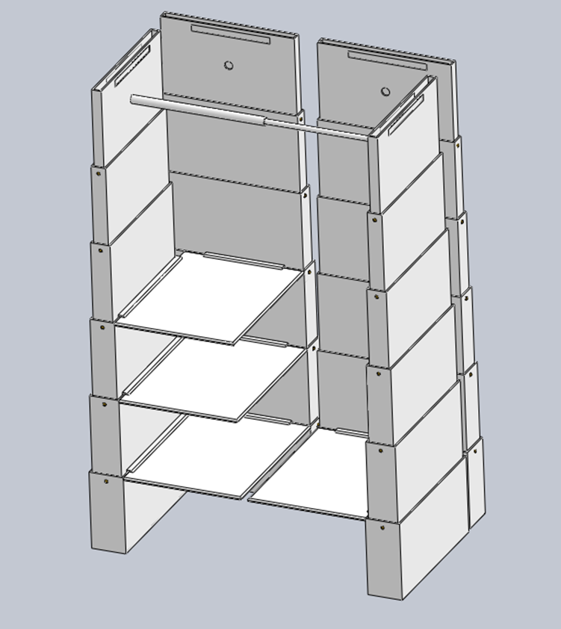
BEST SOLUTION
Polyethelene Low-Density Plastic (LDPE)
Heavy Duty Model
Weight: 190 lbs
Fully assembled: 4’ x 6’
Compacted:24” x 26.5” x 17.25”
Shelves (4) and retractable handle
Room for variable lengths of clothing, shoes, and personal items

Slide 9
BEST SOLUTION
Pine
Economical Model
Weight: 72 lbs.
Fully assembled: 4’ x 6’
Compacted:24” x 26.5” x 17.25”
Shelves (4) and retractable handle
Room for variable lengths of clothing, shoes, and personal items

Slide 10
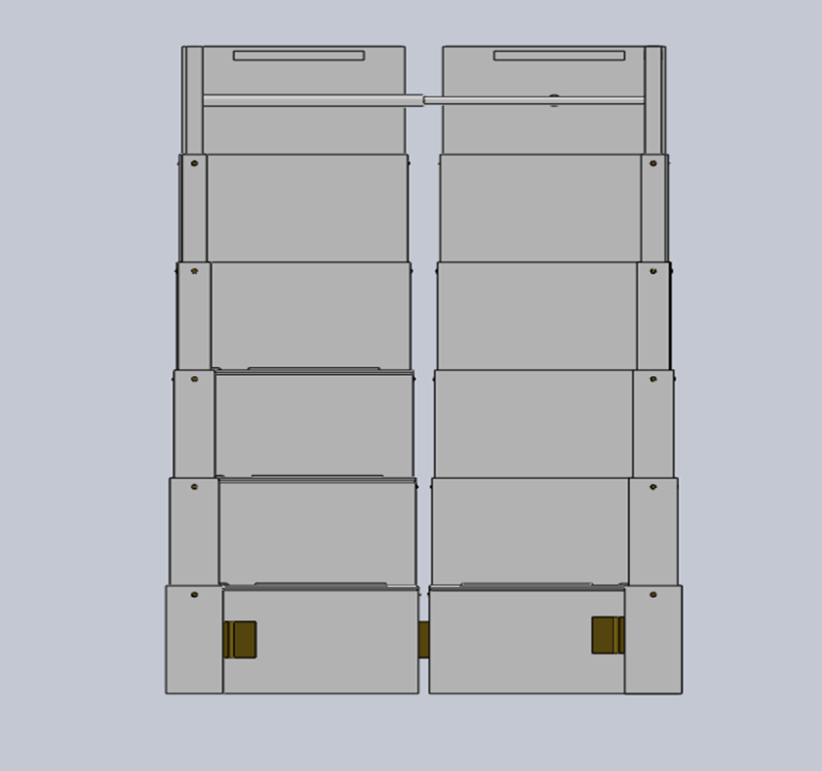
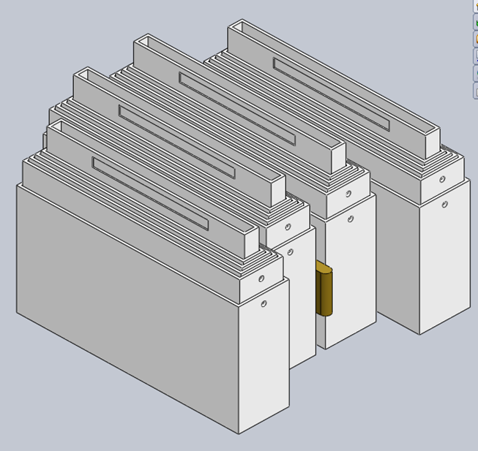
Final design

Slide 11
Project EVALUATION

Slide 12
LESSONS LEARNED
Communication is essential
Cooperation and collaboration are key
Brainstorming with people of different expertise leads to creativity
Process is important – the EDP is useful for structuring a group project
Informed trial and error leads to better production
End products should be cost-effective, easy to manufacture, and marketable

Slide 13
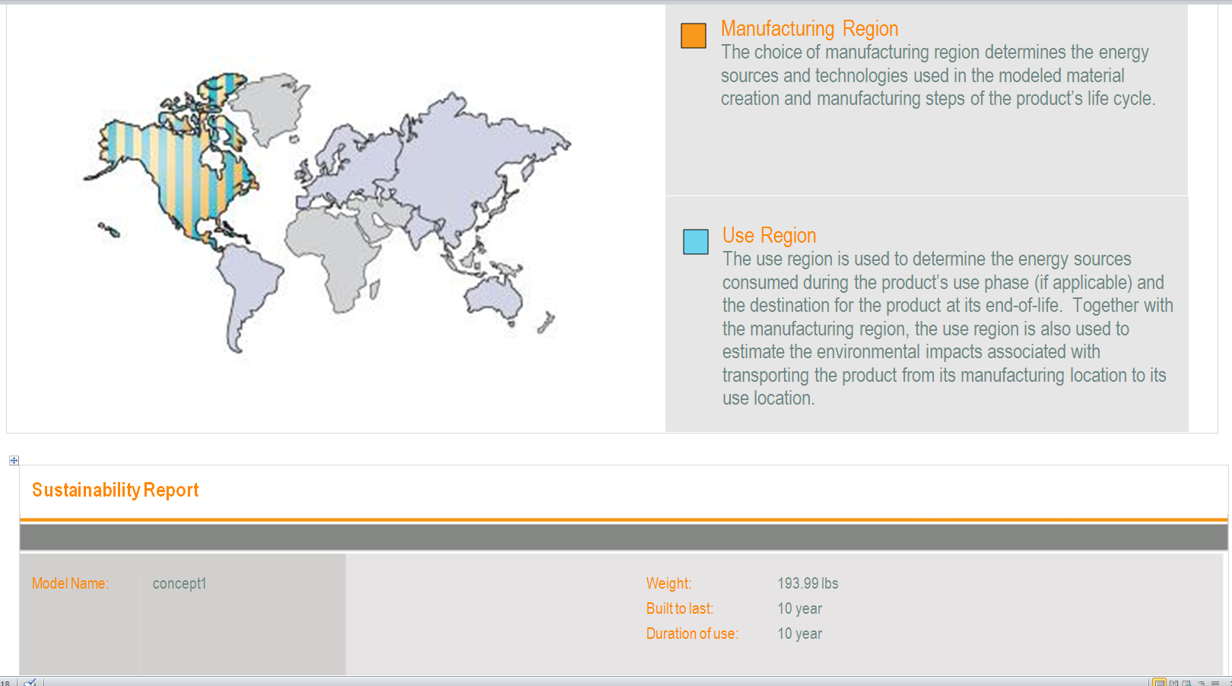
Sustainability Report - LDPE

Slide 15
Compacting Video

Slide 16
Expanded Video

