Slide 1





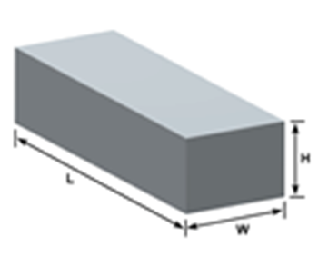
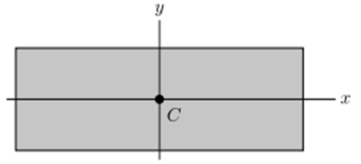
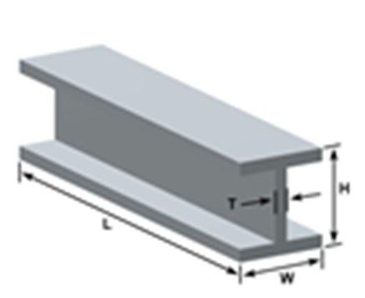
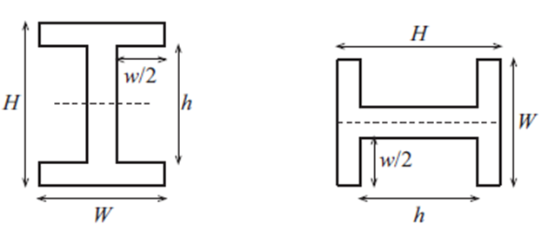
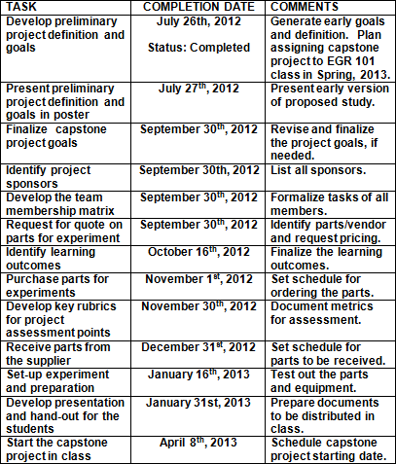
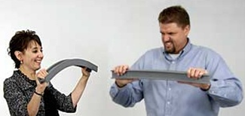
Flexural Rigidity of Beam and CAD Modeling
Tony Mak
Middlesex Community College, MA
Project/Goal
Inclusion of 3D CAD modeling using SolidWorks in EGR 101, Introduction of Engineering I, at Middlesex Comm. College. Introduction of EDP process for engineering solution.
Familiarizing the concept of modeling and model verification
Evaluation of design option
Student deliverables
SolidWorks CAD models and running simulations in SolidWorks
Measurements of beam deflection.
Applying EDP for an engineering design solution.
Documentation and PowerPoint for presentation
Action plans & implementation schedule
Project Definition
Investigation of flexural rigidity of beam with various cross sections and CAD Modeling
Teacher deliverables
Engineering lectures and handouts
Teaching basic concept of beam deflection
Reviewing EDP design and concept
SolidWorks for CAD solid modeling and simulations.
Performance monitoring
Pre/Post Survey
Pre/Post Assessment Tests
Acknowledgements
Author expresses great thanks and appreciations to Northeastern University Stem Center, Northeastern Engineering Department, and Museum of Science for the opportunity to participate in the 2012 Capsule Summer Program.
EDP
1-4 steps
5. build/Get samples
6. Model and test samples
7. Communicate results
8. Re-design and re-evaluate

